Slide 1
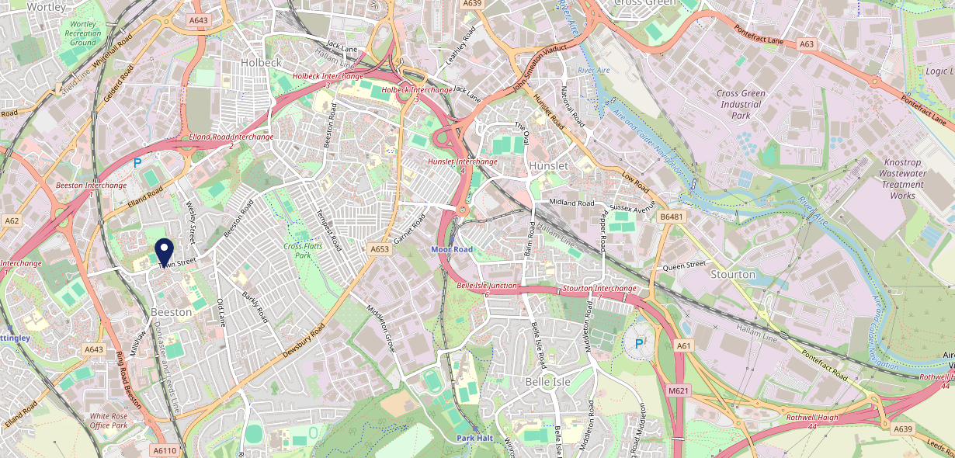
Site Intel
Whistlestop LS118DG
3 Miles
99 Chains
08/11/2023 - 30/10/2024
Site Summary
Whistlestop LS118DG
Work Area
Region
TV Region
Urbanicity
Leeds
Yorkshire and The Humber
Yorkshire
Urban major conurbation
LS118DG
Punch T&L
Top Competitors
ATV
Gender
Old White Hart
#1
£9.76
80.56%
Male
LS118BZ
Punch - Mighty Local
Affluence
Segmentation
South Leeds Conservative Club
#2
54.74%
21.43%
Middle Income
Family Value
LS117JH
Clubs
Age Group
Visit Day
The Broadway
#3
32.47%
52.63%
LS115LD
55 to 64
Sat
Admiral Taverns Ltd
Nearest Station
Cottingley(1.19 miles)
295 Site Customers
497 Competitors
709307 Competitor Customers

Slide 2
Site Intel
Whistlestop LS118DG
3 Miles
99 Chains
08/11/2023 - 30/10/2024
Spend by Weekpart
How is customer spend distributed throughout the week for Whistlestop LS118DG versus its competitors?
% of spend for Whistlestop LS118DG and 99 Chains in 3 Miles from 08/11/2023 - 30/10/2024 split by Day of Week
295 Site Customers
497 Competitors
709307 Competitor Customers

Slide 3
Site Intel
Whistlestop LS118DG
3 Miles
99 Chains
08/11/2023 - 30/10/2024
Visit Frequency
How frequently per year do customers visit Whistlestop LS118DG versus its competitors?
% of customer numbers for Whistlestop LS118DG and 99 Chains in 3 Miles from 08/11/2023 - 30/10/2024 and the number of visits made Per Annum
295 Site Customers
497 Competitors
709307 Competitor Customers

Slide 4
Site Intel
Whistlestop LS118DG
3 Miles
99 Chains
08/11/2023 - 30/10/2024
ATV Change
How has ATV changed between two date ranges?
295 Site Customers

Slide 5
Site Intel
Whistlestop LS118DG
3 Miles
99 Chains
08/11/2023 - 30/10/2024
Market Share Change
How has market share changed between two date ranges?
% of market share spend for Whistlestop LS118DG and 99 Chains in 3 Miles from 08/11/2023 - 30/10/2024
295 Site Customers

Slide 6
Site Intel
Whistlestop LS118DG
3 Miles
99 Chains
08/11/2023 - 30/10/2024
Age
How does the age profile of customers who visit Whistlestop LS118DG compare versus its competitors?
% of spend for Whistlestop LS118DG and 99 Chains in 3 Miles from 08/11/2023 - 30/10/2024 split by Age Range
134 Site Customers
497 Competitors
271700 Competitor Customers

Slide 7
Site Intel
Whistlestop LS118DG
3 Miles
99 Chains
08/11/2023 - 30/10/2024
Affluence
How does the affluence of customers who visit Whistlestop LS118DG compare versus its competitors?
% of spend for Whistlestop LS118DG and 99 Chains in 3 Miles from 08/11/2023 - 30/10/2024 split by Affluence
134 Site Customers
497 Competitors
274775 Competitor Customers

Slide 8
Site Intel
Whistlestop LS118DG
3 Miles
99 Chains
08/11/2023 - 30/10/2024
Gender
How does the gender profile of customers who visit Whistlestop LS118DG compare versus its competitors?
% of spend for Whistlestop LS118DG and 99 Chains in 3 Miles from 08/11/2023 - 30/10/2024 split by Gender
134 Site Customers
497 Competitors
274775 Competitor Customers

Slide 9
Site Intel
Whistlestop LS118DG
3 Miles
99 Chains
08/11/2023 - 30/10/2024
Punch Segmentation
How does the Custom segmentation profile of customers who visit Whistlestop LS118DG compare versus its competitors?
% of spend for Whistlestop LS118DG and 99 Chains in 3 Miles from 08/11/2023 - 30/10/2024 split by Segment
295 Site Customers
497 Competitors
709307 Competitor Customers

Slide 10
Site Intel
Whistlestop LS118DG
3 Miles
99 Chains
08/11/2023 - 30/10/2024
Spend by Distance
How does the spend profile of Whistlestop LS118DG compare versus its competitors based on travel distances?
% of spend for Whistlestop LS118DG and 99 Chains in 3 Miles from 08/11/2023 - 30/10/2024 split by Distance travelled
125 Site Customers
497 Competitors
264862 Competitor Customers

Slide 11
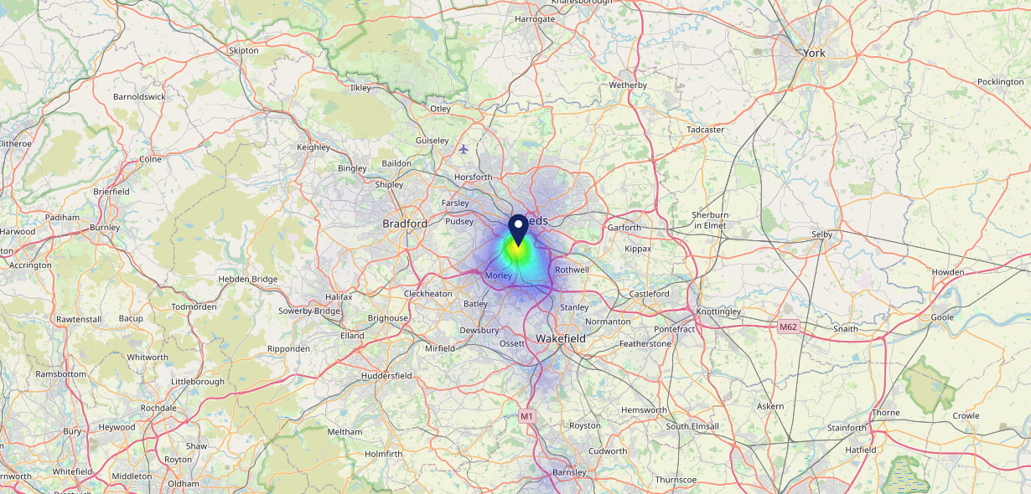
Site Intel
Whistlestop LS118DG
08/11/2023 - 30/10/2024
Map of Guest Origin
Where do customers of Whistlestop LS118DG come from?
Where do customers of Whistlestop LS118DG for 08/11/2023 - 30/10/2024 live
125 Site Customers

Slide 12
Site Intel
Whistlestop LS118DG
3 Miles
99 Chains
08/11/2023 - 30/10/2024
Share of Wallet
What are the Top 20 venues (by spend) that customers of Whistlestop LS118DG also visit?
For customers of Whistlestop LS118DG, who are the top 20 competitors from 99 Chains in 3 Miles for 08/11/2023 - 30/10/2024 split by Venue
295 Site Customers

Slide 13
Site Intel
Whistlestop LS118DG
3 Miles
99 Chains
08/11/2023 - 30/10/2024
Share of Wallet Change
How has share of wallet of customers of Whistlestop LS118DG changed between two date ranges?
295 Site Customers

Slide 14
Site Intel
Whistlestop LS118DG
08/11/2023 - 30/10/2024
Market Summary
How does the local area for Whistlestop LS118DG compare to the national average (1 = low, 10 = high)
Data Type | Name | Spend in 250m | 250m Spend vs National | Spend in 500m | 500m Spend vs National | Spend in 1 mile | 1 mile Spend vs National | Spend in 3 miles | 3 mile Spend vs National
Total | Annual Sales | £373K | 3 | £505K | 3 | £33.41M | 7 | £525.64M | 9
Weekpart | Mon - Thu | 28.3% | 1 | 37.1% | 3 | 46.8% | 9 | 38.4% | 1
Weekpart | Fri - Sat | 59.7% | 10 | 52.4% | 10 | 39.5% | 3 | 47.4% | 10
Weekpart | Sun | 12.0% | 3 | 10.5% | 2 | 13.7% | 3 | 14.2% | 2
Age | 18 to 24 | 5.7% | 5 | 5.8% | 5 | 8.0% | 7 | 9.2% | 7
Age | 25 to 34 | 14.6% | 2 | 14.2% | 2 | 20.4% | 4 | 24.2% | 7
Age | 35 to 44 | 37.2% | 10 | 34.7% | 10 | 31.0% | 10 | 27.5% | 10
Age | 45 to 54 | 12.9% | 1 | 12.5% | 1 | 19.8% | 5 | 19.7% | 5
Age | 55 to 64 | 21.3% | 9 | 24.1% | 10 | 13.4% | 4 | 13.7% | 4
Age | 65 to 74 | 7.6% | 6 | 7.3% | 6 | 5.6% | 4 | 4.4% | 2
Age | 75+ | 0.8% | 3 | 1.4% | 4 | 1.8% | 4 | 1.3% | 2
CAMEO | Business Elite | 1.5% | 2 | 2.1% | 2 | 3.4% | 3 | 8.2% | 6
CAMEO | Prosperous Professionals | 2.5% | 2 | 2.9% | 2 | 2.8% | 2 | 5.4% | 4
CAMEO | Flourishing Society | 6.2% | 2 | 5.7% | 2 | 6.3% | 2 | 8.2% | 3
CAMEO | Content Communities | 12.2% | 5 | 13.6% | 7 | 8.7% | 2 | 10.7% | 3
CAMEO | White Collar Neighbourhoods | 11.2% | 5 | 9.7% | 4 | 9.1% | 3 | 11.4% | 5
CAMEO | Enterprising Mainstream | 15.0% | 9 | 14.5% | 9 | 11.2% | 8 | 10.5% | 7
CAMEO | Paying The Mortgage | 17.0% | 7 | 19.7% | 9 | 20.4% | 9 | 17.0% | 8
CAMEO | Cash Conscious Communities | 8.3% | 5 | 9.6% | 6 | 14.2% | 9 | 11.0% | 7
CAMEO | On A Budget | 7.4% | 6 | 6.5% | 6 | 7.6% | 7 | 7.0% | 6
CAMEO | Family Value | 18.7% | 10 | 15.6% | 10 | 16.2% | 10 | 10.6% | 9
Affluence | AB | 10.2% | 2 | 10.7% | 2 | 12.5% | 2 | 21.8% | 3
Affluence | C1C2 | 55.4% | 8 | 57.6% | 9 | 49.4% | 6 | 49.6% | 6
Affluence | DE | 34.4% | 9 | 31.7% | 8 | 38.1% | 10 | 28.6% | 8

Slide 15
Site Intel
Whistlestop LS118DG
Local Market Profile
Mix of spend by customer segment in Punch site and local market
 | Customer Count | Family Familiar | Occasional & Local | Mid-Week Seniors | Part Of The Pub | Metro Sophisticates | Young & Connected | Bubbly Weekenders | Upmarket Diners
Whistlestop | 39 | 30.12% | 10.47% | 7.35% | 21.67% | 0.91% | 24.05% | 5.38% | 0.00%
Local Catchment | 33749 | 9.09% | 4.87% | 7.65% | 9.51% | 18.72% | 25.11% | 15.36% | 9.65%
Punch T&L | 105276 | 8.60% | 6.18% | 28.63% | 11.51% | 11.04% | 11.82% | 7.12% | 15.06%
Whistlestop vs Local Catchment |  | 21.03% | 5.60% | -0.30% | 12.16% | -17.81% | -1.06% | -9.98% | 0.00%
Whistlestop vs Punch T&L |  | 21.52% | 4.29% | -21.28% | 10.16% | -10.13% | 12.23% | -1.74% | 0.00%
Local Catchment vs Punch T&L |  | 0.49% | -1.31% | -20.98% | -2.00% | 7.68% | 13.29% | 8.24% | -5.41%

Slide 16
Site Intel
Whistlestop LS118DG
Local Competitor Profiles
Mix of spend by customer segment in Punch site and local competitors
 | Customer Count | Family Familiar | Occasional & Local | Mid-Week Seniors | Part Of The Pub | Metro Sophisticates | Young & Connected | Bubbly Weekenders | Upmarket Diners
Whistlestop LS118DG | 39 | 30.12% | 10.47% | 7.35% | 21.67% | 0.91% | 24.05% | 5.38% | 0.00%
Old White Hart LS118BZ | 106 | 14.95% | 4.66% | 11.31% | 10.20% | 15.45% | 34.13% | 4.98% | 4.28%
South Leeds Conservative Club LS117JH | 47 | 20.11% | 0.75% | 1.45% | 8.22% | 11.42% | 30.51% | 26.70% | 0.80%
The Broadway LS115LD | 83 | 20.67% | 6.57% | 10.76% | 20.54% | 3.48% | 25.92% | 11.26% | 0.77%
Old Peacock (Leeds) LS118TU | 680 | 10.45% | 2.72% | 14.27% | 10.18% | 15.19% | 22.32% | 14.20% | 10.64%
Plantation LS104NT | 43 | 36.79% | 3.97% | 0.30% | 0.71% | 6.72% | 37.19% | 13.95% | 0.32%
New Bay Horse LS102DN | 17 | 20.86% | 1.40% | 31.68% | 36.34% | 0.00% | 0.80% | 8.89% | 0.00%
Bar Fibre LS16LY | 1298 | 12.65% | 2.64% | 3.65% | 4.12% | 13.51% | 36.30% | 21.17% | 5.93%
Commercial Armley LS123HZ | 47 | 1.98% | 21.92% | 0.83% | 66.20% | 0.95% | 4.72% | 3.32% | 0.04%
Dragon (Leeds) LS124TJ | 229 | 10.53% | 8.15% | 4.95% | 42.60% | 6.02% | 15.69% | 8.41% | 3.61%
Commercial Inn LS278AG | 107 | 16.09% | 36.01% | 1.37% | 7.88% | 4.92% | 11.78% | 21.92% | 0.00%
Crooked Clock Leeds LS102LF | 105 | 18.20% | 5.68% | 3.61% | 10.69% | 3.42% | 27.09% | 30.93% | 0.34%
Queen Hotel Morley LS278DW | 213 | 12.50% | 8.11% | 2.64% | 39.19% | 4.97% | 16.71% | 14.99% | 0.85%
Revolucion De Cuba Leeds LS16DT | 1503 | 10.69% | 4.04% | 4.17% | 2.73% | 12.51% | 35.62% | 20.59% | 9.62%
The Hedley Verity LS13HQ | 1110 | 10.53% | 6.46% | 7.01% | 20.71% | 5.78% | 30.53% | 13.56% | 5.39%
Horse & Trumpet Hotel Leeds LS16LR | 389 | 8.43% | 2.13% | 5.38% | 52.00% | 7.40% | 12.47% | 9.87% | 2.28%
Heist Bar LS279BR | 256 | 12.68% | 8.75% | 7.01% | 10.65% | 12.82% | 25.25% | 17.42% | 5.39%
Queens Court Leeds LS16LY | 680 | 11.66% | 3.48% | 3.21% | 14.78% | 16.66% | 35.20% | 12.58% | 2.38%
Popworld Leeds LS23AW | 791 | 15.35% | 3.62% | 3.47% | 7.74% | 8.55% | 35.91% | 20.11% | 5.22%
Be At One Leeds Boar Lane LS16EA | 1492 | 10.62% | 2.02% | 4.95% | 3.87% | 13.61% | 34.55% | 22.21% | 8.13%
The Picture House LS278HE | 429 | 14.71% | 13.78% | 4.84% | 16.07% | 13.10% | 23.19% | 12.47% | 1.80%
Box Leeds City LS12JS | 1659 | 7.94% | 2.20% | 5.11% | 4.26% | 24.10% | 29.30% | 15.18% | 11.86%
Royal Park Hotel Leeds LS61NY | 221 | 19.58% | 1.83% | 5.96% | 8.33% | 18.17% | 36.78% | 6.96% | 2.34%
Head of Steam LS15DQ | 2455 | 7.06% | 3.80% | 10.63% | 5.89% | 21.29% | 25.33% | 15.89% | 10.09%
The Merchant Leeds LS28LX | 482 | 11.76% | 6.99% | 4.27% | 22.00% | 8.52% | 30.81% | 13.40% | 2.22%

