Slide 1
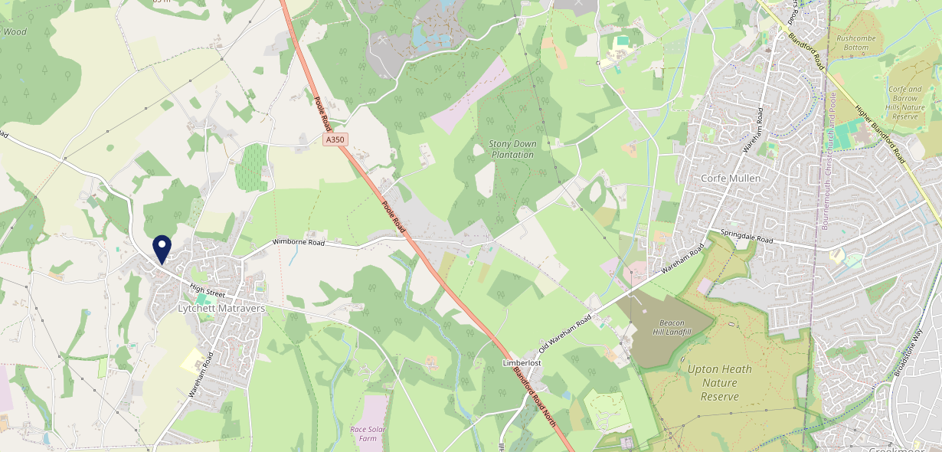
Site Intel
Chequers Inn BH166BJ
3 Miles
99 Chains
08/11/2023 - 30/10/2024
Site Summary
Chequers Inn BH166BJ
Work Area
Region
TV Region
Urbanicity
Poole
South West
South
Rural town and fringe
BH166BJ
Punch T&L
Top Competitors
ATV
Gender
Rose & Crown Inn
#1
£16.57
63.06%
Male
BH166DT
Pub Restaurant
Affluence
Segmentation
St Peter's Finger
#2
54.56%
25.96%
Middle Income
Content Communities
BH166JE
Pub Restaurant
Age Group
Visit Day
Cock And Bottle
#3
25.33%
28.10%
BH207DL
45 to 54
Sat
Pub / Bar
Nearest Station
Holton Heath(5.44 miles)
476 Site Customers
18 Competitors
6889 Competitor Customers

Slide 2
Site Intel
Chequers Inn BH166BJ
3 Miles
99 Chains
08/11/2023 - 30/10/2024
Spend by Weekpart
How is customer spend distributed throughout the week for Chequers Inn BH166BJ versus its competitors?
% of spend for Chequers Inn BH166BJ and 99 Chains in 3 Miles from 08/11/2023 - 30/10/2024 split by Day of Week
476 Site Customers
18 Competitors
6889 Competitor Customers

Slide 3
Site Intel
Chequers Inn BH166BJ
3 Miles
99 Chains
08/11/2023 - 30/10/2024
Visit Frequency
How frequently per year do customers visit Chequers Inn BH166BJ versus its competitors?
% of customer numbers for Chequers Inn BH166BJ and 99 Chains in 3 Miles from 08/11/2023 - 30/10/2024 and the number of visits made Per Annum
476 Site Customers
18 Competitors
6889 Competitor Customers

Slide 4
Site Intel
Chequers Inn BH166BJ
3 Miles
99 Chains
08/11/2023 - 30/10/2024
ATV Change
How has ATV changed between two date ranges?
476 Site Customers

Slide 5
Site Intel
Chequers Inn BH166BJ
3 Miles
99 Chains
08/11/2023 - 30/10/2024
Market Share Change
How has market share changed between two date ranges?
% of market share spend for Chequers Inn BH166BJ and 99 Chains in 3 Miles from 08/11/2023 - 30/10/2024
476 Site Customers

Slide 6
Site Intel
Chequers Inn BH166BJ
3 Miles
99 Chains
08/11/2023 - 30/10/2024
Age
How does the age profile of customers who visit Chequers Inn BH166BJ compare versus its competitors?
% of spend for Chequers Inn BH166BJ and 99 Chains in 3 Miles from 08/11/2023 - 30/10/2024 split by Age Range
262 Site Customers
18 Competitors
3957 Competitor Customers

Slide 7
Site Intel
Chequers Inn BH166BJ
3 Miles
99 Chains
08/11/2023 - 30/10/2024
Affluence
How does the affluence of customers who visit Chequers Inn BH166BJ compare versus its competitors?
% of spend for Chequers Inn BH166BJ and 99 Chains in 3 Miles from 08/11/2023 - 30/10/2024 split by Affluence
265 Site Customers
18 Competitors
3987 Competitor Customers

Slide 8
Site Intel
Chequers Inn BH166BJ
3 Miles
99 Chains
08/11/2023 - 30/10/2024
Gender
How does the gender profile of customers who visit Chequers Inn BH166BJ compare versus its competitors?
% of spend for Chequers Inn BH166BJ and 99 Chains in 3 Miles from 08/11/2023 - 30/10/2024 split by Gender
265 Site Customers
18 Competitors
3987 Competitor Customers

Slide 9
Site Intel
Chequers Inn BH166BJ
3 Miles
99 Chains
08/11/2023 - 30/10/2024
Punch Segmentation
How does the Custom segmentation profile of customers who visit Chequers Inn BH166BJ compare versus its competitors?
% of spend for Chequers Inn BH166BJ and 99 Chains in 3 Miles from 08/11/2023 - 30/10/2024 split by Segment
476 Site Customers
18 Competitors
6889 Competitor Customers

Slide 10
Site Intel
Chequers Inn BH166BJ
3 Miles
99 Chains
08/11/2023 - 30/10/2024
Spend by Distance
How does the spend profile of Chequers Inn BH166BJ compare versus its competitors based on travel distances?
% of spend for Chequers Inn BH166BJ and 99 Chains in 3 Miles from 08/11/2023 - 30/10/2024 split by Distance travelled
259 Site Customers
18 Competitors
3865 Competitor Customers

Slide 11
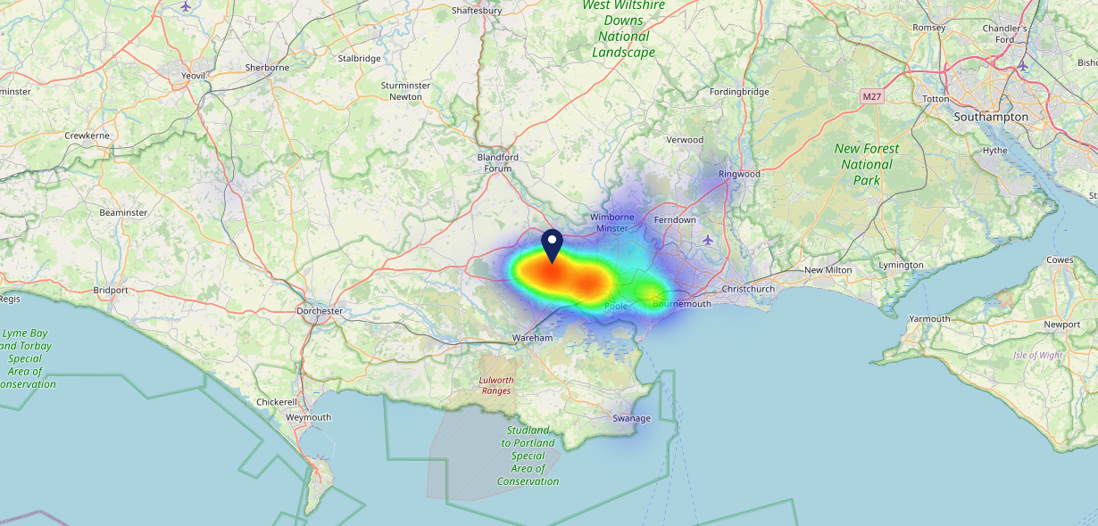
Site Intel
Chequers Inn BH166BJ
08/11/2023 - 30/10/2024
Map of Guest Origin
Where do customers of Chequers Inn BH166BJ come from?
Where do customers of Chequers Inn BH166BJ for 08/11/2023 - 30/10/2024 live
259 Site Customers

Slide 12
Site Intel
Chequers Inn BH166BJ
3 Miles
99 Chains
08/11/2023 - 30/10/2024
Share of Wallet
What are the Top 20 venues (by spend) that customers of Chequers Inn BH166BJ also visit?
For customers of Chequers Inn BH166BJ, who are the top 20 competitors from 99 Chains in 3 Miles for 08/11/2023 - 30/10/2024 split by Venue
476 Site Customers

Slide 13
Site Intel
Chequers Inn BH166BJ
3 Miles
99 Chains
08/11/2023 - 30/10/2024
Share of Wallet Change
How has share of wallet of customers of Chequers Inn BH166BJ changed between two date ranges?
476 Site Customers

Slide 14
Site Intel
Chequers Inn BH166BJ
08/11/2023 - 30/10/2024
Market Summary
How does the local area for Chequers Inn BH166BJ compare to the national average (1 = low, 10 = high)
Data Type | Name | Spend in 250m | 250m Spend vs National | Spend in 500m | 500m Spend vs National | Spend in 1 mile | 1 mile Spend vs National | Spend in 3 miles | 3 mile Spend vs National
Total | Annual Sales | £322K | 3 | £322K | 2 | £787K | 1 | £15.22M | 2
Weekpart | Mon - Thu | 26.6% | 1 | 26.6% | 1 | 36.5% | 2 | 41.9% | 6
Weekpart | Fri - Sat | 50.0% | 9 | 50.0% | 9 | 46.4% | 8 | 40.3% | 3
Weekpart | Sun | 23.4% | 10 | 23.4% | 10 | 17.1% | 8 | 17.7% | 9
Age | 18 to 24 | 7.0% | 6 | 7.0% | 6 | 4.4% | 3 | 3.2% | 1
Age | 25 to 34 | 12.6% | 2 | 12.6% | 1 | 14.2% | 2 | 10.5% | 1
Age | 35 to 44 | 20.7% | 4 | 20.7% | 4 | 23.1% | 5 | 19.8% | 2
Age | 45 to 54 | 26.3% | 10 | 26.3% | 10 | 20.3% | 6 | 17.3% | 1
Age | 55 to 64 | 12.6% | 4 | 12.6% | 3 | 15.1% | 6 | 22.2% | 10
Age | 65 to 74 | 12.9% | 9 | 12.9% | 9 | 13.4% | 10 | 15.8% | 10
Age | 75+ | 7.9% | 10 | 7.9% | 10 | 9.5% | 10 | 11.3% | 10
CAMEO | Business Elite | 6.9% | 6 | 6.9% | 6 | 4.9% | 4 | 4.5% | 3
CAMEO | Prosperous Professionals | 9.9% | 9 | 9.9% | 9 | 12.7% | 10 | 10.7% | 9
CAMEO | Flourishing Society | 15.2% | 7 | 15.2% | 7 | 15.7% | 7 | 15.6% | 7
CAMEO | Content Communities | 24.8% | 10 | 24.8% | 10 | 22.7% | 10 | 20.1% | 10
CAMEO | White Collar Neighbourhoods | 6.4% | 2 | 6.4% | 1 | 10.1% | 4 | 13.2% | 8
CAMEO | Enterprising Mainstream | 14.8% | 9 | 14.8% | 9 | 10.8% | 8 | 13.9% | 9
CAMEO | Paying The Mortgage | 9.2% | 2 | 9.2% | 2 | 11.5% | 3 | 10.4% | 3
CAMEO | Cash Conscious Communities | 5.0% | 2 | 5.0% | 2 | 5.1% | 2 | 5.5% | 2
CAMEO | On A Budget | 7.3% | 6 | 7.3% | 6 | 6.1% | 5 | 4.9% | 3
CAMEO | Family Value | 0.6% | 2 | 0.6% | 2 | 0.4% | 1 | 1.3% | 3
Affluence | AB | 31.9% | 6 | 31.9% | 6 | 33.3% | 7 | 30.7% | 6
Affluence | C1C2 | 55.2% | 8 | 55.2% | 8 | 55.1% | 8 | 57.6% | 10
Affluence | DE | 12.9% | 3 | 12.9% | 3 | 11.6% | 2 | 11.7% | 2

Slide 15
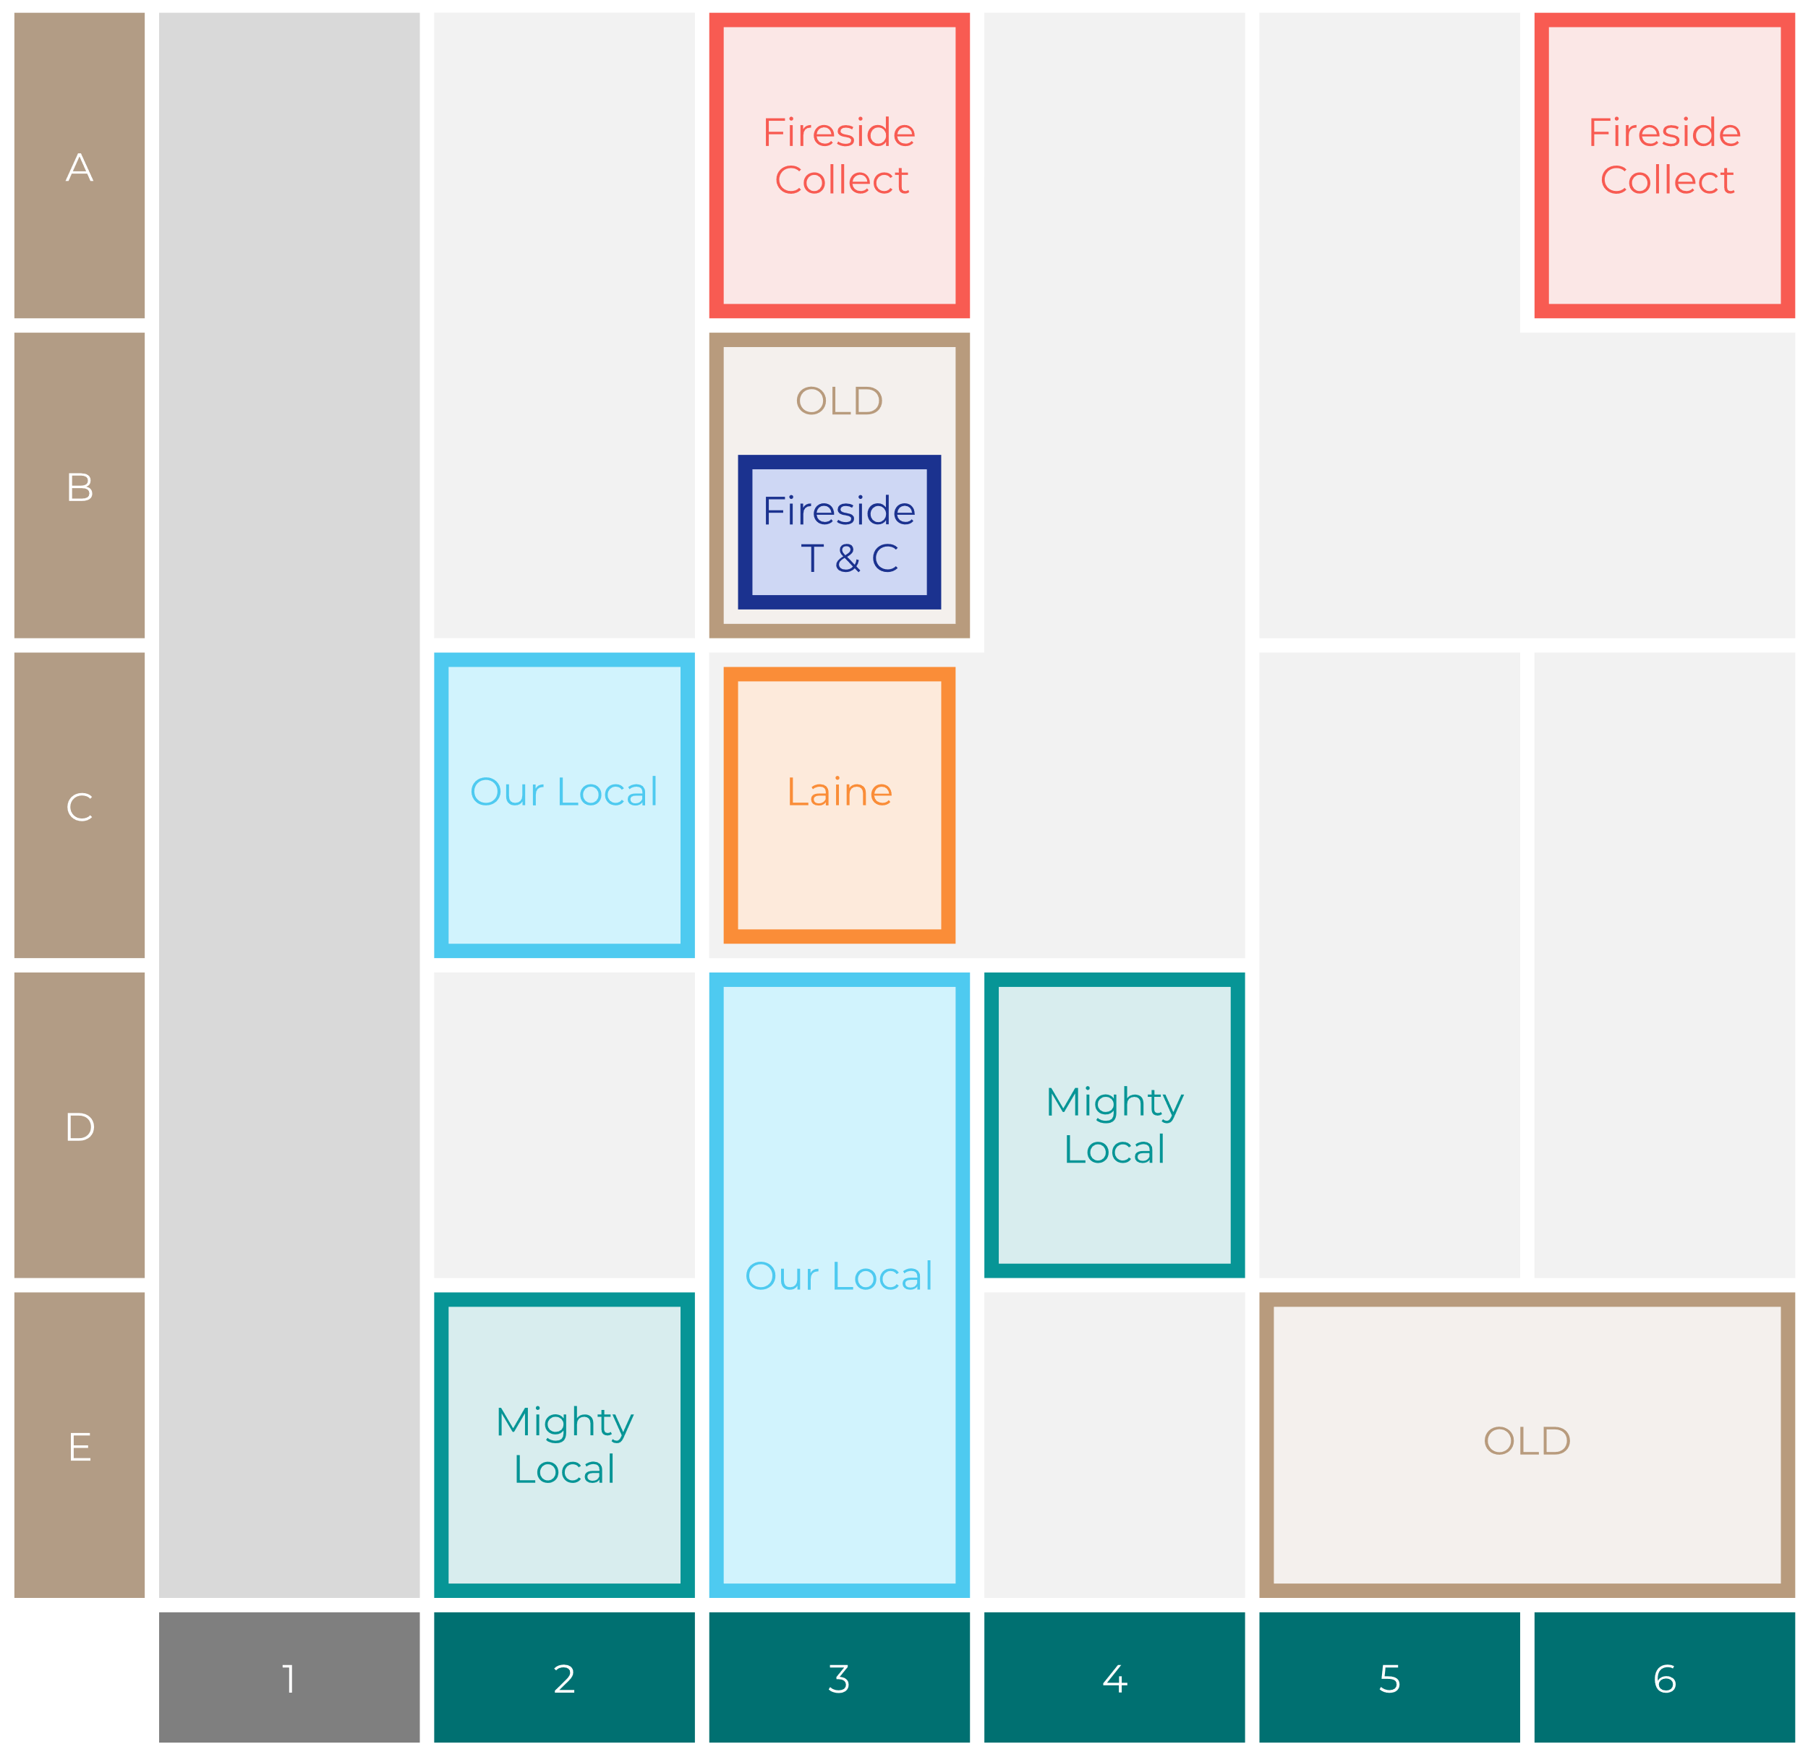
Site Intel
Chequers Inn BH166BJ
Site Potential 1
Site Characteristics
£3000
£18000
OCC Concept Fit
Achievable Average Weekly Takings
Our Local Destination
£8500
A Food-Led High Affluence B Food-Led Mid Affluence C Wet-Led Mid/High Affluence D Wet-Led Low Affluence E Food-Led Low Affluence
AWT 2 Local Regulars 3 Local Passing Trade 4 Destination Wet-Led 5 Destination Food-Led 6 Destination Very Food-Led
A
B
C
D
E
1
2
3
4
5
6

Slide 16
Site Intel
Chequers Inn BH166BJ
Site Potential 2
Concept Recommendation

Slide 17
Site Intel
Chequers Inn BH166BJ
Local Market Profile
Mix of spend by customer segment in Punch site and local market
 | Customer Count | Family Familiar | Occasional & Local | Mid-Week Seniors | Part Of The Pub | Metro Sophisticates | Young & Connected | Bubbly Weekenders | Upmarket Diners
Chequers Inn | 96 | 13.86% | 9.29% | 34.49% | 2.73% | 0.19% | 8.73% | 0.83% | 29.82%
Local Catchment | 1242 | 17.80% | 2.36% | 24.04% | 3.76% | 6.60% | 14.14% | 5.54% | 25.71%
Punch T&L | 105276 | 8.60% | 6.18% | 28.63% | 11.51% | 11.04% | 11.82% | 7.12% | 15.06%
Chequers Inn vs Local Catchment |  | -3.94% | 6.93% | 10.45% | -1.03% | -6.41% | -5.41% | -4.71% | 4.11%
Chequers Inn vs Punch T&L |  | 5.26% | 3.11% | 5.86% | -8.78% | -10.85% | -3.09% | -6.29% | 14.76%
Local Catchment vs Punch T&L |  | 9.20% | -3.82% | -4.59% | -7.75% | -4.44% | 2.32% | -1.58% | 10.65%

Slide 18
Site Intel
Chequers Inn BH166BJ
Local Competitor Profiles
Mix of spend by customer segment in Punch site and local competitors
 | Customer Count | Family Familiar | Occasional & Local | Mid-Week Seniors | Part Of The Pub | Metro Sophisticates | Young & Connected | Bubbly Weekenders | Upmarket Diners
Chequers Inn BH166BJ | 96 | 13.86% | 9.29% | 34.49% | 2.73% | 0.19% | 8.73% | 0.83% | 29.82%
Rose & Crown Inn BH166DT | 90 | 8.44% | 3.88% | 20.57% | 0.93% | 1.81% | 9.55% | 2.83% | 51.95%
St Peter's Finger BH166JE | 368 | 23.47% | 1.59% | 24.47% | 3.23% | 8.80% | 9.48% | 6.14% | 22.78%
Cock And Bottle BH207DL | 84 | 38.66% | 0.00% | 21.71% | 6.31% | 10.03% | 3.28% | 6.83% | 13.15%
Upton Social Club Limited BH165HX | 51 | 41.06% | 0.90% | 0.96% | 10.24% | 0.00% | 46.39% | 0.05% | 0.37%
Botany Bay Inn DT119ET | 225 | 12.45% | 3.25% | 28.96% | 6.98% | 6.59% | 10.67% | 8.36% | 22.70%
Holme Bush Inn Corfe Mullen BH213RZ | 63 | 13.87% | 1.13% | 10.63% | 9.20% | 8.50% | 26.17% | 13.35% | 17.12%
Coventry Arms Corfe Mullen BH213RH | 214 | 6.42% | 2.01% | 10.18% | 0.31% | 13.00% | 12.22% | 6.28% | 49.55%
The Dorset Soldier BH213JZ | 157 | 9.08% | 5.55% | 50.48% | 2.68% | 3.09% | 14.91% | 5.97% | 8.20%
Lytchett Minster R BH166HZ | 60 | 20.43% | 0.24% | 16.81% | 2.31% | 2.32% | 44.45% | 2.21% | 11.19%
Golden Fox BH214AQ | 67 | 3.95% | 0.54% | 26.11% | 1.99% | 1.45% | 3.28% | 1.96% | 60.69%
Par Tee Lounge BH214BD | 30 | 10.28% | 1.45% | 23.08% | 0.00% | 11.91% | 17.15% | 17.64% | 18.45%
Lytchett Minst BH166JD | 12 | 12.50% | 0.00% | 0.00% | 0.00% | 1.08% | 22.28% | 14.13% | 50.00%

