Slide 1
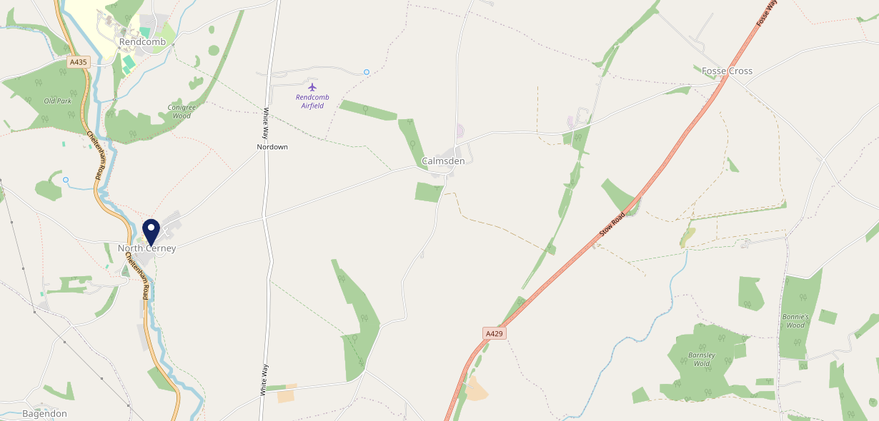
Site Intel
Bathurst Arms GL77BZ
3 Miles
99 Chains
08/11/2023 - 30/10/2024
Site Summary
Bathurst Arms GL77BZ
Work Area
Region
TV Region
Urbanicity
Cheltenham
South West
Central
Rural village
GL77BZ
Punch - Fireside Collection
Top Competitors
ATV
Gender
Plough Inn
#1
£24.89
68.75%
Male
GL72LB
Pub Restaurant
Affluence
Segmentation
Drillmans Arms Lim
#2
47.47%
23.01%
High Income
Flourishing Society
GL72JY
Pub / Bar
Age Group
Visit Day
Chedworth Vill
#3
20.80%
23.56%
GL544NE
55 to 64
Sat
Pub / Bar
Nearest Station
Kemble(11.00 miles)
872 Site Customers
7 Competitors
1006 Competitor Customers

Slide 2
Site Intel
Bathurst Arms GL77BZ
3 Miles
99 Chains
08/11/2023 - 30/10/2024
Spend by Weekpart
How is customer spend distributed throughout the week for Bathurst Arms GL77BZ versus its competitors?
% of spend for Bathurst Arms GL77BZ and 99 Chains in 3 Miles from 08/11/2023 - 30/10/2024 split by Day of Week
872 Site Customers
7 Competitors
1006 Competitor Customers

Slide 3
Site Intel
Bathurst Arms GL77BZ
3 Miles
99 Chains
08/11/2023 - 30/10/2024
Visit Frequency
How frequently per year do customers visit Bathurst Arms GL77BZ versus its competitors?
% of customer numbers for Bathurst Arms GL77BZ and 99 Chains in 3 Miles from 08/11/2023 - 30/10/2024 and the number of visits made Per Annum
872 Site Customers
7 Competitors
1006 Competitor Customers

Slide 4
Site Intel
Bathurst Arms GL77BZ
3 Miles
99 Chains
08/11/2023 - 30/10/2024
ATV Change
How has ATV changed between two date ranges?
872 Site Customers

Slide 5
Site Intel
Bathurst Arms GL77BZ
3 Miles
99 Chains
08/11/2023 - 30/10/2024
Market Share Change
How has market share changed between two date ranges?
% of market share spend for Bathurst Arms GL77BZ and 99 Chains in 3 Miles from 08/11/2023 - 30/10/2024
872 Site Customers

Slide 6
Site Intel
Bathurst Arms GL77BZ
3 Miles
99 Chains
08/11/2023 - 30/10/2024
Age
How does the age profile of customers who visit Bathurst Arms GL77BZ compare versus its competitors?
% of spend for Bathurst Arms GL77BZ and 99 Chains in 3 Miles from 08/11/2023 - 30/10/2024 split by Age Range
461 Site Customers
7 Competitors
494 Competitor Customers

Slide 7
Site Intel
Bathurst Arms GL77BZ
3 Miles
99 Chains
08/11/2023 - 30/10/2024
Affluence
How does the affluence of customers who visit Bathurst Arms GL77BZ compare versus its competitors?
% of spend for Bathurst Arms GL77BZ and 99 Chains in 3 Miles from 08/11/2023 - 30/10/2024 split by Affluence
461 Site Customers
7 Competitors
497 Competitor Customers

Slide 8
Site Intel
Bathurst Arms GL77BZ
3 Miles
99 Chains
08/11/2023 - 30/10/2024
Gender
How does the gender profile of customers who visit Bathurst Arms GL77BZ compare versus its competitors?
% of spend for Bathurst Arms GL77BZ and 99 Chains in 3 Miles from 08/11/2023 - 30/10/2024 split by Gender
461 Site Customers
7 Competitors
497 Competitor Customers

Slide 9
Site Intel
Bathurst Arms GL77BZ
3 Miles
99 Chains
08/11/2023 - 30/10/2024
Punch Segmentation
How does the Custom segmentation profile of customers who visit Bathurst Arms GL77BZ compare versus its competitors?
% of spend for Bathurst Arms GL77BZ and 99 Chains in 3 Miles from 08/11/2023 - 30/10/2024 split by Segment
872 Site Customers
7 Competitors
1006 Competitor Customers

Slide 10
Site Intel
Bathurst Arms GL77BZ
3 Miles
99 Chains
08/11/2023 - 30/10/2024
Spend by Distance
How does the spend profile of Bathurst Arms GL77BZ compare versus its competitors based on travel distances?
% of spend for Bathurst Arms GL77BZ and 99 Chains in 3 Miles from 08/11/2023 - 30/10/2024 split by Distance travelled
447 Site Customers
7 Competitors
483 Competitor Customers

Slide 11
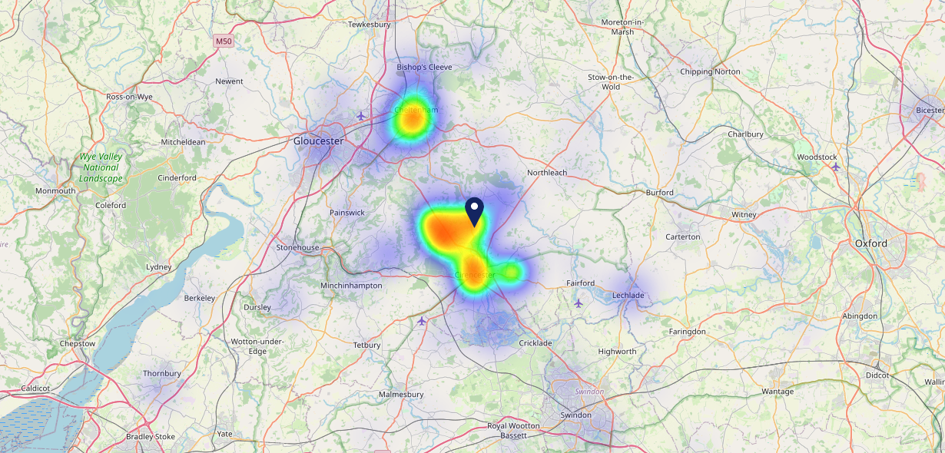
Site Intel
Bathurst Arms GL77BZ
08/11/2023 - 30/10/2024
Map of Guest Origin
Where do customers of Bathurst Arms GL77BZ come from?
Where do customers of Bathurst Arms GL77BZ for 08/11/2023 - 30/10/2024 live
447 Site Customers

Slide 12
Site Intel
Bathurst Arms GL77BZ
3 Miles
99 Chains
08/11/2023 - 30/10/2024
Share of Wallet
What are the Top 20 venues (by spend) that customers of Bathurst Arms GL77BZ also visit?
For customers of Bathurst Arms GL77BZ, who are the top 20 competitors from 99 Chains in 3 Miles for 08/11/2023 - 30/10/2024 split by Venue
872 Site Customers

Slide 13
Site Intel
Bathurst Arms GL77BZ
3 Miles
99 Chains
08/11/2023 - 30/10/2024
Share of Wallet Change
How has share of wallet of customers of Bathurst Arms GL77BZ changed between two date ranges?
872 Site Customers

Slide 14
Site Intel
Bathurst Arms GL77BZ
08/11/2023 - 30/10/2024
Market Summary
How does the local area for Bathurst Arms GL77BZ compare to the national average (1 = low, 10 = high)
Data Type | Name | Spend in 250m | 250m Spend vs National | Spend in 500m | 500m Spend vs National | Spend in 1 mile | 1 mile Spend vs National | Spend in 3 miles | 3 mile Spend vs National
Total | Annual Sales | £457K | 3 | £457K | 2 | £457K | 1 | £1.72M | 1
Weekpart | Mon - Thu | 43.4% | 7 | 43.4% | 7 | 43.4% | 7 | 44.0% | 8
Weekpart | Fri - Sat | 42.6% | 5 | 42.6% | 5 | 42.6% | 5 | 40.3% | 3
Weekpart | Sun | 14.0% | 5 | 14.0% | 4 | 14.0% | 3 | 15.7% | 6
Age | 18 to 24 | 0.4% | 1 | 0.4% | 1 | 0.4% | 1 | 2.2% | 1
Age | 25 to 34 | 14.3% | 2 | 14.3% | 2 | 14.3% | 2 | 16.9% | 2
Age | 35 to 44 | 14.2% | 1 | 14.2% | 1 | 14.2% | 1 | 18.1% | 1
Age | 45 to 54 | 17.2% | 3 | 17.2% | 3 | 17.2% | 2 | 18.6% | 3
Age | 55 to 64 | 20.8% | 9 | 20.8% | 9 | 20.8% | 9 | 22.2% | 10
Age | 65 to 74 | 14.8% | 10 | 14.8% | 10 | 14.8% | 10 | 12.2% | 10
Age | 75+ | 18.2% | 10 | 18.2% | 10 | 18.2% | 10 | 9.8% | 10
CAMEO | Business Elite | 9.0% | 7 | 9.0% | 7 | 9.0% | 7 | 8.4% | 6
CAMEO | Prosperous Professionals | 15.5% | 10 | 15.5% | 10 | 15.5% | 10 | 11.9% | 10
CAMEO | Flourishing Society | 23.1% | 9 | 23.1% | 9 | 23.1% | 9 | 24.3% | 10
CAMEO | Content Communities | 19.9% | 10 | 19.9% | 10 | 19.9% | 10 | 15.3% | 8
CAMEO | White Collar Neighbourhoods | 8.0% | 3 | 8.0% | 2 | 8.0% | 2 | 11.5% | 5
CAMEO | Enterprising Mainstream | 10.0% | 7 | 10.0% | 7 | 10.0% | 7 | 10.9% | 8
CAMEO | Paying The Mortgage | 8.5% | 2 | 8.5% | 2 | 8.5% | 2 | 8.6% | 1
CAMEO | Cash Conscious Communities | 4.3% | 2 | 4.3% | 2 | 4.3% | 1 | 4.6% | 1
CAMEO | On A Budget | 1.0% | 1 | 1.0% | 1 | 1.0% | 1 | 3.1% | 1
CAMEO | Family Value | 0.7% | 2 | 0.7% | 2 | 0.7% | 2 | 1.4% | 3
Affluence | AB | 47.6% | 9 | 47.6% | 9 | 47.6% | 9 | 44.7% | 9
Affluence | C1C2 | 46.4% | 5 | 46.4% | 5 | 46.4% | 4 | 46.3% | 4
Affluence | DE | 6.0% | 1 | 6.0% | 1 | 6.0% | 1 | 9.1% | 1

Slide 15
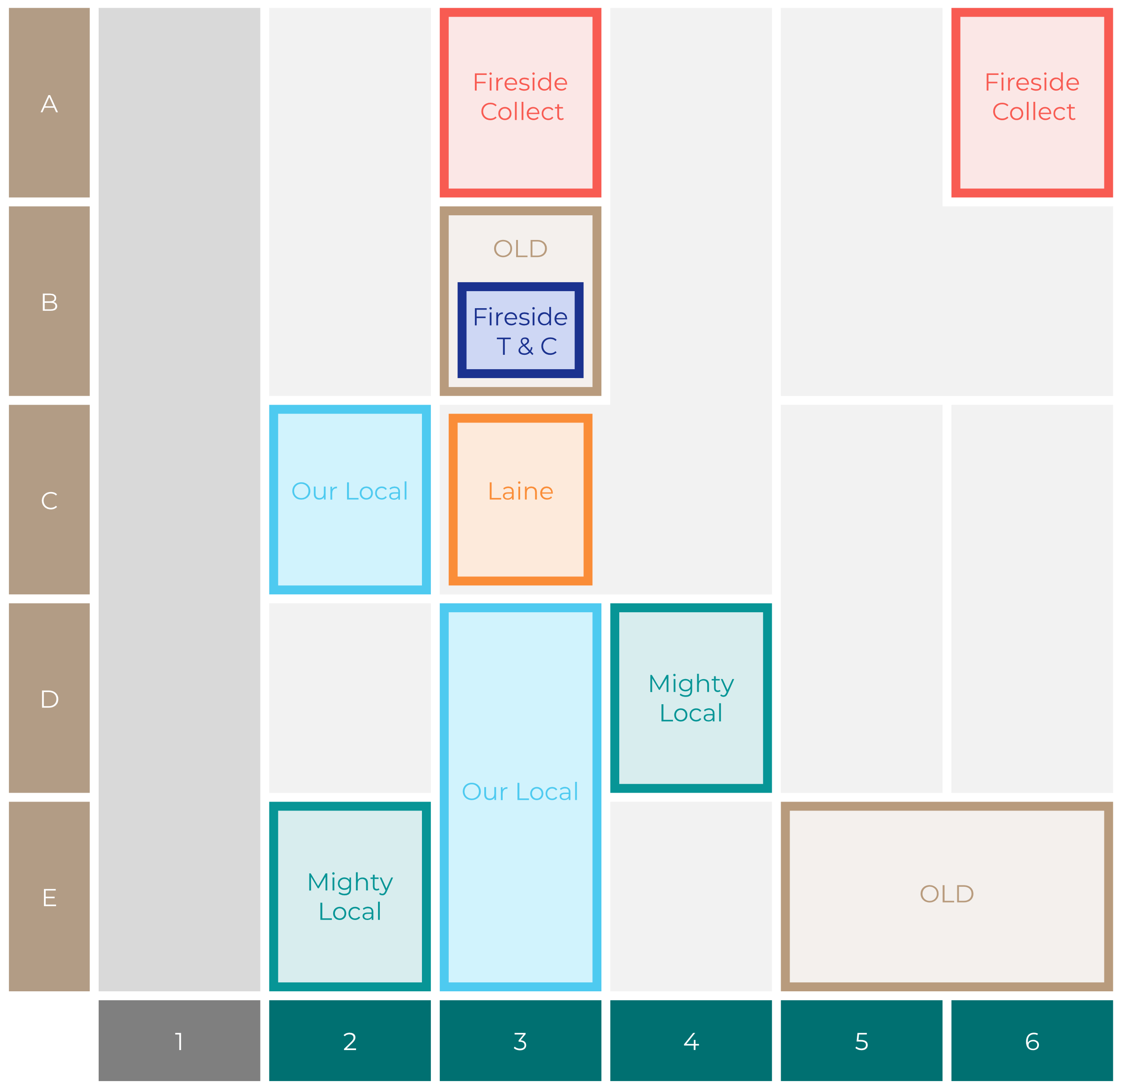
Site Intel
Bathurst Arms GL77BZ
Site Potential 1
Site Characteristics
£3000
£18000
OCC Concept Fit
Achievable Average Weekly Takings
Fireside Scenic
£11500
A Food-Led High Affluence B Food-Led Mid Affluence C Wet-Led Mid/High Affluence D Wet-Led Low Affluence E Food-Led Low Affluence
AWT 2 Local Regulars 3 Local Passing Trade 4 Destination Wet-Led 5 Destination Food-Led 6 Destination Very Food-Led
A
B
C
D
E
1
2
3
4
5
6

Slide 16
Site Intel
Bathurst Arms GL77BZ
Site Potential 2
Concept Recommendation

Slide 17
Site Intel
Bathurst Arms GL77BZ
Local Market Profile
Mix of spend by customer segment in Punch site and local market
 | Customer Count | Family Familiar | Occasional & Local | Mid-Week Seniors | Part Of The Pub | Metro Sophisticates | Young & Connected | Bubbly Weekenders | Upmarket Diners
Bathurst Arms | 176 | 3.10% | 0.88% | 39.63% | 1.58% | 11.37% | 2.63% | 4.60% | 36.17%
Local Catchment | 169 | 5.89% | 0.78% | 24.01% | 1.43% | 10.11% | 5.13% | 2.84% | 49.76%
Punch T&L | 105276 | 8.60% | 6.18% | 28.63% | 11.51% | 11.04% | 11.82% | 7.12% | 15.06%
Bathurst Arms vs Local Catchment |  | -2.79% | 0.10% | 15.62% | 0.15% | 1.26% | -2.50% | 1.76% | -13.59%
Bathurst Arms vs Punch T&L |  | -5.50% | -5.30% | 11.00% | -9.93% | 0.33% | -9.19% | -2.52% | 21.11%
Local Catchment vs Punch T&L |  | -2.71% | -5.40% | -4.62% | -10.08% | -0.93% | -6.69% | -4.28% | 34.70%

Slide 18
Site Intel
Bathurst Arms GL77BZ
Local Competitor Profiles
Mix of spend by customer segment in Punch site and local competitors
 | Customer Count | Family Familiar | Occasional & Local | Mid-Week Seniors | Part Of The Pub | Metro Sophisticates | Young & Connected | Bubbly Weekenders | Upmarket Diners
Bathurst Arms GL77BZ | 176 | 3.10% | 0.88% | 39.63% | 1.58% | 11.37% | 2.63% | 4.60% | 36.17%
Plough Inn GL72LB | 130 | 6.09% | 0.88% | 16.91% | 1.35% | 11.55% | 5.11% | 2.23% | 55.84%
Drillmans Arms Lim GL72JY | 41 | 5.68% | 0.18% | 56.12% | 1.53% | 5.19% | 5.78% | 5.68% | 19.79%
Chedworth Vill GL544NE | 11 | 0.00% | 2.66% | 2.28% | 4.00% | 0.00% | 0.00% | 0.00% | 91.04%
North Cerney M GL77DT | 2 | 0.00% | 0.00% | 0.00% | 0.00% | 0.00% | 0.00% | 0.00% | 100.00%

