Slide 1
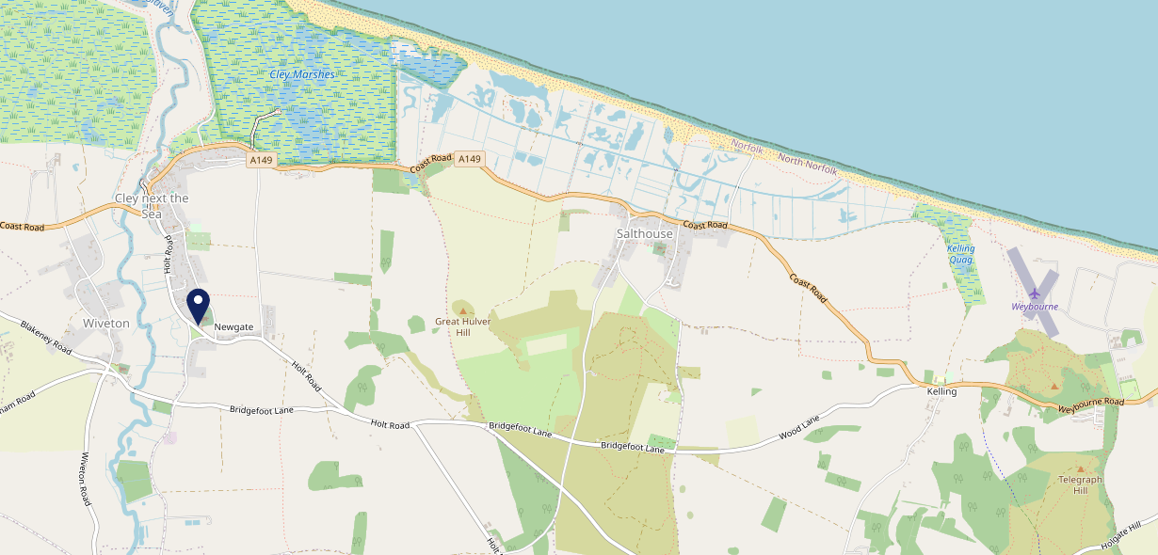
Site Intel
Three Swallows NR257TT
3 Miles
99 Chains
08/11/2023 - 30/10/2024
Site Summary
Three Swallows NR257TT
Work Area
Region
TV Region
Urbanicity
Cromer and Sheringham
East of England
Anglia
Rural hamlet and isolated dwellings in a sparse setting
NR257TT
Punch - Fireside Collection
Top Competitors
ATV
Gender
George And Dragon
#1
£32.58
65.62%
Male
NR257RN
Pub Restaurant
Affluence
Segmentation
Dun Cow
#2
44.89%
25.75%
Middle Income
Flourishing Society
NR257XA
Punch T&L
Age Group
Visit Day
Wiveton Bell
#3
31.15%
19.66%
NR257TL
55 to 64
Sun
Pub Restaurant
Nearest Station
Sheringham(10.97 miles)
898 Site Customers
12 Competitors
9442 Competitor Customers

Slide 2
Site Intel
Three Swallows NR257TT
3 Miles
99 Chains
08/11/2023 - 30/10/2024
Spend by Weekpart
How is customer spend distributed throughout the week for Three Swallows NR257TT versus its competitors?
% of spend for Three Swallows NR257TT and 99 Chains in 3 Miles from 08/11/2023 - 30/10/2024 split by Day of Week
898 Site Customers
12 Competitors
9442 Competitor Customers

Slide 3
Site Intel
Three Swallows NR257TT
3 Miles
99 Chains
08/11/2023 - 30/10/2024
Visit Frequency
How frequently per year do customers visit Three Swallows NR257TT versus its competitors?
% of customer numbers for Three Swallows NR257TT and 99 Chains in 3 Miles from 08/11/2023 - 30/10/2024 and the number of visits made Per Annum
898 Site Customers
12 Competitors
9442 Competitor Customers

Slide 4
Site Intel
Three Swallows NR257TT
3 Miles
99 Chains
08/11/2023 - 30/10/2024
ATV Change
How has ATV changed between two date ranges?
898 Site Customers

Slide 5
Site Intel
Three Swallows NR257TT
3 Miles
99 Chains
08/11/2023 - 30/10/2024
Market Share Change
How has market share changed between two date ranges?
% of market share spend for Three Swallows NR257TT and 99 Chains in 3 Miles from 08/11/2023 - 30/10/2024
898 Site Customers

Slide 6
Site Intel
Three Swallows NR257TT
3 Miles
99 Chains
08/11/2023 - 30/10/2024
Age
How does the age profile of customers who visit Three Swallows NR257TT compare versus its competitors?
% of spend for Three Swallows NR257TT and 99 Chains in 3 Miles from 08/11/2023 - 30/10/2024 split by Age Range
485 Site Customers
12 Competitors
4964 Competitor Customers

Slide 7
Site Intel
Three Swallows NR257TT
3 Miles
99 Chains
08/11/2023 - 30/10/2024
Affluence
How does the affluence of customers who visit Three Swallows NR257TT compare versus its competitors?
% of spend for Three Swallows NR257TT and 99 Chains in 3 Miles from 08/11/2023 - 30/10/2024 split by Affluence
485 Site Customers
12 Competitors
4970 Competitor Customers

Slide 8
Site Intel
Three Swallows NR257TT
3 Miles
99 Chains
08/11/2023 - 30/10/2024
Gender
How does the gender profile of customers who visit Three Swallows NR257TT compare versus its competitors?
% of spend for Three Swallows NR257TT and 99 Chains in 3 Miles from 08/11/2023 - 30/10/2024 split by Gender
485 Site Customers
12 Competitors
4970 Competitor Customers

Slide 9
Site Intel
Three Swallows NR257TT
3 Miles
99 Chains
08/11/2023 - 30/10/2024
Punch Segmentation
How does the Custom segmentation profile of customers who visit Three Swallows NR257TT compare versus its competitors?
% of spend for Three Swallows NR257TT and 99 Chains in 3 Miles from 08/11/2023 - 30/10/2024 split by Segment
898 Site Customers
12 Competitors
9442 Competitor Customers

Slide 10
Site Intel
Three Swallows NR257TT
3 Miles
99 Chains
08/11/2023 - 30/10/2024
Spend by Distance
How does the spend profile of Three Swallows NR257TT compare versus its competitors based on travel distances?
% of spend for Three Swallows NR257TT and 99 Chains in 3 Miles from 08/11/2023 - 30/10/2024 split by Distance travelled
474 Site Customers
12 Competitors
4853 Competitor Customers

Slide 11
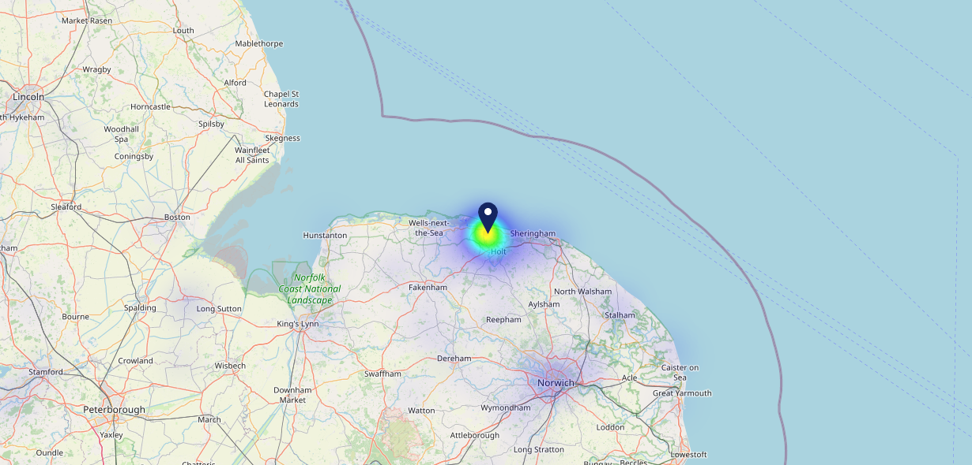
Site Intel
Three Swallows NR257TT
08/11/2023 - 30/10/2024
Map of Guest Origin
Where do customers of Three Swallows NR257TT come from?
Where do customers of Three Swallows NR257TT for 08/11/2023 - 30/10/2024 live
474 Site Customers

Slide 12
Site Intel
Three Swallows NR257TT
3 Miles
99 Chains
08/11/2023 - 30/10/2024
Share of Wallet
What are the Top 20 venues (by spend) that customers of Three Swallows NR257TT also visit?
For customers of Three Swallows NR257TT, who are the top 20 competitors from 99 Chains in 3 Miles for 08/11/2023 - 30/10/2024 split by Venue
898 Site Customers

Slide 13
Site Intel
Three Swallows NR257TT
3 Miles
99 Chains
08/11/2023 - 30/10/2024
Share of Wallet Change
How has share of wallet of customers of Three Swallows NR257TT changed between two date ranges?
898 Site Customers

Slide 14
Site Intel
Three Swallows NR257TT
08/11/2023 - 30/10/2024
Market Summary
How does the local area for Three Swallows NR257TT compare to the national average (1 = low, 10 = high)
Data Type | Name | Spend in 250m | 250m Spend vs National | Spend in 500m | 500m Spend vs National | Spend in 1 mile | 1 mile Spend vs National | Spend in 3 miles | 3 mile Spend vs National
Total | Annual Sales | £479K | 3 | £479K | 2 | £2.47M | 2 | £11.43M | 2
Weekpart | Mon - Thu | 44.8% | 8 | 44.8% | 8 | 41.7% | 6 | 44.8% | 9
Weekpart | Fri - Sat | 35.7% | 2 | 35.7% | 1 | 37.2% | 1 | 35.8% | 1
Weekpart | Sun | 19.5% | 9 | 19.5% | 9 | 21.2% | 10 | 19.4% | 10
Age | 18 to 24 | 1.2% | 1 | 1.2% | 1 | 0.5% | 1 | 0.6% | 1
Age | 25 to 34 | 7.6% | 1 | 7.6% | 1 | 7.3% | 1 | 5.5% | 1
Age | 35 to 44 | 7.7% | 1 | 7.7% | 1 | 10.0% | 1 | 11.6% | 1
Age | 45 to 54 | 20.6% | 6 | 20.6% | 6 | 20.1% | 5 | 16.9% | 1
Age | 55 to 64 | 30.8% | 10 | 30.8% | 10 | 31.2% | 10 | 28.9% | 10
Age | 65 to 74 | 26.2% | 10 | 26.2% | 10 | 19.7% | 10 | 22.5% | 10
Age | 75+ | 5.8% | 9 | 5.8% | 9 | 11.1% | 10 | 14.1% | 10
CAMEO | Business Elite | 11.2% | 8 | 11.2% | 7 | 12.2% | 8 | 11.5% | 7
CAMEO | Prosperous Professionals | 7.1% | 7 | 7.1% | 7 | 9.9% | 9 | 10.6% | 9
CAMEO | Flourishing Society | 25.7% | 10 | 25.7% | 10 | 26.4% | 10 | 27.1% | 10
CAMEO | Content Communities | 23.9% | 10 | 23.9% | 10 | 18.7% | 10 | 17.5% | 10
CAMEO | White Collar Neighbourhoods | 6.8% | 2 | 6.8% | 2 | 7.7% | 2 | 8.0% | 2
CAMEO | Enterprising Mainstream | 10.0% | 7 | 10.0% | 7 | 10.6% | 7 | 10.8% | 8
CAMEO | Paying The Mortgage | 5.1% | 1 | 5.1% | 1 | 7.9% | 1 | 8.4% | 1
CAMEO | Cash Conscious Communities | 6.7% | 4 | 6.7% | 3 | 3.7% | 1 | 3.6% | 1
CAMEO | On A Budget | 2.1% | 1 | 2.1% | 1 | 2.1% | 1 | 1.8% | 1
CAMEO | Family Value | 1.6% | 4 | 1.6% | 4 | 0.8% | 2 | 0.7% | 1
Affluence | AB | 44.0% | 9 | 44.0% | 9 | 48.5% | 9 | 49.1% | 10
Affluence | C1C2 | 45.7% | 5 | 45.7% | 4 | 44.9% | 4 | 44.7% | 4
Affluence | DE | 10.4% | 2 | 10.4% | 2 | 6.6% | 1 | 6.2% | 1

Slide 15
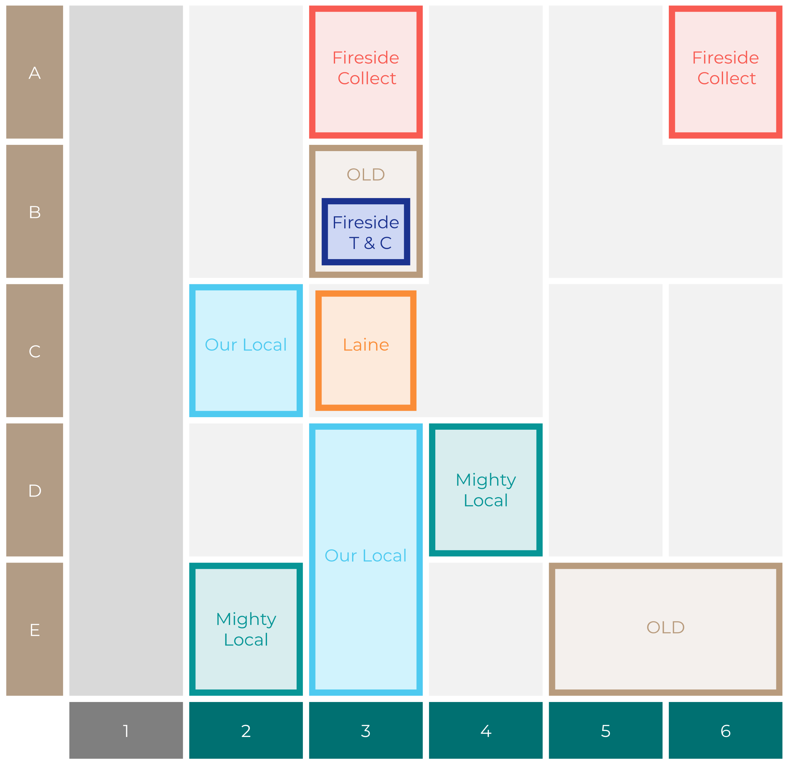
Site Intel
Three Swallows NR257TT
Site Potential 1
Site Characteristics
£3000
£18000
OCC Concept Fit
Achievable Average Weekly Takings
Fireside Scenic
£0
A Food-Led High Affluence B Food-Led Mid Affluence C Wet-Led Mid/High Affluence D Wet-Led Low Affluence E Food-Led Low Affluence
AWT 2 Local Regulars 3 Local Passing Trade 4 Destination Wet-Led 5 Destination Food-Led 6 Destination Very Food-Led
A
B
C
D
E
1
2
3
4
5
6

Slide 16
Site Intel
Three Swallows NR257TT
Site Potential 2
Concept Recommendation

Slide 17
Site Intel
Three Swallows NR257TT
Local Market Profile
Mix of spend by customer segment in Punch site and local market
 | Customer Count | Family Familiar | Occasional & Local | Mid-Week Seniors | Part Of The Pub | Metro Sophisticates | Young & Connected | Bubbly Weekenders | Upmarket Diners
Three Swallows | 183 | 3.83% | 0.75% | 33.85% | 2.40% | 7.04% | 0.95% | 2.28% | 48.86%
Local Catchment | 1338 | 1.70% | 1.24% | 32.58% | 2.38% | 10.74% | 2.79% | 2.20% | 46.33%
Punch T&L | 105276 | 8.60% | 6.18% | 28.63% | 11.51% | 11.04% | 11.82% | 7.12% | 15.06%
Three Swallows vs Local Catchment |  | 2.13% | -0.49% | 1.27% | 0.02% | -3.70% | -1.84% | 0.08% | 2.53%
Three Swallows vs Punch T&L |  | -4.77% | -5.43% | 5.22% | -9.11% | -4.00% | -10.87% | -4.84% | 33.80%
Local Catchment vs Punch T&L |  | -6.90% | -4.94% | 3.95% | -9.13% | -0.30% | -9.03% | -4.92% | 31.27%

Slide 18
Site Intel
Three Swallows NR257TT
Local Competitor Profiles
Mix of spend by customer segment in Punch site and local competitors
 | Customer Count | Family Familiar | Occasional & Local | Mid-Week Seniors | Part Of The Pub | Metro Sophisticates | Young & Connected | Bubbly Weekenders | Upmarket Diners
Three Swallows NR257TT | 183 | 3.83% | 0.75% | 33.85% | 2.40% | 7.04% | 0.95% | 2.28% | 48.86%
George And Dragon NR257RN | 373 | 2.23% | 0.85% | 21.91% | 2.58% | 16.05% | 2.28% | 3.36% | 50.70%
Dun Cow NR257XA | 336 | 1.11% | 1.89% | 29.65% | 0.40% | 10.91% | 1.74% | 1.66% | 52.60%
Wiveton Bell NR257TL | 200 | 1.27% | 0.04% | 28.84% | 0.09% | 10.69% | 0.18% | 1.22% | 57.64%
Kings Arms NR257NQ | 335 | 2.10% | 0.30% | 43.92% | 6.00% | 13.21% | 6.11% | 2.20% | 26.11%
Blakeney Manor NR257ND | 240 | 1.05% | 1.58% | 44.00% | 3.55% | 6.01% | 3.33% | 1.49% | 38.94%
Harbour Room NR257NX | 67 | 3.43% | 4.21% | 48.24% | 4.97% | 11.64% | 8.20% | 0.72% | 18.54%
Blue Bell NR257BX | 104 | 2.73% | 2.56% | 11.84% | 2.71% | 10.62% | 3.33% | 4.80% | 61.37%
Anchor Inn NR257AA | 91 | 5.40% | 1.67% | 23.77% | 0.87% | 7.12% | 3.10% | 6.40% | 51.64%

