Slide 1
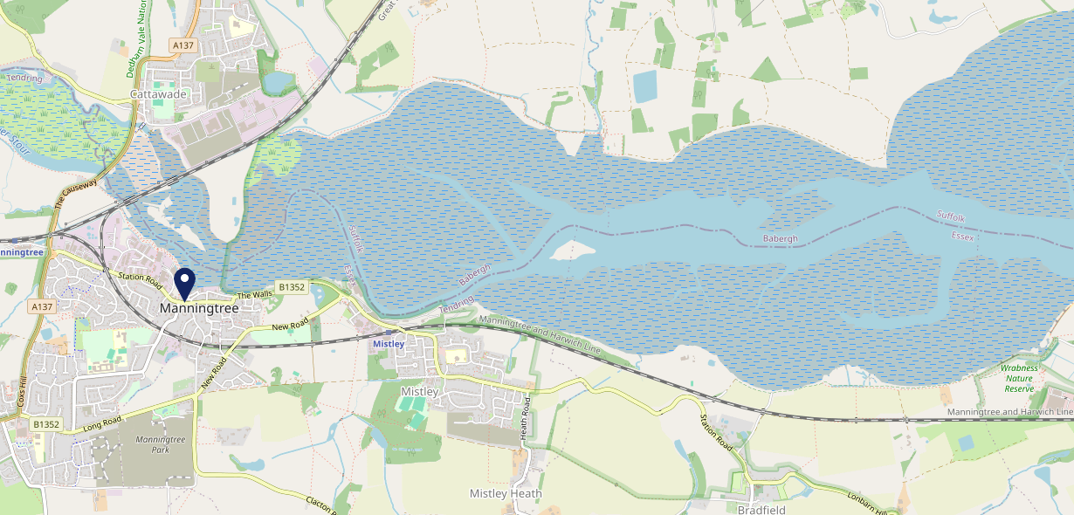
Site Intel
Skinners CO111DX
1 Miles
99 Chains
08/11/2023 - 30/10/2024
Site Summary
Skinners CO111DX
Work Area
Region
TV Region
Urbanicity
Colchester
East of England
Anglia
Rural town and fringe
CO111DX
Punch - Our Local
Top Competitors
ATV
Gender
Crown (Manningtree)
#1
£10.29
79.56%
Male
CO111AH
GK Pub Partners
Affluence
Segmentation
Red Lion
#2
70.97%
36.17%
Middle Income
Paying The Mortgage
CO111BG
Pub / Bar
Age Group
Visit Day
Crown Inn (Cattawade)
#3
27.05%
28.92%
CO111RE
45 to 54
Sat
Pub / Bar
Nearest Station
Manningtree(1.17 miles)
599 Site Customers
6 Competitors
4222 Competitor Customers

Slide 2
Site Intel
Skinners CO111DX
1 Miles
99 Chains
08/11/2023 - 30/10/2024
Spend by Weekpart
How is customer spend distributed throughout the week for Skinners CO111DX versus its competitors?
% of spend for Skinners CO111DX and 99 Chains in 1 Miles from 08/11/2023 - 30/10/2024 split by Day of Week
599 Site Customers
6 Competitors
4222 Competitor Customers

Slide 3
Site Intel
Skinners CO111DX
1 Miles
99 Chains
08/11/2023 - 30/10/2024
Visit Frequency
How frequently per year do customers visit Skinners CO111DX versus its competitors?
% of customer numbers for Skinners CO111DX and 99 Chains in 1 Miles from 08/11/2023 - 30/10/2024 and the number of visits made Per Annum
599 Site Customers
6 Competitors
4222 Competitor Customers

Slide 4
Site Intel
Skinners CO111DX
1 Miles
99 Chains
08/11/2023 - 30/10/2024
ATV Change
How has ATV changed between two date ranges?
599 Site Customers

Slide 5
Site Intel
Skinners CO111DX
1 Miles
99 Chains
08/11/2023 - 30/10/2024
Market Share Change
How has market share changed between two date ranges?
% of market share spend for Skinners CO111DX and 99 Chains in 1 Miles from 08/11/2023 - 30/10/2024
599 Site Customers

Slide 6
Site Intel
Skinners CO111DX
1 Miles
99 Chains
08/11/2023 - 30/10/2024
Age
How does the age profile of customers who visit Skinners CO111DX compare versus its competitors?
% of spend for Skinners CO111DX and 99 Chains in 1 Miles from 08/11/2023 - 30/10/2024 split by Age Range
256 Site Customers
6 Competitors
1942 Competitor Customers

Slide 7
Site Intel
Skinners CO111DX
1 Miles
99 Chains
08/11/2023 - 30/10/2024
Affluence
How does the affluence of customers who visit Skinners CO111DX compare versus its competitors?
% of spend for Skinners CO111DX and 99 Chains in 1 Miles from 08/11/2023 - 30/10/2024 split by Affluence
262 Site Customers
6 Competitors
1960 Competitor Customers

Slide 8
Site Intel
Skinners CO111DX
1 Miles
99 Chains
08/11/2023 - 30/10/2024
Gender
How does the gender profile of customers who visit Skinners CO111DX compare versus its competitors?
% of spend for Skinners CO111DX and 99 Chains in 1 Miles from 08/11/2023 - 30/10/2024 split by Gender
262 Site Customers
6 Competitors
1960 Competitor Customers

Slide 9
Site Intel
Skinners CO111DX
1 Miles
99 Chains
08/11/2023 - 30/10/2024
Punch Segmentation
How does the Custom segmentation profile of customers who visit Skinners CO111DX compare versus its competitors?
% of spend for Skinners CO111DX and 99 Chains in 1 Miles from 08/11/2023 - 30/10/2024 split by Segment
599 Site Customers
6 Competitors
4222 Competitor Customers

Slide 10
Site Intel
Skinners CO111DX
1 Miles
99 Chains
08/11/2023 - 30/10/2024
Spend by Distance
How does the spend profile of Skinners CO111DX compare versus its competitors based on travel distances?
% of spend for Skinners CO111DX and 99 Chains in 1 Miles from 08/11/2023 - 30/10/2024 split by Distance travelled
246 Site Customers
6 Competitors
1884 Competitor Customers

Slide 11
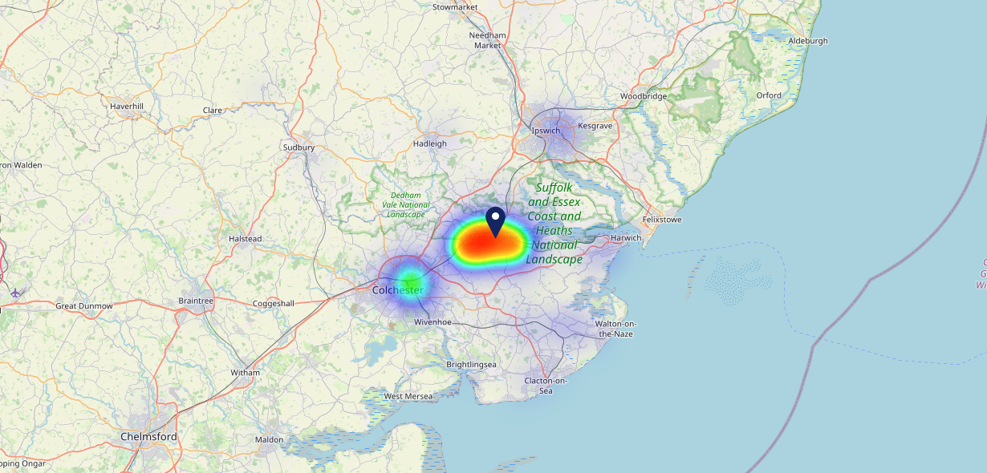
Site Intel
Skinners CO111DX
08/11/2023 - 30/10/2024
Map of Guest Origin
Where do customers of Skinners CO111DX come from?
Where do customers of Skinners CO111DX for 08/11/2023 - 30/10/2024 live
246 Site Customers

Slide 12
Site Intel
Skinners CO111DX
1 Miles
99 Chains
08/11/2023 - 30/10/2024
Share of Wallet
What are the Top 20 venues (by spend) that customers of Skinners CO111DX also visit?
For customers of Skinners CO111DX, who are the top 20 competitors from 99 Chains in 1 Miles for 08/11/2023 - 30/10/2024 split by Venue
599 Site Customers

Slide 13
Site Intel
Skinners CO111DX
1 Miles
99 Chains
08/11/2023 - 30/10/2024
Share of Wallet Change
How has share of wallet of customers of Skinners CO111DX changed between two date ranges?
599 Site Customers

Slide 14
Site Intel
Skinners CO111DX
08/11/2023 - 30/10/2024
Market Summary
How does the local area for Skinners CO111DX compare to the national average (1 = low, 10 = high)
Data Type | Name | Spend in 250m | 250m Spend vs National | Spend in 500m | 500m Spend vs National | Spend in 1 mile | 1 mile Spend vs National | Spend in 3 miles | 3 mile Spend vs National
Total | Annual Sales | £3.67M | 7 | £7.80M | 7 | £9.21M | 4 | £14.32M | 2
Weekpart | Mon - Thu | 31.6% | 2 | 35.4% | 2 | 35.6% | 1 | 35.3% | 1
Weekpart | Fri - Sat | 54.4% | 10 | 51.6% | 10 | 49.6% | 10 | 47.9% | 10
Weekpart | Sun | 14.1% | 5 | 13.0% | 3 | 14.8% | 5 | 16.8% | 8
Age | 18 to 24 | 4.4% | 4 | 4.8% | 4 | 4.0% | 3 | 3.0% | 1
Age | 25 to 34 | 15.1% | 3 | 12.8% | 2 | 11.6% | 1 | 10.8% | 1
Age | 35 to 44 | 25.0% | 7 | 23.8% | 6 | 22.0% | 4 | 20.6% | 2
Age | 45 to 54 | 19.1% | 4 | 18.6% | 4 | 17.9% | 2 | 16.8% | 1
Age | 55 to 64 | 20.4% | 8 | 21.2% | 9 | 22.9% | 10 | 21.6% | 10
Age | 65 to 74 | 12.4% | 9 | 13.0% | 9 | 14.6% | 10 | 16.6% | 10
Age | 75+ | 3.6% | 8 | 5.8% | 9 | 7.1% | 10 | 10.6% | 10
CAMEO | Business Elite | 6.1% | 5 | 5.5% | 5 | 6.2% | 5 | 6.2% | 5
CAMEO | Prosperous Professionals | 6.8% | 6 | 7.5% | 7 | 8.4% | 8 | 8.7% | 8
CAMEO | Flourishing Society | 14.9% | 7 | 15.4% | 7 | 16.6% | 7 | 18.6% | 8
CAMEO | Content Communities | 18.4% | 9 | 19.1% | 10 | 19.8% | 10 | 20.4% | 10
CAMEO | White Collar Neighbourhoods | 8.3% | 3 | 9.1% | 3 | 8.9% | 3 | 8.7% | 2
CAMEO | Enterprising Mainstream | 16.7% | 10 | 15.5% | 10 | 14.5% | 10 | 12.9% | 9
CAMEO | Paying The Mortgage | 20.2% | 9 | 18.0% | 8 | 16.4% | 7 | 15.5% | 6
CAMEO | Cash Conscious Communities | 3.8% | 2 | 4.1% | 2 | 3.8% | 1 | 4.2% | 1
CAMEO | On A Budget | 2.2% | 1 | 3.0% | 2 | 2.9% | 1 | 2.6% | 1
CAMEO | Family Value | 2.6% | 6 | 2.8% | 6 | 2.5% | 5 | 2.2% | 5
Affluence | AB | 27.8% | 6 | 28.4% | 6 | 31.2% | 6 | 33.5% | 7
Affluence | C1C2 | 63.6% | 10 | 61.7% | 10 | 59.6% | 10 | 57.5% | 10
Affluence | DE | 8.6% | 2 | 10.0% | 2 | 9.2% | 1 | 9.1% | 1

Slide 15
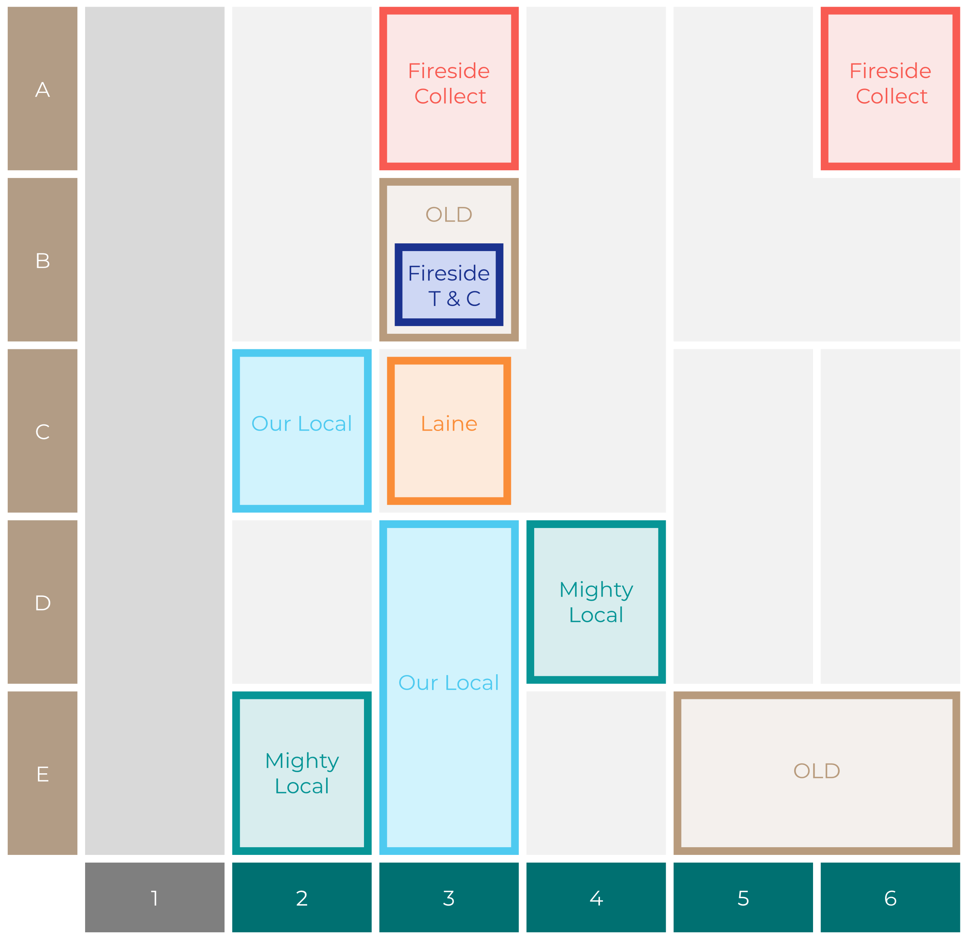
Site Intel
Skinners CO111DX
Site Potential 1
Site Characteristics
£3000
£18000
OCC Concept Fit
Achievable Average Weekly Takings
Non-Core
£7500
A Food-Led High Affluence B Food-Led Mid Affluence C Wet-Led Mid/High Affluence D Wet-Led Low Affluence E Food-Led Low Affluence
AWT 2 Local Regulars 3 Local Passing Trade 4 Destination Wet-Led 5 Destination Food-Led 6 Destination Very Food-Led
A
B
C
D
E
1
2
3
4
5
6

Slide 16
Site Intel
Skinners CO111DX
Site Potential 2
Concept Recommendation

Slide 17
Site Intel
Skinners CO111DX
Local Market Profile
Mix of spend by customer segment in Punch site and local market
 | Customer Count | Family Familiar | Occasional & Local | Mid-Week Seniors | Part Of The Pub | Metro Sophisticates | Young & Connected | Bubbly Weekenders | Upmarket Diners
Skinners | 94 | 12.00% | 2.53% | 48.96% | 5.59% | 9.88% | 12.28% | 4.78% | 3.95%
Local Catchment | 516 | 8.90% | 2.68% | 30.83% | 5.64% | 7.51% | 13.78% | 8.81% | 21.81%
Punch T&L | 105276 | 8.60% | 6.18% | 28.63% | 11.51% | 11.04% | 11.82% | 7.12% | 15.06%
Skinners vs Local Catchment |  | 3.10% | -0.15% | 18.13% | -0.05% | 2.37% | -1.50% | -4.03% | -17.86%
Skinners vs Punch T&L |  | 3.40% | -3.65% | 20.33% | -5.92% | -1.16% | 0.46% | -2.34% | -11.11%
Local Catchment vs Punch T&L |  | 0.30% | -3.50% | 2.20% | -5.87% | -3.53% | 1.96% | 1.69% | 6.75%

Slide 18
Site Intel
Skinners CO111DX
Local Competitor Profiles
Mix of spend by customer segment in Punch site and local competitors
 | Customer Count | Family Familiar | Occasional & Local | Mid-Week Seniors | Part Of The Pub | Metro Sophisticates | Young & Connected | Bubbly Weekenders | Upmarket Diners
Skinners CO111DX | 94 | 12.00% | 2.53% | 48.96% | 5.59% | 9.88% | 12.28% | 4.78% | 3.95%
Crown (Manningtree) CO111AH | 369 | 7.88% | 2.25% | 31.90% | 7.97% | 5.94% | 16.08% | 8.44% | 19.50%
Red Lion CO111BG | 221 | 4.79% | 3.25% | 30.67% | 0.58% | 11.64% | 10.41% | 9.80% | 28.82%
Crown Inn (Cattawade) CO111RE | 28 | 62.86% | 4.26% | 16.05% | 3.96% | 4.55% | 0.72% | 3.20% | 4.36%
Manningtree Be CO112HL | 14 | 0.00% | 7.63% | 25.76% | 0.00% | 8.43% | 0.00% | 15.27% | 42.87%
Brantham Manag CO111RZ | 13 | 8.97% | 11.77% | 0.00% | 0.00% | 0.00% | 4.78% | 41.56% | 32.88%

