Slide 1
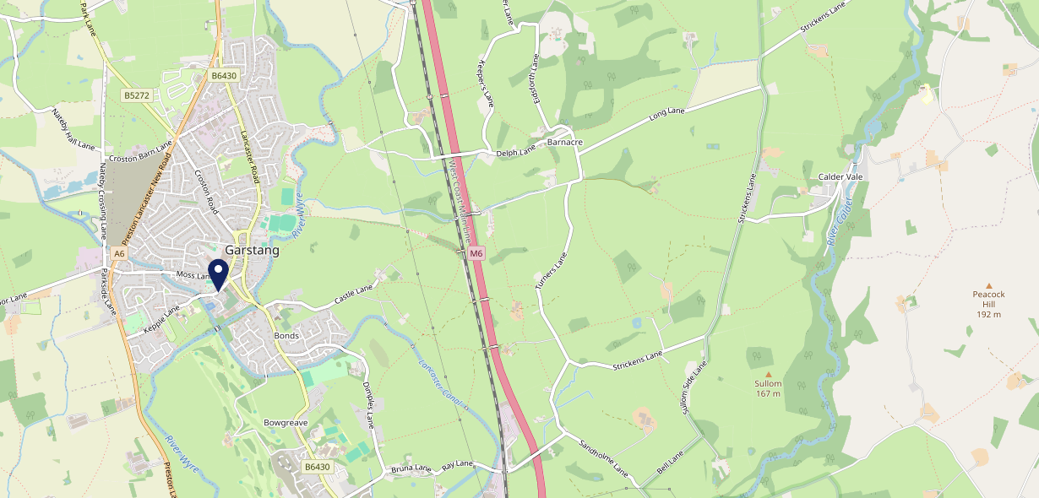
Site Intel
The Owd Tithe Barn PR31PA
3 Miles
97 Chains
20/09/2023 - 11/09/2024
Site Summary
The Owd Tithe Barn PR31PA
Work Area
Region
TV Region
Urbanicity
Preston
North West
North West
Rural town and fringe
PR31PA
Punch - Our Local +
Top Competitors
ATV
Gender
Crown Hotel
#1
£16.71
65.60%
Male
PR31FA
Thwaites
Affluence
Segmentation
Royal Oak Hotel
#2
58.99%
17.68%
Middle Income
Enterprising Mainstream
PR31ZA
Pub Restaurant
Age Group
Visit Day
Horns Inn
#3
31.03%
26.13%
PR30HR
55 to 64
Sat
Star Pubs & Bars
Nearest Station
Salwick(13.32 miles)
2375 Site Customers
22 Competitors
18908 Competitor Customers

Slide 2
Site Intel
The Owd Tithe Barn PR31PA
3 Miles
97 Chains
20/09/2023 - 11/09/2024
Spend by Weekpart
How is customer spend distributed throughout the week for The Owd Tithe Barn PR31PA versus its competitors?
% of spend for The Owd Tithe Barn PR31PA and 97 Chains in 3 Miles from 20/09/2023 - 11/09/2024 split by Day of Week
2375 Site Customers
22 Competitors
18908 Competitor Customers

Slide 3
Site Intel
The Owd Tithe Barn PR31PA
3 Miles
97 Chains
20/09/2023 - 11/09/2024
Visit Frequency
How frequently per year do customers visit The Owd Tithe Barn PR31PA versus its competitors?
% of customer numbers for The Owd Tithe Barn PR31PA and 97 Chains in 3 Miles from 20/09/2023 - 11/09/2024 and the number of visits made Per Annum
2375 Site Customers
22 Competitors
18908 Competitor Customers

Slide 4
Site Intel
The Owd Tithe Barn PR31PA
3 Miles
97 Chains
20/09/2023 - 11/09/2024
ATV Change
How has ATV changed between two date ranges?
2375 Site Customers

Slide 5
Site Intel
The Owd Tithe Barn PR31PA
3 Miles
97 Chains
20/09/2023 - 11/09/2024
Market Share Change
How has market share changed between two date ranges?
% of market share spend for The Owd Tithe Barn PR31PA and 97 Chains in 3 Miles from 20/09/2023 - 11/09/2024
2375 Site Customers

Slide 6
Site Intel
The Owd Tithe Barn PR31PA
3 Miles
97 Chains
20/09/2023 - 11/09/2024
Age
How does the age profile of customers who visit The Owd Tithe Barn PR31PA compare versus its competitors?
% of spend for The Owd Tithe Barn PR31PA and 97 Chains in 3 Miles from 20/09/2023 - 11/09/2024 split by Age Range
1129 Site Customers
22 Competitors
8596 Competitor Customers

Slide 7
Site Intel
The Owd Tithe Barn PR31PA
3 Miles
97 Chains
20/09/2023 - 11/09/2024
Affluence
How does the affluence of customers who visit The Owd Tithe Barn PR31PA compare versus its competitors?
% of spend for The Owd Tithe Barn PR31PA and 97 Chains in 3 Miles from 20/09/2023 - 11/09/2024 split by Affluence
1141 Site Customers
22 Competitors
8734 Competitor Customers

Slide 8
Site Intel
The Owd Tithe Barn PR31PA
3 Miles
97 Chains
20/09/2023 - 11/09/2024
Gender
How does the gender profile of customers who visit The Owd Tithe Barn PR31PA compare versus its competitors?
% of spend for The Owd Tithe Barn PR31PA and 97 Chains in 3 Miles from 20/09/2023 - 11/09/2024 split by Gender
1141 Site Customers
22 Competitors
8734 Competitor Customers

Slide 9
Site Intel
The Owd Tithe Barn PR31PA
3 Miles
97 Chains
20/09/2023 - 11/09/2024
Punch Segmentation
How does the Custom segmentation profile of customers who visit The Owd Tithe Barn PR31PA compare versus its competitors?
% of spend for The Owd Tithe Barn PR31PA and 97 Chains in 3 Miles from 20/09/2023 - 11/09/2024 split by Segment
2375 Site Customers
22 Competitors
18908 Competitor Customers

Slide 10
Site Intel
The Owd Tithe Barn PR31PA
3 Miles
97 Chains
20/09/2023 - 11/09/2024
Spend by Distance
How does the spend profile of The Owd Tithe Barn PR31PA compare versus its competitors based on travel distances?
% of spend for The Owd Tithe Barn PR31PA and 97 Chains in 3 Miles from 20/09/2023 - 11/09/2024 split by Distance travelled
1111 Site Customers
22 Competitors
8459 Competitor Customers

Slide 11
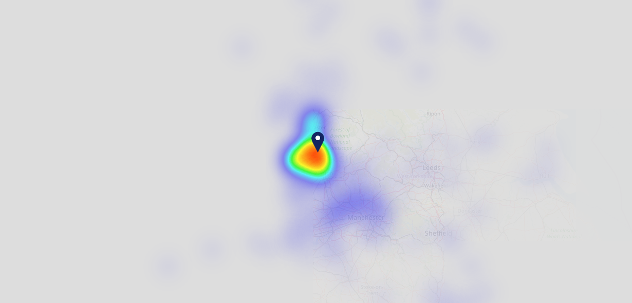
Site Intel
The Owd Tithe Barn PR31PA
20/09/2023 - 11/09/2024
Map of Guest Origin
Where do customers of The Owd Tithe Barn PR31PA come from?
Where do customers of The Owd Tithe Barn PR31PA for 20/09/2023 - 11/09/2024 live
1111 Site Customers

Slide 12
Site Intel
The Owd Tithe Barn PR31PA
3 Miles
97 Chains
20/09/2023 - 11/09/2024
Share of Wallet
What are the Top 20 venues (by spend) that customers of The Owd Tithe Barn PR31PA also visit?
For customers of The Owd Tithe Barn PR31PA, who are the top 20 competitors from 97 Chains in 3 Miles for 20/09/2023 - 11/09/2024 split by Venue
2375 Site Customers

Slide 13
Site Intel
The Owd Tithe Barn PR31PA
3 Miles
97 Chains
20/09/2023 - 11/09/2024
Share of Wallet Change
How has share of wallet of customers of The Owd Tithe Barn PR31PA changed between two date ranges?
2375 Site Customers

Slide 14
Site Intel
The Owd Tithe Barn PR31PA
20/09/2023 - 11/09/2024
Market Summary
How does the local area for The Owd Tithe Barn PR31PA compare to the national average (1 = low, 10 = high)
Data Type | Name | Spend in 250m | 250m Spend vs National | Spend in 500m | 500m Spend vs National | Spend in 1 mile | 1 mile Spend vs National | Spend in 3 miles | 3 mile Spend vs National
Total | Annual Sales | £5.69M | 8 | £11.97M | 8 | £14.51M | 5 | £25.30M | 3
Weekpart | Mon - Thu | 37.4% | 4 | 34.4% | 2 | 34.7% | 1 | 34.8% | 1
Weekpart | Fri - Sat | 46.5% | 7 | 50.4% | 9 | 49.0% | 10 | 46.4% | 10
Weekpart | Sun | 16.1% | 7 | 15.2% | 6 | 16.3% | 7 | 18.8% | 10
Age | 18 to 24 | 6.0% | 6 | 8.9% | 7 | 7.9% | 7 | 6.9% | 5
Age | 25 to 34 | 10.7% | 1 | 12.2% | 1 | 12.8% | 1 | 13.2% | 1
Age | 35 to 44 | 10.9% | 1 | 11.4% | 1 | 12.0% | 1 | 13.9% | 1
Age | 45 to 54 | 17.6% | 3 | 17.6% | 3 | 17.4% | 2 | 18.2% | 2
Age | 55 to 64 | 24.6% | 10 | 24.4% | 10 | 24.1% | 10 | 23.2% | 10
Age | 65 to 74 | 16.0% | 10 | 14.8% | 10 | 15.3% | 10 | 14.7% | 10
Age | 75+ | 14.1% | 10 | 10.8% | 10 | 10.6% | 10 | 9.9% | 10
CAMEO | Business Elite | 11.6% | 8 | 11.0% | 7 | 10.2% | 7 | 9.5% | 6
CAMEO | Prosperous Professionals | 8.9% | 8 | 8.8% | 8 | 8.9% | 8 | 9.4% | 9
CAMEO | Flourishing Society | 14.3% | 7 | 16.6% | 7 | 16.1% | 7 | 16.1% | 7
CAMEO | Content Communities | 18.1% | 9 | 18.8% | 10 | 18.6% | 10 | 17.9% | 10
CAMEO | White Collar Neighbourhoods | 10.7% | 5 | 9.7% | 4 | 9.8% | 4 | 10.6% | 4
CAMEO | Enterprising Mainstream | 17.5% | 10 | 16.5% | 10 | 16.2% | 10 | 17.0% | 10
CAMEO | Paying The Mortgage | 8.0% | 2 | 7.7% | 1 | 8.6% | 2 | 9.3% | 2
CAMEO | Cash Conscious Communities | 7.7% | 4 | 7.4% | 4 | 7.5% | 4 | 6.2% | 2
CAMEO | On A Budget | 2.0% | 1 | 2.1% | 1 | 2.3% | 1 | 2.4% | 1
CAMEO | Family Value | 1.2% | 4 | 1.3% | 4 | 1.8% | 4 | 1.7% | 4
Affluence | AB | 34.9% | 7 | 36.5% | 7 | 35.3% | 7 | 35.0% | 7
Affluence | C1C2 | 54.2% | 8 | 52.8% | 7 | 53.2% | 8 | 54.8% | 9
Affluence | DE | 10.9% | 2 | 10.8% | 2 | 11.6% | 2 | 10.2% | 1

Slide 15
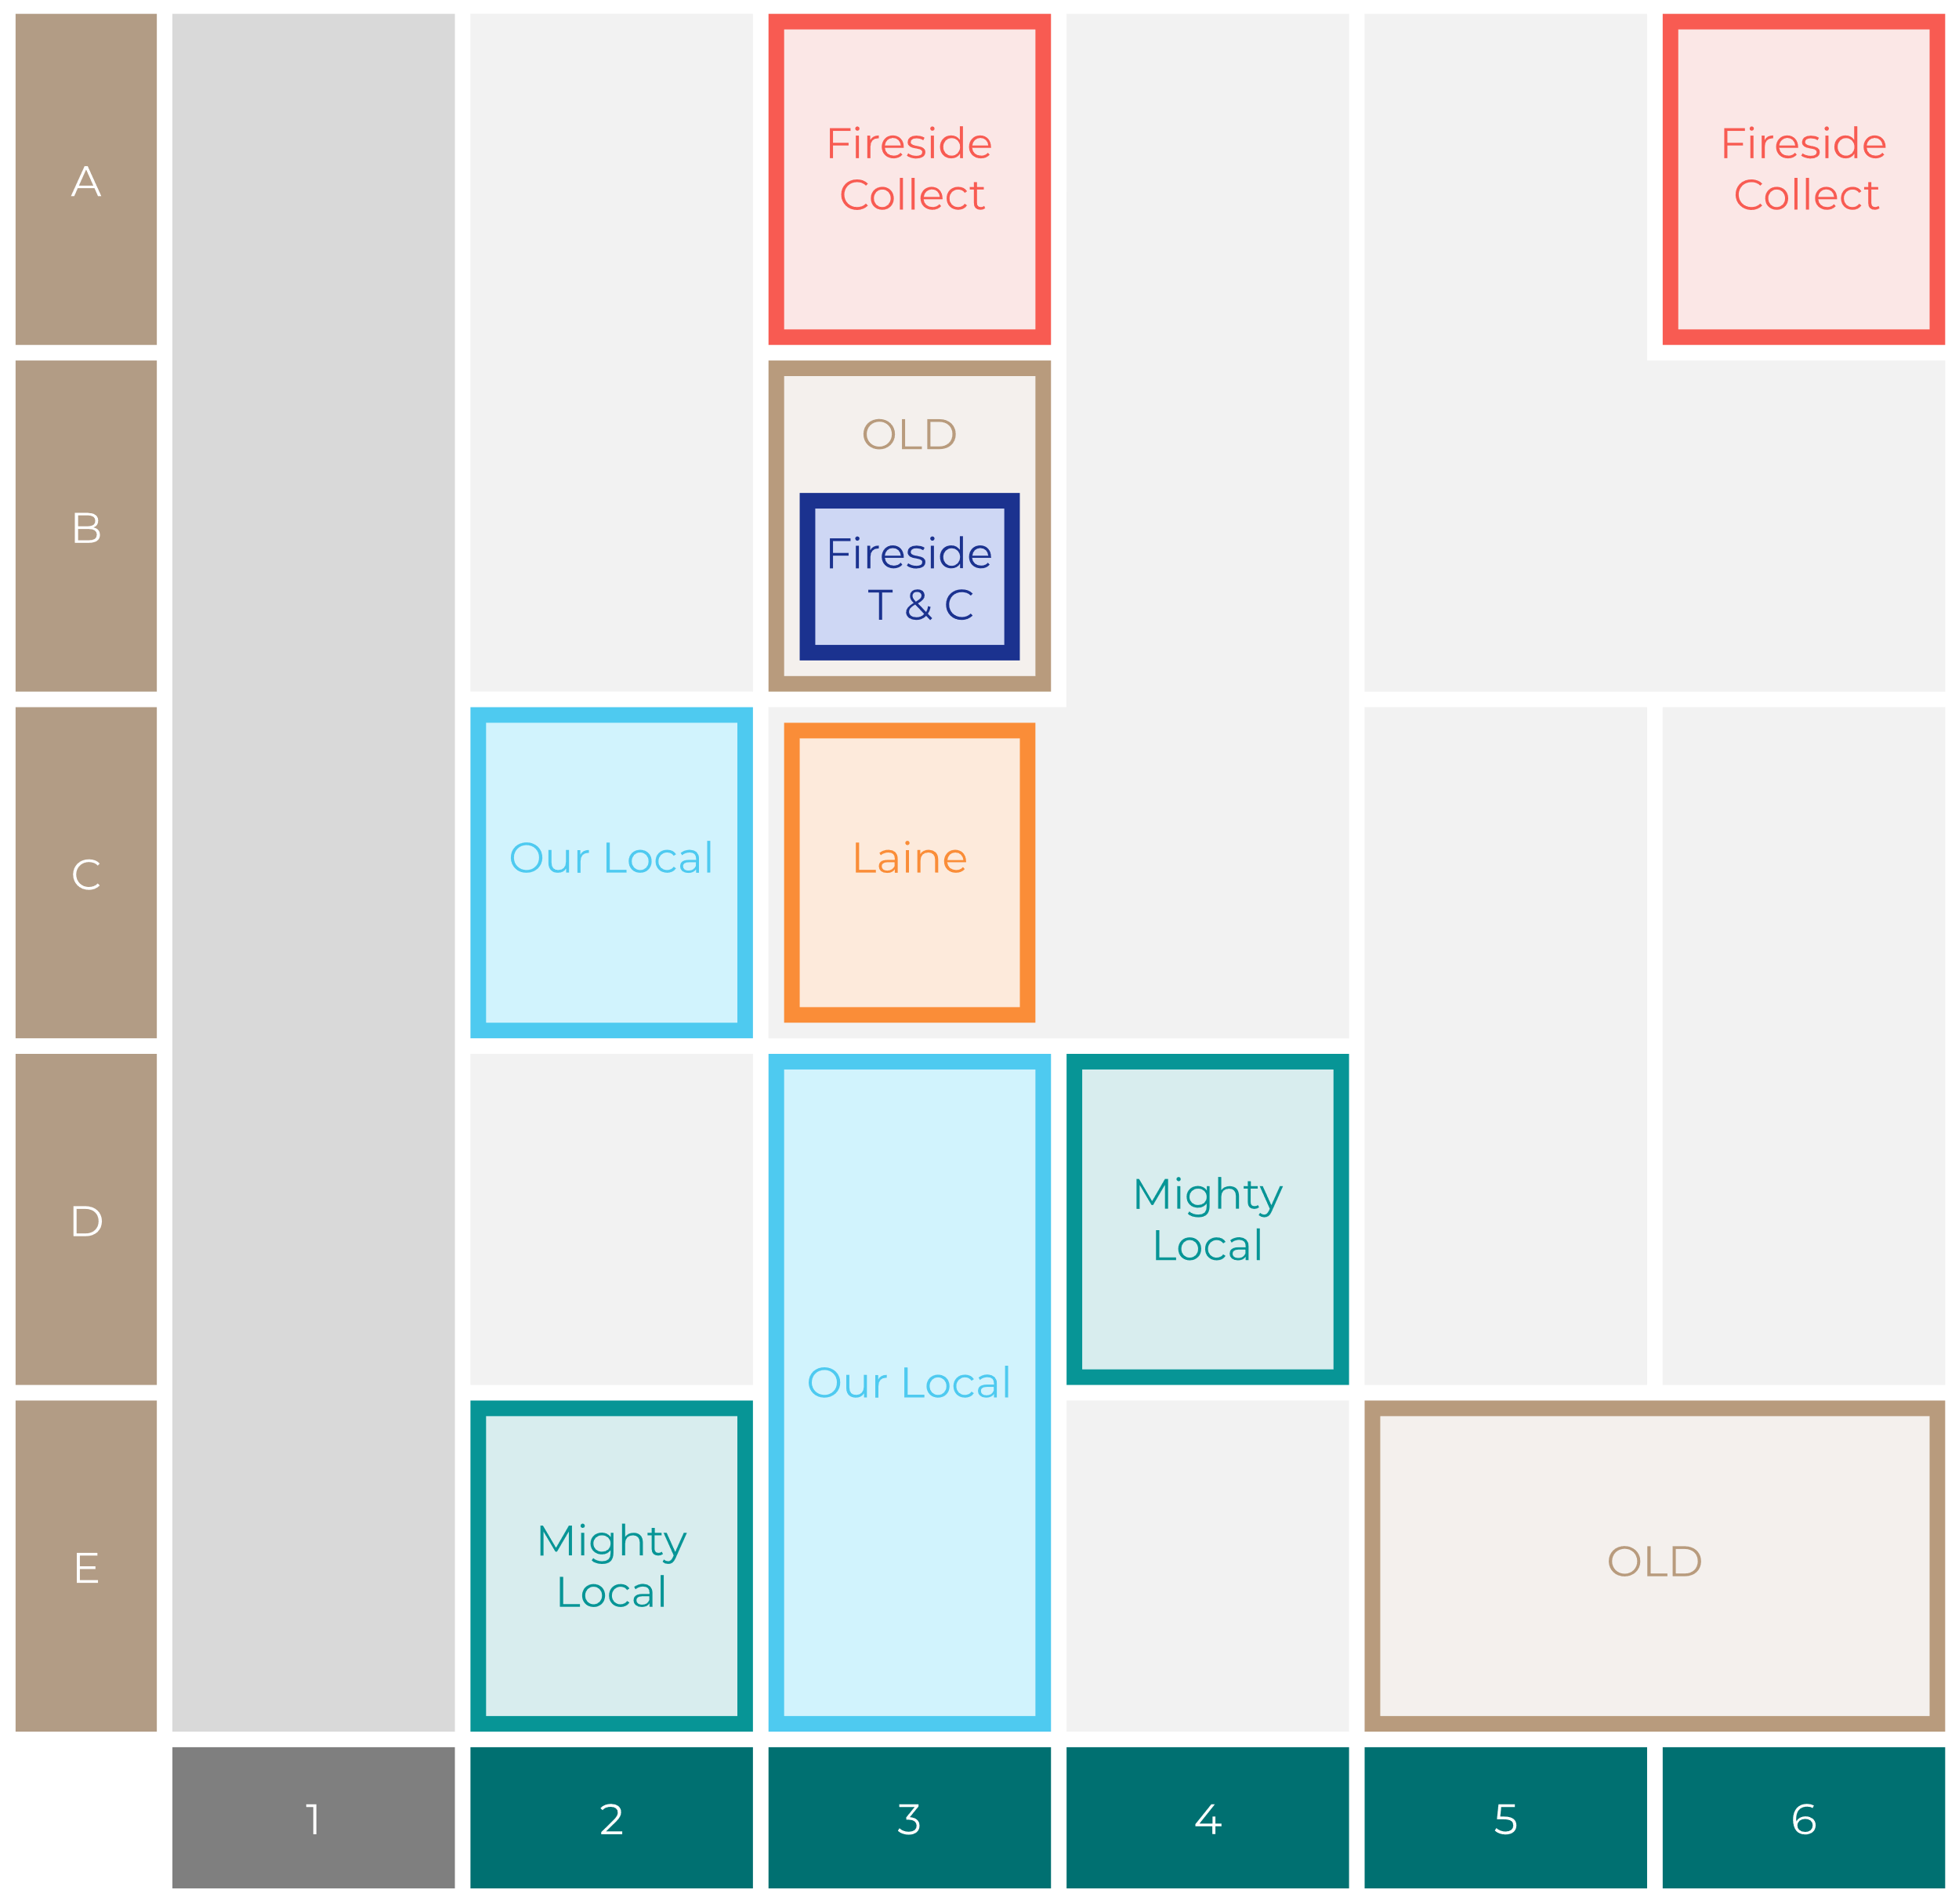
Site Intel
The Owd Tithe Barn PR31PA
Site Potential 1
Site Characteristics
£3000
£18000
OCC Concept Fit
Achievable Average Weekly Takings
Non-Core
£10000
A Food-Led High Affluence B Food-Led Mid Affluence C Wet-Led Mid/High Affluence D Wet-Led Low Affluence E Food-Led Low Affluence
AWT 2 Local Regulars 3 Local Passing Trade 4 Destination Wet-Led 5 Destination Food-Led 6 Destination Very Food-Led
A
B
C
D
E
1
2
3
4
5
6

Slide 16
Site Intel
The Owd Tithe Barn PR31PA
Site Potential 2
Concept Recommendation

Slide 17
Site Intel
The Owd Tithe Barn PR31PA
Local Market Profile
Mix of spend by customer segment in Punch site and local market
 | Customer Count | Family Familiar | Occasional & Local | Mid-Week Seniors | Part Of The Pub | Metro Sophisticates | Young & Connected | Bubbly Weekenders | Upmarket Diners
The Owd Tithe Barn | 470 | 11.44% | 2.76% | 33.87% | 4.44% | 16.61% | 14.32% | 5.63% | 10.89%
Local Catchment | 1754 | 8.66% | 4.32% | 29.98% | 9.19% | 15.32% | 13.74% | 5.59% | 13.15%
Punch T&L | 102659 | 8.37% | 6.01% | 29.00% | 10.93% | 11.58% | 11.69% | 7.07% | 15.31%
The Owd Tithe Barn vs Local Catchment |  | 2.78% | -1.56% | 3.89% | -4.75% | 1.29% | 0.58% | 0.04% | -2.26%
The Owd Tithe Barn vs Punch T&L |  | 3.07% | -3.25% | 4.87% | -6.49% | 5.03% | 2.63% | -1.44% | -4.42%
Local Catchment vs Punch T&L |  | 0.29% | -1.69% | 0.98% | -1.74% | 3.74% | 2.05% | -1.48% | -2.16%

Slide 18
Site Intel
The Owd Tithe Barn PR31PA
Local Competitor Profiles
Mix of spend by customer segment in Punch site and local competitors
 | Customer Count | Family Familiar | Occasional & Local | Mid-Week Seniors | Part Of The Pub | Metro Sophisticates | Young & Connected | Bubbly Weekenders | Upmarket Diners
The Owd Tithe Barn PR31PA | 470 | 11.44% | 2.76% | 33.87% | 4.44% | 16.61% | 14.32% | 5.63% | 10.89%
Crown Hotel PR31FA | 352 | 4.23% | 2.76% | 28.47% | 14.08% | 24.07% | 16.07% | 3.46% | 6.81%
Royal Oak Hotel PR31ZA | 557 | 6.20% | 4.76% | 42.45% | 8.35% | 7.61% | 7.72% | 4.43% | 18.45%
Horns Inn PR30HR | 587 | 18.77% | 5.22% | 25.97% | 2.78% | 8.96% | 13.08% | 9.10% | 16.08%
Kings Arms Garstang PR31EA | 308 | 5.85% | 8.01% | 13.83% | 22.58% | 13.21% | 29.65% | 4.59% | 2.23%
Wheatsheaf Hotel PR31EL | 307 | 4.06% | 4.67% | 30.09% | 6.29% | 33.51% | 9.14% | 3.79% | 8.41%
Brockholes Arms PR30PH | 172 | 4.46% | 2.58% | 36.55% | 17.62% | 18.98% | 8.86% | 5.40% | 5.51%
Patten Arms Hotel PR30JU | 218 | 11.06% | 1.41% | 29.63% | 0.58% | 8.90% | 21.45% | 3.75% | 23.18%
Farmers Arms PR31PA | 236 | 6.15% | 10.55% | 18.57% | 13.79% | 17.30% | 20.41% | 6.48% | 6.71%
Clockwork Bar PR30EN | 136 | 2.27% | 1.69% | 18.82% | 29.69% | 20.29% | 12.42% | 10.12% | 4.66%
Orchard Distillery PR31EA | 157 | 4.87% | 0.78% | 25.40% | 1.21% | 38.53% | 11.07% | 3.98% | 14.12%
V12 PR31HF | 74 | 2.83% | 0.76% | 38.09% | 0.48% | 8.77% | 18.22% | 8.88% | 21.93%
The Grapes PR30TJ | 71 | 9.41% | 8.41% | 39.54% | 3.10% | 8.03% | 2.92% | 1.98% | 26.58%
Calder Vale Co PR31SH | 17 | 7.84% | 0.00% | 51.54% | 0.00% | 28.77% | 0.00% | 4.04% | 7.78%
Farmers Arms PR31ZA | 5 | 37.06% | 0.00% | 0.00% | 37.56% | 25.36% | 0.00% | 0.00% | 0.00%
Hadlows Bbq Flames PR31AB | 50 | 50.35% | 0.89% | 8.19% | 0.00% | 0.00% | 32.79% | 6.14% | 1.60%

