Slide 1
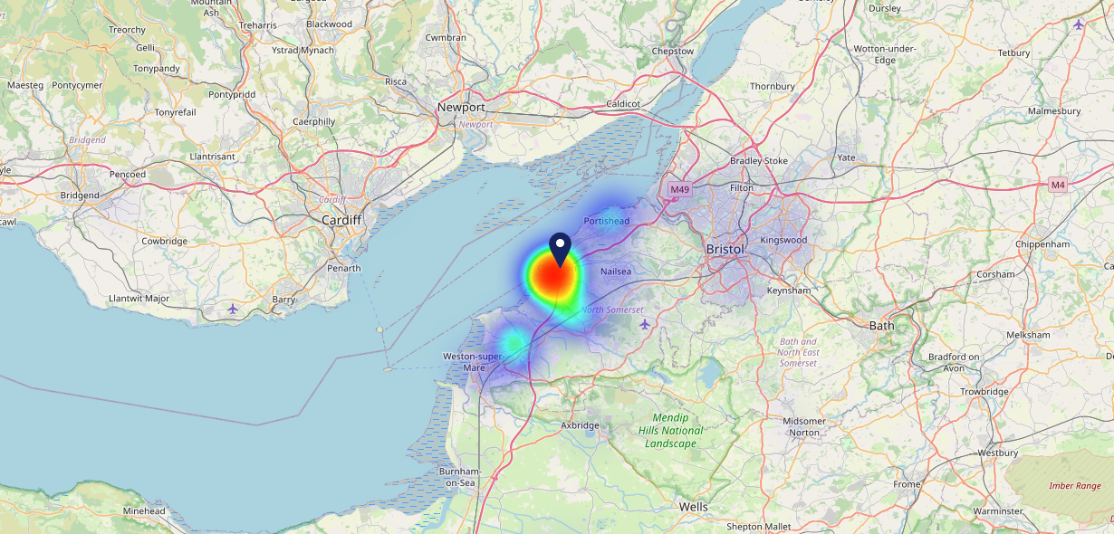
Site Intel
Old Wheatsheaf EN26SE
1 Miles
97 Chains
06/09/2023 - 28/08/2024
Site Summary
Old Wheatsheaf EN26SE
Work Area
Region
TV Region
Urbanicity
London
London
London
Urban major conurbation
EN26SE
Punch T&L
Top Competitors
ATV
Gender
Kings Head Hotel
#1
£12.39
71.99%
Male
EN26LL
Pub / Bar
Affluence
Segmentation
Cricketers
#2
51.65%
27.41%
Middle Income
Flourishing Society
EN26QA
McMullens
Age Group
Visit Day
Crown & Horseshoes (Enfield)
#3
29.90%
27.46%
EN26PZ
35 to 44
Sat
GK - Pub & Kitchen
Nearest Station
Enfield Chase(0.09 miles)
1030 Site Customers
27 Competitors
19047 Competitor Customers

Slide 2
Site Intel
Old Wheatsheaf EN26SE
1 Miles
97 Chains
06/09/2023 - 28/08/2024
Spend by Weekpart
How is customer spend distributed throughout the week for Old Wheatsheaf EN26SE versus its competitors?
% of spend for Old Wheatsheaf EN26SE and 97 Chains in 1 Miles from 06/09/2023 - 28/08/2024 split by Day of Week
1030 Site Customers
27 Competitors
19047 Competitor Customers

Slide 3
Site Intel
Old Wheatsheaf EN26SE
1 Miles
97 Chains
06/09/2023 - 28/08/2024
Visit Frequency
How frequently per year do customers visit Old Wheatsheaf EN26SE versus its competitors?
% of customer numbers for Old Wheatsheaf EN26SE and 97 Chains in 1 Miles from 06/09/2023 - 28/08/2024 and the number of visits made Per Annum
1030 Site Customers
27 Competitors
19047 Competitor Customers

Slide 4
Site Intel
Old Wheatsheaf EN26SE
1 Miles
97 Chains
06/09/2023 - 28/08/2024
ATV Change
How has ATV changed between two date ranges?
1030 Site Customers

Slide 5
Site Intel
Old Wheatsheaf EN26SE
1 Miles
97 Chains
06/09/2023 - 28/08/2024
Market Share Change
How has market share changed between two date ranges?
% of market share spend for Old Wheatsheaf EN26SE and 97 Chains in 1 Miles from 06/09/2023 - 28/08/2024
1030 Site Customers

Slide 6
Site Intel
Old Wheatsheaf EN26SE
1 Miles
97 Chains
06/09/2023 - 28/08/2024
Age
How does the age profile of customers who visit Old Wheatsheaf EN26SE compare versus its competitors?
% of spend for Old Wheatsheaf EN26SE and 97 Chains in 1 Miles from 06/09/2023 - 28/08/2024 split by Age Range
481 Site Customers
27 Competitors
8702 Competitor Customers

Slide 7
Site Intel
Old Wheatsheaf EN26SE
1 Miles
97 Chains
06/09/2023 - 28/08/2024
Affluence
How does the affluence of customers who visit Old Wheatsheaf EN26SE compare versus its competitors?
% of spend for Old Wheatsheaf EN26SE and 97 Chains in 1 Miles from 06/09/2023 - 28/08/2024 split by Affluence
481 Site Customers
27 Competitors
8771 Competitor Customers

Slide 8
Site Intel
Old Wheatsheaf EN26SE
1 Miles
97 Chains
06/09/2023 - 28/08/2024
Gender
How does the gender profile of customers who visit Old Wheatsheaf EN26SE compare versus its competitors?
% of spend for Old Wheatsheaf EN26SE and 97 Chains in 1 Miles from 06/09/2023 - 28/08/2024 split by Gender
481 Site Customers
27 Competitors
8771 Competitor Customers

Slide 9
Site Intel
Old Wheatsheaf EN26SE
1 Miles
97 Chains
06/09/2023 - 28/08/2024
Punch Segmentation
How does the Custom segmentation profile of customers who visit Old Wheatsheaf EN26SE compare versus its competitors?
% of spend for Old Wheatsheaf EN26SE and 97 Chains in 1 Miles from 06/09/2023 - 28/08/2024 split by Segment
1030 Site Customers
27 Competitors
19047 Competitor Customers

Slide 10
Site Intel
Old Wheatsheaf EN26SE
1 Miles
97 Chains
06/09/2023 - 28/08/2024
Spend by Distance
How does the spend profile of Old Wheatsheaf EN26SE compare versus its competitors based on travel distances?
% of spend for Old Wheatsheaf EN26SE and 97 Chains in 1 Miles from 06/09/2023 - 28/08/2024 split by Distance travelled
462 Site Customers
27 Competitors
8465 Competitor Customers

Slide 11
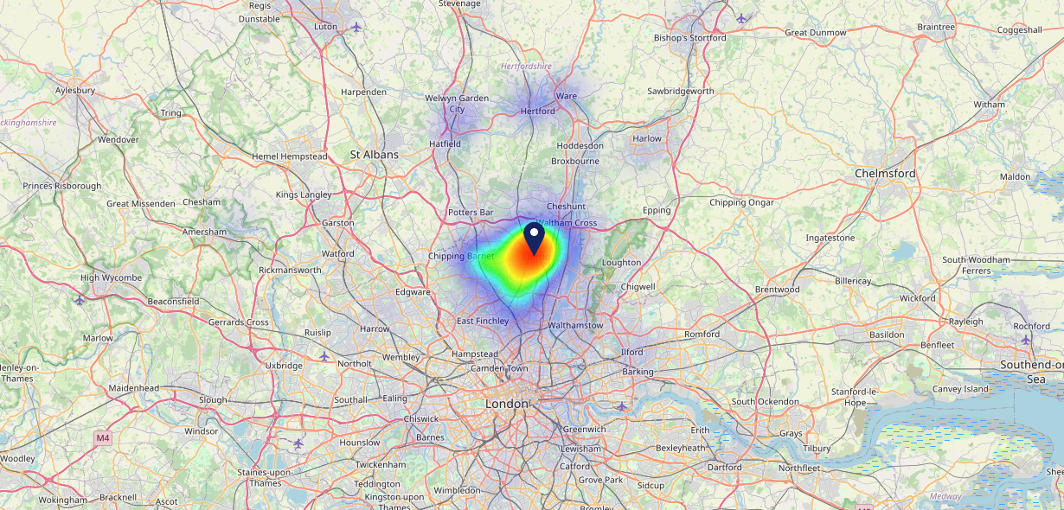
Site Intel
Old Wheatsheaf EN26SE
06/09/2023 - 28/08/2024
Map of Guest Origin
Where do customers of Old Wheatsheaf EN26SE come from?
Where do customers of Old Wheatsheaf EN26SE for 06/09/2023 - 28/08/2024 live
462 Site Customers

Slide 12
Site Intel
Old Wheatsheaf EN26SE
1 Miles
97 Chains
06/09/2023 - 28/08/2024
Share of Wallet
What are the Top 20 venues (by spend) that customers of Old Wheatsheaf EN26SE also visit?
For customers of Old Wheatsheaf EN26SE, who are the top 20 competitors from 97 Chains in 1 Miles for 06/09/2023 - 28/08/2024 split by Venue
1030 Site Customers

Slide 13
Site Intel
Old Wheatsheaf EN26SE
1 Miles
97 Chains
06/09/2023 - 28/08/2024
Share of Wallet Change
How has share of wallet of customers of Old Wheatsheaf EN26SE changed between two date ranges?
1030 Site Customers

Slide 14
Site Intel
Old Wheatsheaf EN26SE
06/09/2023 - 28/08/2024
Market Summary
How does the local area for Old Wheatsheaf EN26SE compare to the national average (1 = low, 10 = high)
Data Type | Name | Spend in 250m | 250m Spend vs National | Spend in 500m | 500m Spend vs National | Spend in 1 mile | 1 mile Spend vs National | Spend in 3 miles | 3 mile Spend vs National
Total | Annual Sales | £1.39M | 5 | £10.39M | 7 | £30.48M | 7 | £170.59M | 8
Weekpart | Mon - Thu | 42.2% | 7 | 43.5% | 7 | 42.9% | 7 | 42.7% | 7
Weekpart | Fri - Sat | 44.9% | 6 | 41.7% | 4 | 41.3% | 4 | 40.0% | 3
Weekpart | Sun | 12.8% | 4 | 14.8% | 5 | 15.8% | 7 | 17.4% | 9
Age | 18 to 24 | 3.6% | 3 | 8.3% | 7 | 6.3% | 5 | 6.1% | 4
Age | 25 to 34 | 9.8% | 1 | 14.0% | 2 | 12.1% | 1 | 14.0% | 1
Age | 35 to 44 | 20.7% | 4 | 25.5% | 7 | 23.6% | 6 | 26.1% | 8
Age | 45 to 54 | 19.5% | 5 | 22.3% | 8 | 22.8% | 9 | 22.3% | 9
Age | 55 to 64 | 21.3% | 9 | 17.9% | 7 | 19.3% | 8 | 18.2% | 8
Age | 65 to 74 | 12.3% | 9 | 7.2% | 6 | 9.7% | 8 | 8.7% | 8
Age | 75+ | 12.9% | 10 | 4.8% | 9 | 6.1% | 9 | 4.5% | 8
CAMEO | Business Elite | 11.6% | 8 | 9.1% | 7 | 10.1% | 7 | 12.9% | 8
CAMEO | Prosperous Professionals | 4.0% | 4 | 3.1% | 3 | 2.8% | 2 | 2.5% | 1
CAMEO | Flourishing Society | 26.2% | 10 | 21.8% | 9 | 21.4% | 9 | 17.0% | 8
CAMEO | Content Communities | 9.1% | 3 | 9.3% | 3 | 9.3% | 2 | 11.0% | 3
CAMEO | White Collar Neighbourhoods | 17.8% | 10 | 15.6% | 9 | 15.4% | 9 | 12.2% | 6
CAMEO | Enterprising Mainstream | 2.9% | 1 | 3.7% | 2 | 3.6% | 1 | 3.7% | 1
CAMEO | Paying The Mortgage | 15.5% | 6 | 19.6% | 9 | 20.5% | 9 | 19.5% | 9
CAMEO | Cash Conscious Communities | 6.1% | 3 | 8.1% | 5 | 7.8% | 4 | 10.2% | 6
CAMEO | On A Budget | 6.2% | 5 | 8.6% | 7 | 7.9% | 7 | 9.7% | 9
CAMEO | Family Value | 0.4% | 2 | 1.1% | 3 | 1.2% | 3 | 1.4% | 4
Affluence | AB | 41.9% | 8 | 34.0% | 7 | 34.3% | 7 | 32.4% | 6
Affluence | C1C2 | 45.4% | 4 | 48.2% | 5 | 48.8% | 6 | 46.3% | 4
Affluence | DE | 12.7% | 3 | 17.8% | 5 | 16.9% | 4 | 21.3% | 6

Slide 15
Site Intel
Old Wheatsheaf EN26SE
Local Market Profile
Mix of spend by customer segment in Punch site and local market
 | Customer Count | Family Familiar | Occasional & Local | Mid-Week Seniors | Part Of The Pub | Metro Sophisticates | Young & Connected | Bubbly Weekenders | Upmarket Diners
Old Wheatsheaf | 227 | 8.39% | 1.15% | 9.98% | 6.78% | 23.60% | 13.95% | 6.65% | 29.44%
Local Catchment | 1636 | 9.37% | 6.56% | 12.43% | 19.77% | 13.57% | 14.43% | 7.90% | 15.92%
Punch T&L | 103132 | 8.32% | 5.96% | 29.09% | 10.93% | 11.57% | 11.74% | 7.07% | 15.28%
Old Wheatsheaf vs Local Catchment |  | -0.98% | -5.41% | -2.45% | -12.99% | 10.03% | -0.48% | -1.25% | 13.52%
Old Wheatsheaf vs Punch T&L |  | 0.07% | -4.81% | -19.11% | -4.15% | 12.03% | 2.21% | -0.42% | 14.16%
Local Catchment vs Punch T&L |  | 1.05% | 0.60% | -16.66% | 8.84% | 2.00% | 2.69% | 0.83% | 0.64%

Slide 16
Site Intel
Old Wheatsheaf EN26SE
Local Competitor Profiles
Mix of spend by customer segment in Punch site and local competitors
 | Customer Count | Family Familiar | Occasional & Local | Mid-Week Seniors | Part Of The Pub | Metro Sophisticates | Young & Connected | Bubbly Weekenders | Upmarket Diners
Old Wheatsheaf EN26SE | 227 | 8.39% | 1.15% | 9.98% | 6.78% | 23.60% | 13.95% | 6.65% | 29.44%
Kings Head Hotel EN26LL | 427 | 9.72% | 6.27% | 7.50% | 13.43% | 19.08% | 21.03% | 14.53% | 8.42%
Cricketers EN26QA | 274 | 6.98% | 2.05% | 9.86% | 23.84% | 10.87% | 8.44% | 6.23% | 31.69%
Crown & Horseshoes (Enfield) EN26PZ | 298 | 9.84% | 1.14% | 4.25% | 27.46% | 9.12% | 19.91% | 7.14% | 21.09%
The Moon Under Water EN26NN | 333 | 12.44% | 4.43% | 10.23% | 39.23% | 5.30% | 21.11% | 3.55% | 3.66%
The Wonder EN20JG | 152 | 2.02% | 3.53% | 9.74% | 21.14% | 33.95% | 12.07% | 6.60% | 10.91%
Jolly Butchers EN13JS | 122 | 7.03% | 4.77% | 7.98% | 32.66% | 9.83% | 25.20% | 5.71% | 6.78%
Jolly Farmers EN27QS | 344 | 11.69% | 5.61% | 15.36% | 6.56% | 16.24% | 5.87% | 5.21% | 33.43%
Stag EN26PH | 74 | 12.13% | 8.84% | 7.04% | 6.95% | 11.13% | 32.24% | 12.93% | 8.71%
The Ridgeway Tavern EN28JF | 201 | 11.12% | 16.03% | 30.44% | 14.91% | 5.57% | 7.07% | 5.34% | 9.47%
Hop Poles EN13LH | 90 | 5.36% | 6.35% | 1.44% | 12.17% | 47.87% | 11.24% | 5.35% | 10.18%
The Gryphon N211RE | 235 | 8.14% | 15.87% | 22.62% | 16.85% | 11.10% | 5.80% | 5.16% | 14.43%
ONeills Enfield EN26LE | 277 | 9.66% | 5.41% | 4.88% | 9.64% | 10.09% | 35.92% | 17.28% | 7.08%
Taps Irish Bar EN13EF | 107 | 3.16% | 2.34% | 4.72% | 20.20% | 17.14% | 32.50% | 9.60% | 10.30%
Enfield Town Conservative Club EN26PR | 18 | 32.18% | 0.47% | 12.25% | 17.37% | 11.84% | 7.40% | 0.30% | 18.16%
Holtwhites Sports & Social Club EN20RN | 39 | 31.81% | 0.52% | 2.17% | 2.69% | 5.25% | 7.43% | 9.41% | 40.69%
Arda Ocakbasi Bar EN13TN | 34 | 24.67% | 0.00% | 13.53% | 15.39% | 8.94% | 17.78% | 15.60% | 4.05%
Grill On The Hill EN27AE | 37 | 6.31% | 17.83% | 33.88% | 0.00% | 3.68% | 2.45% | 6.56% | 29.26%
Six Bells Hotel EN20PT | 24 | 3.77% | 0.34% | 0.57% | 82.85% | 5.77% | 6.29% | 0.37% | 0.00%
North Enfield Conservative Club EN13LD | 13 | 0.00% | 6.57% | 52.41% | 0.00% | 17.64% | 0.00% | 5.03% | 18.33%
Misty Bar EN13ED | 17 | 12.65% | 0.00% | 18.07% | 0.00% | 9.37% | 4.33% | 55.55% | 0.00%
Babylon Bar Lounge EN12AA | 18 | 6.54% | 0.00% | 0.00% | 0.00% | 3.15% | 16.24% | 74.05% | 0.00%
Starlight Lounge EN20JN | 2 | 0.00% | 0.00% | 38.88% | 61.11% | 0.00% | 0.00% | 0.00% | 0.00%

