Slide 1
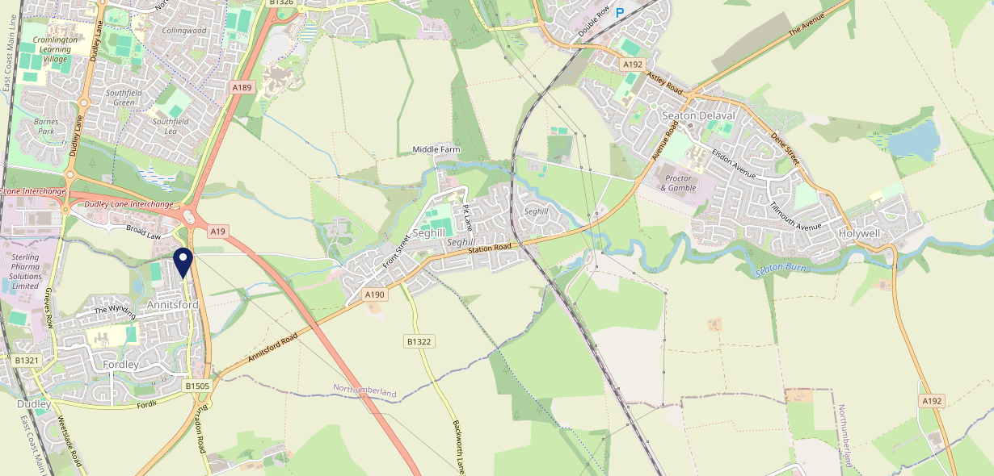
Site Intel
Bridge Inn NE237QS
1 Miles
97 Chains
23/08/2023 - 14/08/2024
Site Summary
Bridge Inn NE237QS
Work Area
Region
TV Region
Urbanicity
Newcastle
North East
Tyne Tees
Urban major conurbation
NE237QS
Punch - Mighty Local
Top Competitors
ATV
Gender
Clayton Arms
#1
£8.36
79.80%
Male
NE237PX
Punch T&L
Affluence
Segmentation
Pioneer
#2
51.35%
34.09%
Low Income
Enterprising Mainstream
NE237BE
Pub / Bar
Age Group
Visit Day
Pioneer Social
#3
52.93%
25.46%
NE237UD
45 to 54
Sat
Pub / Bar
Nearest Station
Cramlington(3.14 miles)
151 Site Customers
8 Competitors
545 Competitor Customers

Slide 2
Site Intel
Bridge Inn NE237QS
1 Miles
97 Chains
23/08/2023 - 14/08/2024
Spend by Weekpart
How is customer spend distributed throughout the week for Bridge Inn NE237QS versus its competitors?
% of spend for Bridge Inn NE237QS and 97 Chains in 1 Miles from 23/08/2023 - 14/08/2024 split by Day of Week
151 Site Customers
8 Competitors
545 Competitor Customers

Slide 3
Site Intel
Bridge Inn NE237QS
1 Miles
97 Chains
23/08/2023 - 14/08/2024
Visit Frequency
How frequently per year do customers visit Bridge Inn NE237QS versus its competitors?
% of customer numbers for Bridge Inn NE237QS and 97 Chains in 1 Miles from 23/08/2023 - 14/08/2024 and the number of visits made Per Annum
151 Site Customers
8 Competitors
545 Competitor Customers

Slide 4
Site Intel
Bridge Inn NE237QS
1 Miles
97 Chains
23/08/2023 - 14/08/2024
ATV Change
How has ATV changed between two date ranges?
151 Site Customers

Slide 5
Site Intel
Bridge Inn NE237QS
1 Miles
97 Chains
23/08/2023 - 14/08/2024
Market Share Change
How has market share changed between two date ranges?
% of market share spend for Bridge Inn NE237QS and 97 Chains in 1 Miles from 23/08/2023 - 14/08/2024
151 Site Customers

Slide 6
Site Intel
Bridge Inn NE237QS
1 Miles
97 Chains
23/08/2023 - 14/08/2024
Age
How does the age profile of customers who visit Bridge Inn NE237QS compare versus its competitors?
% of spend for Bridge Inn NE237QS and 97 Chains in 1 Miles from 23/08/2023 - 14/08/2024 split by Age Range
64 Site Customers
8 Competitors
224 Competitor Customers

Slide 7
Site Intel
Bridge Inn NE237QS
1 Miles
97 Chains
23/08/2023 - 14/08/2024
Affluence
How does the affluence of customers who visit Bridge Inn NE237QS compare versus its competitors?
% of spend for Bridge Inn NE237QS and 97 Chains in 1 Miles from 23/08/2023 - 14/08/2024 split by Affluence
67 Site Customers
8 Competitors
227 Competitor Customers

Slide 8
Site Intel
Bridge Inn NE237QS
1 Miles
97 Chains
23/08/2023 - 14/08/2024
Gender
How does the gender profile of customers who visit Bridge Inn NE237QS compare versus its competitors?
% of spend for Bridge Inn NE237QS and 97 Chains in 1 Miles from 23/08/2023 - 14/08/2024 split by Gender
67 Site Customers
8 Competitors
227 Competitor Customers

Slide 9
Site Intel
Bridge Inn NE237QS
1 Miles
97 Chains
23/08/2023 - 14/08/2024
Punch Segmentation
How does the Custom segmentation profile of customers who visit Bridge Inn NE237QS compare versus its competitors?
% of spend for Bridge Inn NE237QS and 97 Chains in 1 Miles from 23/08/2023 - 14/08/2024 split by Segment
151 Site Customers
8 Competitors
545 Competitor Customers

Slide 10
Site Intel
Bridge Inn NE237QS
1 Miles
97 Chains
23/08/2023 - 14/08/2024
Spend by Distance
How does the spend profile of Bridge Inn NE237QS compare versus its competitors based on travel distances?
% of spend for Bridge Inn NE237QS and 97 Chains in 1 Miles from 23/08/2023 - 14/08/2024 split by Distance travelled
65 Site Customers
8 Competitors
217 Competitor Customers

Slide 11
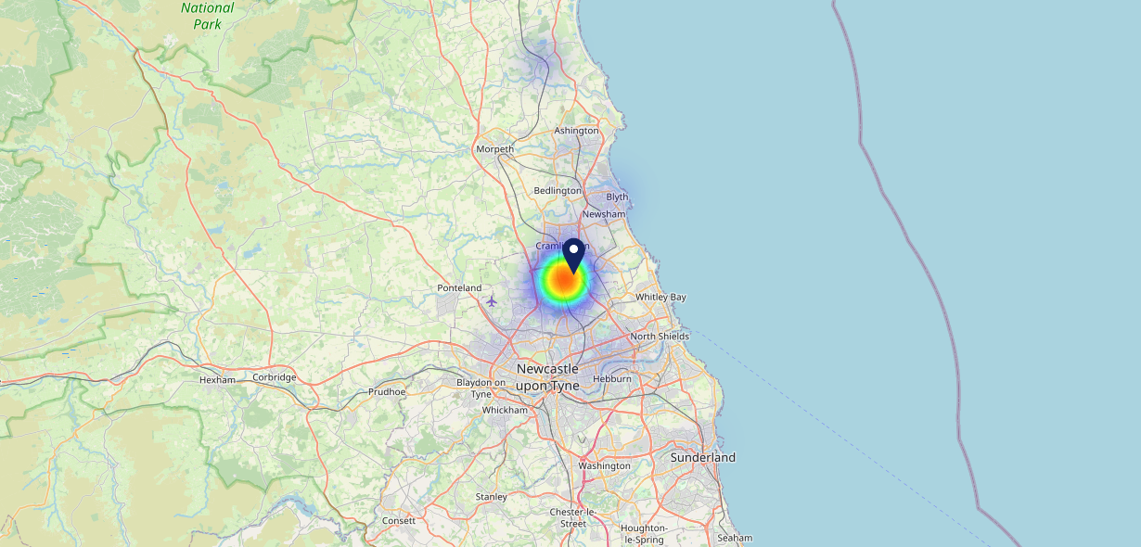
Site Intel
Bridge Inn NE237QS
23/08/2023 - 14/08/2024
Map of Guest Origin
Where do customers of Bridge Inn NE237QS come from?
Where do customers of Bridge Inn NE237QS for 23/08/2023 - 14/08/2024 live
65 Site Customers

Slide 12
Site Intel
Bridge Inn NE237QS
1 Miles
97 Chains
23/08/2023 - 14/08/2024
Share of Wallet
What are the Top 20 venues (by spend) that customers of Bridge Inn NE237QS also visit?
For customers of Bridge Inn NE237QS, who are the top 20 competitors from 97 Chains in 1 Miles for 23/08/2023 - 14/08/2024 split by Venue
151 Site Customers

Slide 13
Site Intel
Bridge Inn NE237QS
1 Miles
97 Chains
23/08/2023 - 14/08/2024
Share of Wallet Change
How has share of wallet of customers of Bridge Inn NE237QS changed between two date ranges?
151 Site Customers

Slide 14
Site Intel
Bridge Inn NE237QS
23/08/2023 - 14/08/2024
Market Summary
How does the local area for Bridge Inn NE237QS compare to the national average (1 = low, 10 = high)
Data Type | Name | Spend in 250m | 250m Spend vs National | Spend in 500m | 500m Spend vs National | Spend in 1 mile | 1 mile Spend vs National | Spend in 3 miles | 3 mile Spend vs National
Total | Annual Sales | £415K | 3 | £4.11M | 6 | £5.66M | 3 | £49.61M | 5
Weekpart | Mon - Thu | 45.2% | 8 | 48.2% | 9 | 46.8% | 9 | 46.3% | 9
Weekpart | Fri - Sat | 41.4% | 4 | 35.9% | 1 | 35.5% | 1 | 37.6% | 1
Weekpart | Sun | 13.5% | 4 | 15.9% | 7 | 17.7% | 9 | 16.0% | 7
Age | 18 to 24 | 2.4% | 2 | 7.0% | 6 | 6.3% | 5 | 5.9% | 4
Age | 25 to 34 | 9.3% | 1 | 18.3% | 4 | 15.9% | 2 | 15.3% | 2
Age | 35 to 44 | 14.0% | 1 | 29.4% | 9 | 27.7% | 9 | 28.0% | 10
Age | 45 to 54 | 30.8% | 10 | 22.1% | 7 | 22.7% | 8 | 23.1% | 9
Age | 55 to 64 | 31.5% | 10 | 16.4% | 6 | 17.1% | 7 | 16.3% | 7
Age | 65 to 74 | 10.6% | 8 | 5.5% | 4 | 7.9% | 7 | 8.4% | 8
Age | 75+ | 1.5% | 4 | 1.3% | 3 | 2.4% | 5 | 2.9% | 6
CAMEO | Business Elite | 1.0% | 1 | 2.4% | 2 | 1.9% | 1 | 2.3% | 1
CAMEO | Prosperous Professionals | 1.5% | 1 | 2.4% | 2 | 2.0% | 1 | 3.1% | 2
CAMEO | Flourishing Society | 5.6% | 2 | 5.8% | 2 | 5.3% | 1 | 8.0% | 2
CAMEO | Content Communities | 4.6% | 1 | 10.1% | 3 | 8.9% | 2 | 9.4% | 2
CAMEO | White Collar Neighbourhoods | 7.1% | 2 | 8.4% | 3 | 8.4% | 2 | 11.4% | 5
CAMEO | Enterprising Mainstream | 14.3% | 9 | 9.5% | 7 | 9.9% | 7 | 8.6% | 6
CAMEO | Paying The Mortgage | 11.6% | 4 | 17.4% | 8 | 19.6% | 9 | 19.0% | 9
CAMEO | Cash Conscious Communities | 14.8% | 9 | 14.3% | 9 | 14.2% | 9 | 14.8% | 10
CAMEO | On A Budget | 8.6% | 7 | 5.7% | 5 | 5.6% | 4 | 5.7% | 4
CAMEO | Family Value | 30.9% | 10 | 23.9% | 10 | 24.2% | 10 | 17.8% | 10
Affluence | AB | 8.1% | 1 | 10.6% | 2 | 9.2% | 1 | 13.4% | 2
Affluence | C1C2 | 37.6% | 2 | 45.5% | 4 | 46.8% | 5 | 48.3% | 5
Affluence | DE | 54.3% | 10 | 43.9% | 10 | 44.0% | 10 | 38.3% | 10

Slide 15
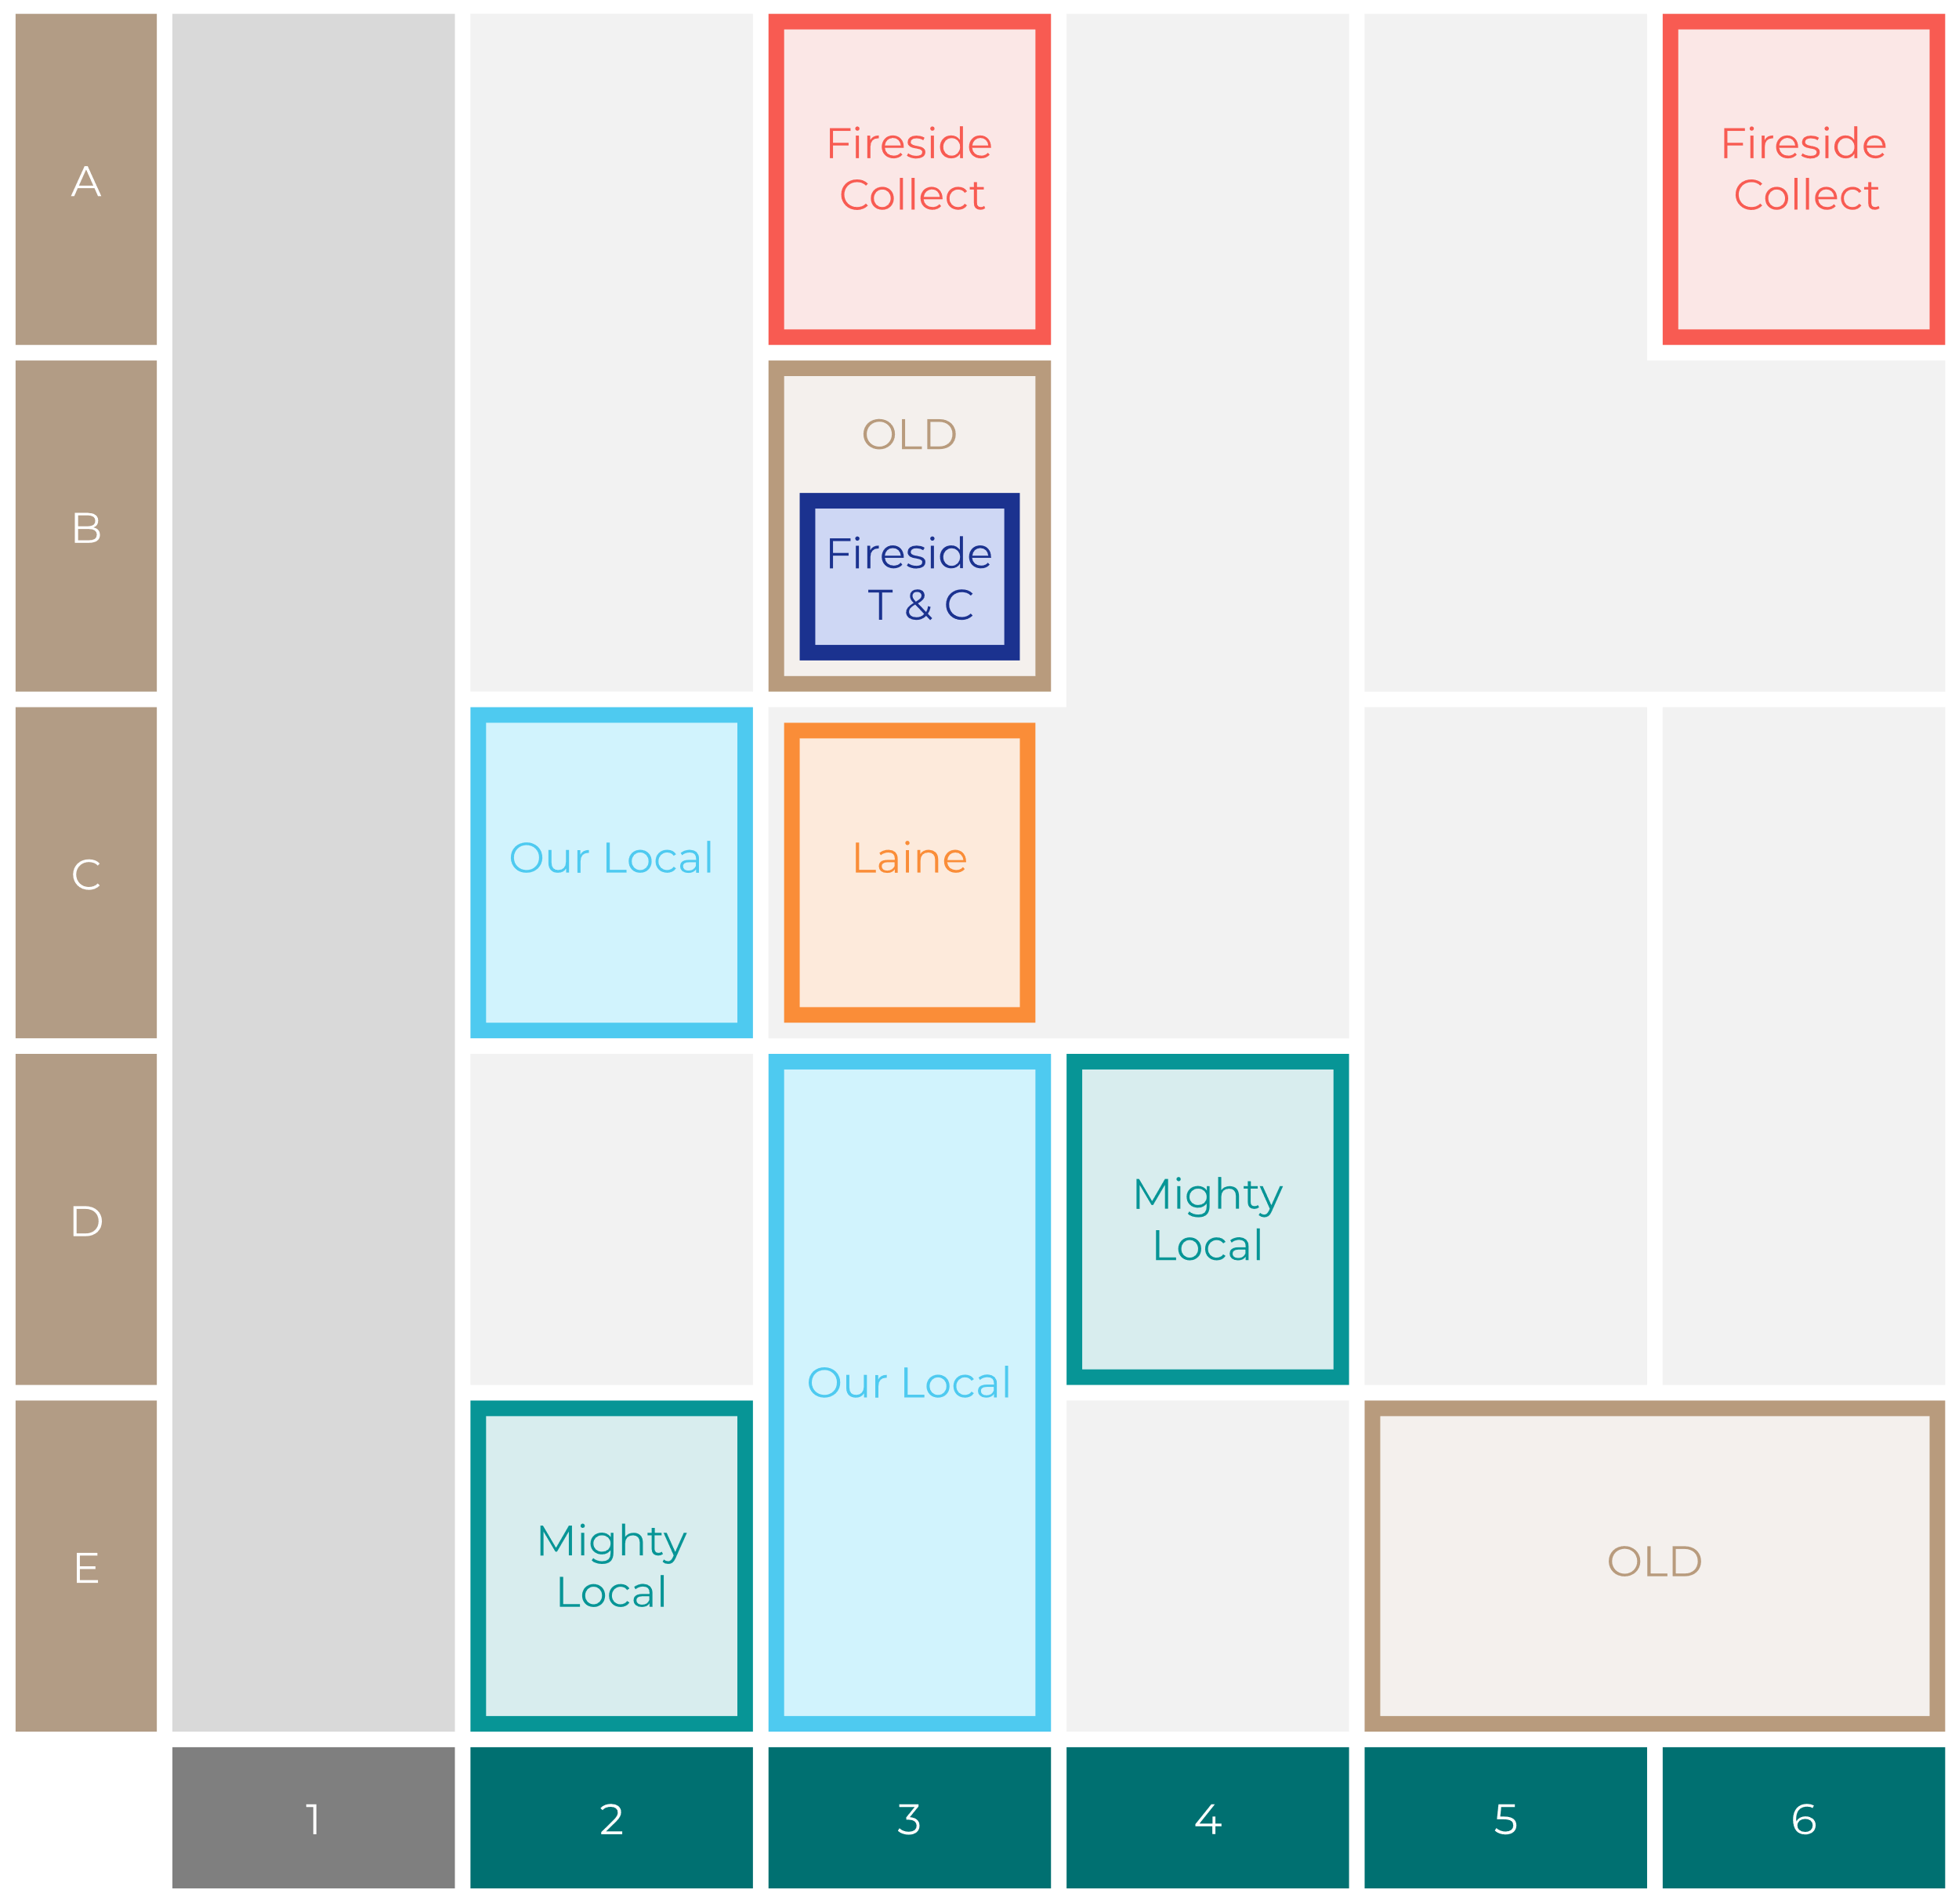
Site Intel
Bridge Inn NE237QS
Site Potential 1
Site Characteristics
£3000
£18000
OCC Concept Fit
Achievable Average Weekly Takings
Mighty Local
£8500
A Food-Led High Affluence B Food-Led Mid Affluence C Wet-Led Mid/High Affluence D Wet-Led Low Affluence E Food-Led Low Affluence
AWT 2 Local Regulars 3 Local Passing Trade 4 Destination Wet-Led 5 Destination Food-Led 6 Destination Very Food-Led
A
B
C
D
E
1
2
3
4
5
6

Slide 16
Site Intel
Bridge Inn NE237QS
Site Potential 2
Concept Recommendation

Slide 17
Site Intel
Bridge Inn NE237QS
Local Market Profile
Mix of spend by customer segment in Punch site and local market
 | Customer Count | Family Familiar | Occasional & Local | Mid-Week Seniors | Part Of The Pub | Metro Sophisticates | Young & Connected | Bubbly Weekenders | Upmarket Diners
Bridge Inn | 32 | 8.88% | 11.99% | 5.27% | 59.84% | 0.23% | 5.04% | 8.71% | 0.00%
Local Catchment | 94 | 18.44% | 2.71% | 32.62% | 12.58% | 4.16% | 16.99% | 10.08% | 2.38%
Punch T&L | 103835 | 8.28% | 5.94% | 29.09% | 10.91% | 11.60% | 11.76% | 7.09% | 15.30%
Bridge Inn vs Local Catchment |  | -9.56% | 9.28% | -27.35% | 47.26% | -3.93% | -11.95% | -1.37% | 0.00%
Bridge Inn vs Punch T&L |  | 0.60% | 6.05% | -23.82% | 48.93% | -11.37% | -6.72% | 1.62% | 0.00%
Local Catchment vs Punch T&L |  | 10.16% | -3.23% | 3.53% | 1.67% | -7.44% | 5.23% | 2.99% | -12.92%

Slide 18
Site Intel
Bridge Inn NE237QS
Local Competitor Profiles
Mix of spend by customer segment in Punch site and local competitors
 | Customer Count | Family Familiar | Occasional & Local | Mid-Week Seniors | Part Of The Pub | Metro Sophisticates | Young & Connected | Bubbly Weekenders | Upmarket Diners
Bridge Inn NE237QS | 32 | 8.88% | 11.99% | 5.27% | 59.84% | 0.23% | 5.04% | 8.71% | 0.00%
Clayton Arms NE237PX | 37 | 16.58% | 2.47% | 47.68% | 15.36% | 3.08% | 5.24% | 6.29% | 3.25%
Pioneer NE237BE | 12 | 6.64% | 18.47% | 4.52% | 14.04% | 12.58% | 8.34% | 35.39% | 0.00%
Pioneer Social NE237UD | 6 | 68.83% | 25.11% | 0.00% | 6.04% | 0.00% | 0.00% | 0.00% | 0.00%
Benedictine Social Club NE236YA | 25 | 17.34% | 0.64% | 2.32% | 3.49% | 4.09% | 53.39% | 17.85% | 0.85%

