Slide 1
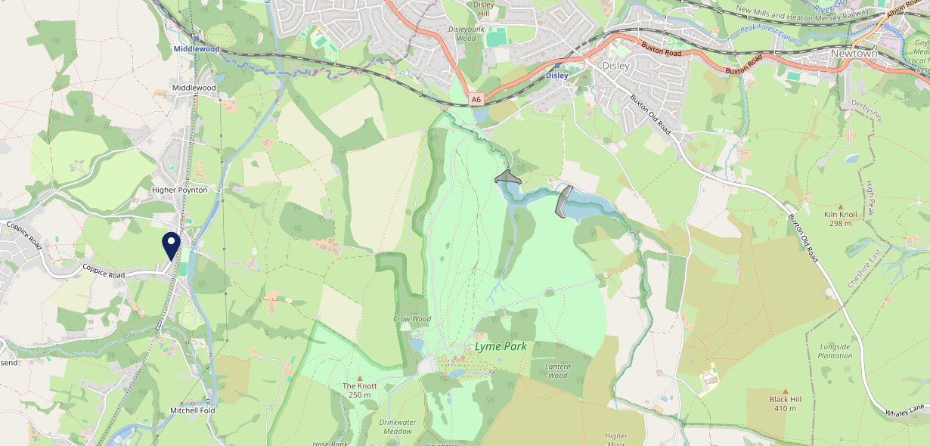
Site Intel
Boars Head SK121TE
3 Miles
97 Chains
06/09/2023 - 28/08/2024
Site Summary
Boars Head SK121TE
Work Area
Region
TV Region
Urbanicity
Manchester
North West
North West
Urban city and town
SK121TE
Punch - Our Local +
Top Competitors
ATV
Gender
Flute & Firkin
#1
£15.29
68.28%
Male
SK121RD
Pub / Bar
Affluence
Segmentation
The Kingfisher
#2
51.53%
20.03%
Middle Income
Business Elite
SK121NJ
JD Wetherspoon
Age Group
Visit Day
Farmers Arms (Poynton)
#3
25.33%
25.74%
SK121RE
55 to 64
Sun
Pub Restaurant
Nearest Station
Middlewood(1.68 miles)
2744 Site Customers
56 Competitors
68475 Competitor Customers

Slide 2
Site Intel
Boars Head SK121TE
3 Miles
97 Chains
06/09/2023 - 28/08/2024
Spend by Weekpart
How is customer spend distributed throughout the week for Boars Head SK121TE versus its competitors?
% of spend for Boars Head SK121TE and 97 Chains in 3 Miles from 06/09/2023 - 28/08/2024 split by Day of Week
2744 Site Customers
56 Competitors
68475 Competitor Customers

Slide 3
Site Intel
Boars Head SK121TE
3 Miles
97 Chains
06/09/2023 - 28/08/2024
Visit Frequency
How frequently per year do customers visit Boars Head SK121TE versus its competitors?
% of customer numbers for Boars Head SK121TE and 97 Chains in 3 Miles from 06/09/2023 - 28/08/2024 and the number of visits made Per Annum
2744 Site Customers
56 Competitors
68475 Competitor Customers

Slide 4
Site Intel
Boars Head SK121TE
3 Miles
97 Chains
06/09/2023 - 28/08/2024
ATV Change
How has ATV changed between two date ranges?
2744 Site Customers

Slide 5
Site Intel
Boars Head SK121TE
3 Miles
97 Chains
06/09/2023 - 28/08/2024
Market Share Change
How has market share changed between two date ranges?
% of market share spend for Boars Head SK121TE and 97 Chains in 3 Miles from 06/09/2023 - 28/08/2024
2744 Site Customers

Slide 6
Site Intel
Boars Head SK121TE
3 Miles
97 Chains
06/09/2023 - 28/08/2024
Age
How does the age profile of customers who visit Boars Head SK121TE compare versus its competitors?
% of spend for Boars Head SK121TE and 97 Chains in 3 Miles from 06/09/2023 - 28/08/2024 split by Age Range
1223 Site Customers
56 Competitors
29294 Competitor Customers

Slide 7
Site Intel
Boars Head SK121TE
3 Miles
97 Chains
06/09/2023 - 28/08/2024
Affluence
How does the affluence of customers who visit Boars Head SK121TE compare versus its competitors?
% of spend for Boars Head SK121TE and 97 Chains in 3 Miles from 06/09/2023 - 28/08/2024 split by Affluence
1229 Site Customers
56 Competitors
29615 Competitor Customers

Slide 8
Site Intel
Boars Head SK121TE
3 Miles
97 Chains
06/09/2023 - 28/08/2024
Gender
How does the gender profile of customers who visit Boars Head SK121TE compare versus its competitors?
% of spend for Boars Head SK121TE and 97 Chains in 3 Miles from 06/09/2023 - 28/08/2024 split by Gender
1229 Site Customers
56 Competitors
29615 Competitor Customers

Slide 9
Site Intel
Boars Head SK121TE
3 Miles
97 Chains
06/09/2023 - 28/08/2024
Punch Segmentation
How does the Custom segmentation profile of customers who visit Boars Head SK121TE compare versus its competitors?
% of spend for Boars Head SK121TE and 97 Chains in 3 Miles from 06/09/2023 - 28/08/2024 split by Segment
2744 Site Customers
56 Competitors
68475 Competitor Customers

Slide 10
Site Intel
Boars Head SK121TE
3 Miles
97 Chains
06/09/2023 - 28/08/2024
Spend by Distance
How does the spend profile of Boars Head SK121TE compare versus its competitors based on travel distances?
% of spend for Boars Head SK121TE and 97 Chains in 3 Miles from 06/09/2023 - 28/08/2024 split by Distance travelled
1198 Site Customers
56 Competitors
28812 Competitor Customers

Slide 11
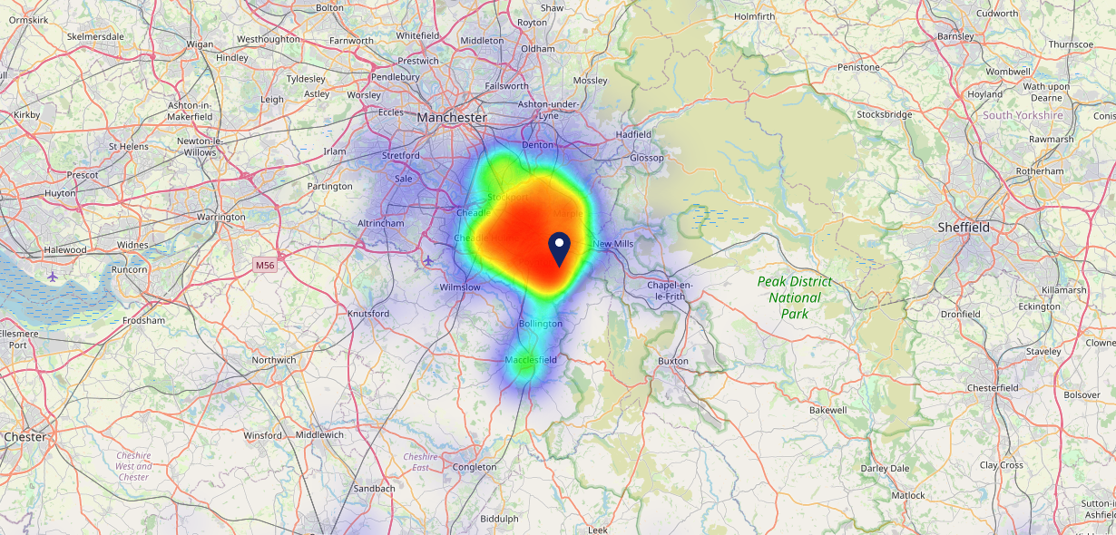
Site Intel
Boars Head SK121TE
06/09/2023 - 28/08/2024
Map of Guest Origin
Where do customers of Boars Head SK121TE come from?
Where do customers of Boars Head SK121TE for 06/09/2023 - 28/08/2024 live
1198 Site Customers

Slide 12
Site Intel
Boars Head SK121TE
3 Miles
97 Chains
06/09/2023 - 28/08/2024
Share of Wallet
What are the Top 20 venues (by spend) that customers of Boars Head SK121TE also visit?
For customers of Boars Head SK121TE, who are the top 20 competitors from 97 Chains in 3 Miles for 06/09/2023 - 28/08/2024 split by Venue
2744 Site Customers

Slide 13
Site Intel
Boars Head SK121TE
3 Miles
97 Chains
06/09/2023 - 28/08/2024
Share of Wallet Change
How has share of wallet of customers of Boars Head SK121TE changed between two date ranges?
2744 Site Customers

Slide 14
Site Intel
Boars Head SK121TE
06/09/2023 - 28/08/2024
Market Summary
How does the local area for Boars Head SK121TE compare to the national average (1 = low, 10 = high)
Data Type | Name | Spend in 250m | 250m Spend vs National | Spend in 500m | 500m Spend vs National | Spend in 1 mile | 1 mile Spend vs National | Spend in 3 miles | 3 mile Spend vs National
Total | Annual Sales | £1.32M | 5 | £1.32M | 4 | £1.32M | 2 | £117.30M | 7
Weekpart | Mon - Thu | 38.9% | 5 | 38.9% | 4 | 38.9% | 3 | 38.1% | 1
Weekpart | Fri - Sat | 35.5% | 2 | 35.5% | 1 | 35.5% | 1 | 43.9% | 8
Weekpart | Sun | 25.6% | 10 | 25.6% | 10 | 25.6% | 10 | 18.0% | 10
Age | 18 to 24 | 1.6% | 2 | 1.6% | 1 | 1.6% | 1 | 5.2% | 3
Age | 25 to 34 | 12.7% | 2 | 12.7% | 2 | 12.7% | 1 | 13.4% | 1
Age | 35 to 44 | 22.2% | 5 | 22.2% | 5 | 22.2% | 4 | 21.7% | 3
Age | 45 to 54 | 17.0% | 3 | 17.0% | 2 | 17.0% | 2 | 19.9% | 5
Age | 55 to 64 | 25.5% | 10 | 25.5% | 10 | 25.5% | 10 | 19.7% | 9
Age | 65 to 74 | 14.7% | 10 | 14.7% | 10 | 14.7% | 10 | 12.1% | 10
Age | 75+ | 6.3% | 9 | 6.3% | 9 | 6.3% | 9 | 8.0% | 10
CAMEO | Business Elite | 19.9% | 9 | 19.9% | 9 | 19.9% | 9 | 11.6% | 8
CAMEO | Prosperous Professionals | 11.7% | 9 | 11.7% | 10 | 11.7% | 10 | 9.1% | 9
CAMEO | Flourishing Society | 7.8% | 3 | 7.8% | 3 | 7.8% | 3 | 8.8% | 3
CAMEO | Content Communities | 16.7% | 9 | 16.7% | 9 | 16.7% | 9 | 17.4% | 10
CAMEO | White Collar Neighbourhoods | 15.1% | 9 | 15.1% | 9 | 15.1% | 9 | 14.9% | 9
CAMEO | Enterprising Mainstream | 7.6% | 5 | 7.6% | 5 | 7.6% | 5 | 8.2% | 5
CAMEO | Paying The Mortgage | 12.3% | 4 | 12.3% | 4 | 12.3% | 4 | 15.1% | 6
CAMEO | Cash Conscious Communities | 4.1% | 2 | 4.1% | 2 | 4.1% | 1 | 7.5% | 4
CAMEO | On A Budget | 2.5% | 2 | 2.5% | 1 | 2.5% | 1 | 4.0% | 2
CAMEO | Family Value | 2.2% | 5 | 2.2% | 5 | 2.2% | 5 | 3.5% | 6
Affluence | AB | 39.4% | 8 | 39.4% | 8 | 39.4% | 8 | 29.5% | 6
Affluence | C1C2 | 51.8% | 7 | 51.8% | 7 | 51.8% | 7 | 55.6% | 9
Affluence | DE | 8.8% | 2 | 8.8% | 1 | 8.8% | 1 | 14.9% | 3

Slide 15
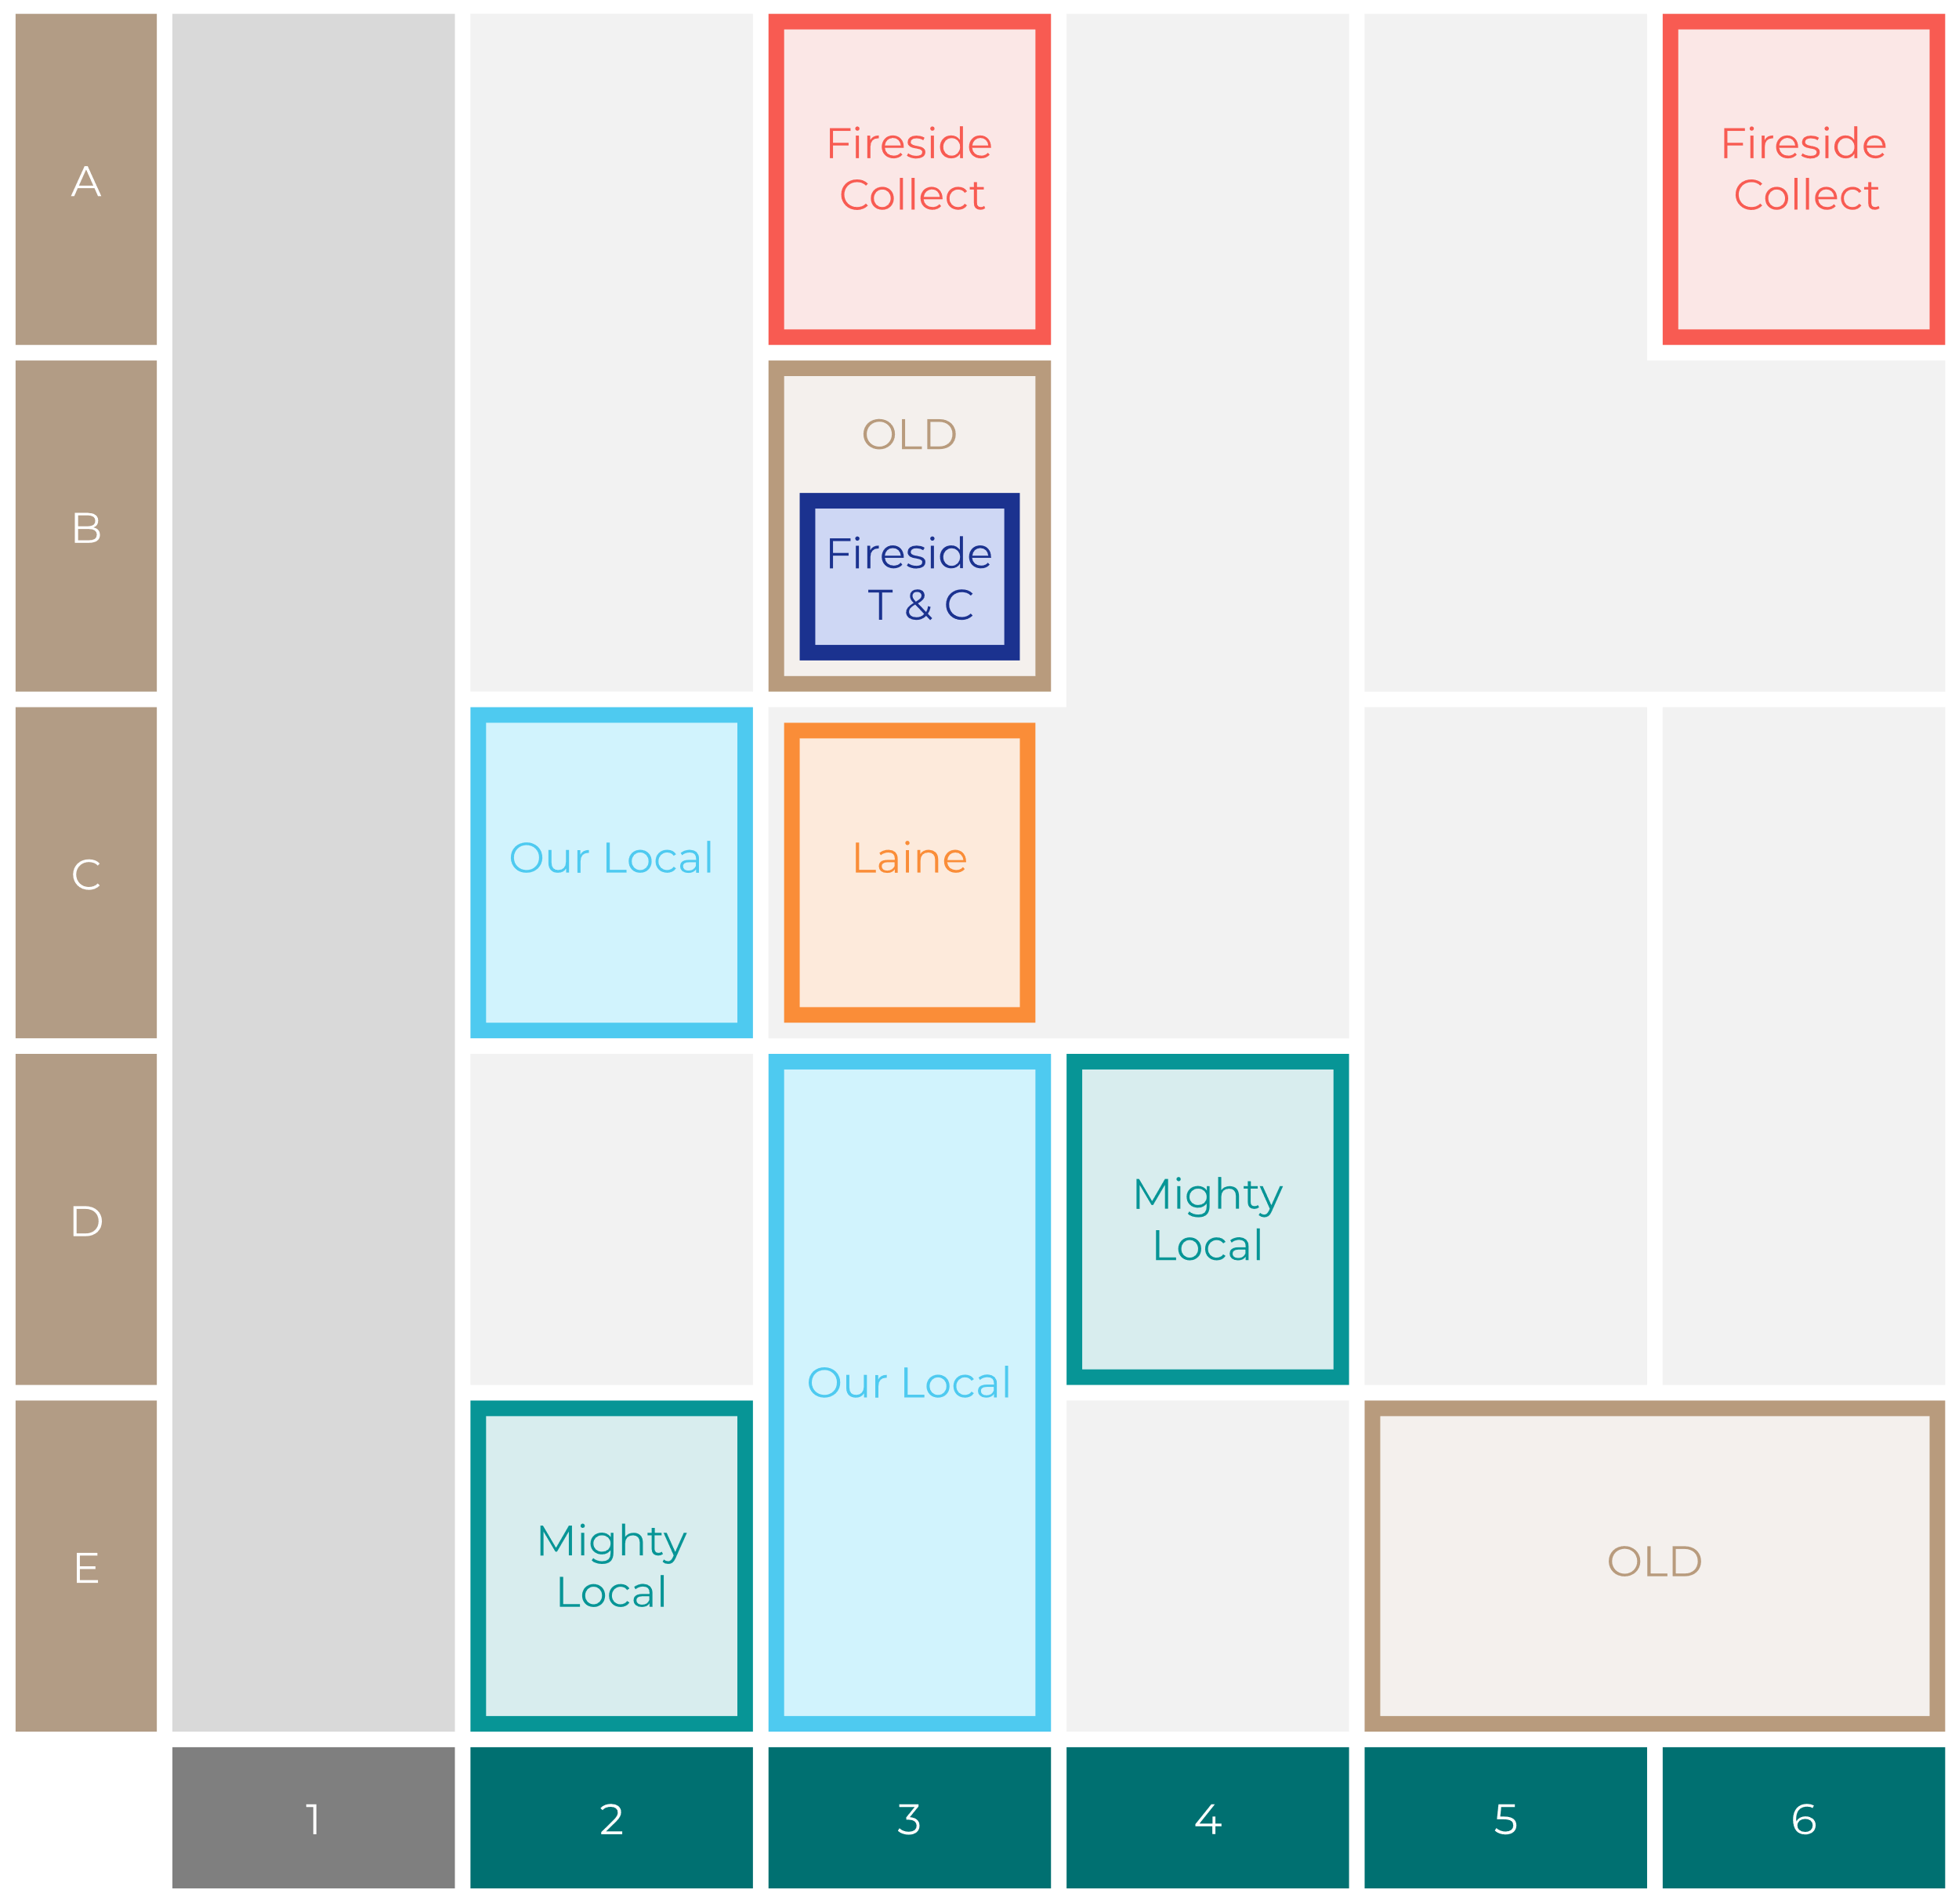
Site Intel
Boars Head SK121TE
Site Potential 1
Site Characteristics
£3000
£18000
OCC Concept Fit
Achievable Average Weekly Takings
Non-Core
£11500
A Food-Led High Affluence B Food-Led Mid Affluence C Wet-Led Mid/High Affluence D Wet-Led Low Affluence E Food-Led Low Affluence
AWT 2 Local Regulars 3 Local Passing Trade 4 Destination Wet-Led 5 Destination Food-Led 6 Destination Very Food-Led
A
B
C
D
E
1
2
3
4
5
6

Slide 16
Site Intel
Boars Head SK121TE
Site Potential 2
Concept Recommendation

Slide 17
Site Intel
Boars Head SK121TE
Local Market Profile
Mix of spend by customer segment in Punch site and local market
 | Customer Count | Family Familiar | Occasional & Local | Mid-Week Seniors | Part Of The Pub | Metro Sophisticates | Young & Connected | Bubbly Weekenders | Upmarket Diners
Boars Head | 508 | 5.80% | 2.56% | 22.79% | 2.79% | 15.99% | 9.47% | 8.00% | 32.57%
Local Catchment | 5569 | 5.27% | 7.36% | 19.46% | 9.97% | 15.53% | 8.88% | 8.97% | 24.53%
Punch T&L | 103230 | 8.34% | 5.96% | 29.07% | 10.93% | 11.57% | 11.74% | 7.08% | 15.27%
Boars Head vs Local Catchment |  | 0.53% | -4.80% | 3.33% | -7.18% | 0.46% | 0.59% | -0.97% | 8.04%
Boars Head vs Punch T&L |  | -2.54% | -3.40% | -6.28% | -8.14% | 4.42% | -2.27% | 0.92% | 17.30%
Local Catchment vs Punch T&L |  | -3.07% | 1.40% | -9.61% | -0.96% | 3.96% | -2.86% | 1.89% | 9.26%

Slide 18
Site Intel
Boars Head SK121TE
Local Competitor Profiles
Mix of spend by customer segment in Punch site and local competitors
 | Customer Count | Family Familiar | Occasional & Local | Mid-Week Seniors | Part Of The Pub | Metro Sophisticates | Young & Connected | Bubbly Weekenders | Upmarket Diners
Boars Head SK121TE | 508 | 5.80% | 2.56% | 22.79% | 2.79% | 15.99% | 9.47% | 8.00% | 32.57%
Flute & Firkin SK121RD | 368 | 2.92% | 1.24% | 34.45% | 13.91% | 13.89% | 4.36% | 6.63% | 22.56%
The Kingfisher SK121NJ | 1086 | 12.96% | 6.68% | 19.55% | 21.48% | 7.18% | 15.65% | 5.36% | 11.09%
Farmers Arms (Poynton) SK121RE | 707 | 3.37% | 5.49% | 15.56% | 2.74% | 19.40% | 8.29% | 12.00% | 33.11%
Vinehop SK121QX | 581 | 3.58% | 1.29% | 11.64% | 2.82% | 25.78% | 6.99% | 10.68% | 37.17%
Cask Tavern SK121RE | 371 | 0.64% | 4.33% | 39.76% | 6.11% | 17.94% | 4.36% | 4.62% | 22.19%
Poynton Working Mens Club SK121RG | 267 | 3.52% | 1.86% | 23.24% | 11.34% | 13.58% | 16.62% | 9.23% | 20.58%
Bulls Head SK68BH | 225 | 1.59% | 1.11% | 42.92% | 8.30% | 14.38% | 4.51% | 3.27% | 23.88%
Acoustic Lounge SK121RE | 543 | 4.14% | 6.45% | 19.41% | 2.71% | 14.42% | 10.80% | 13.74% | 28.28%
Windmill SK105SJ | 495 | 3.14% | 1.23% | 18.48% | 2.32% | 17.22% | 3.63% | 5.24% | 48.71%
Red Lion Hotel SK68ED | 857 | 5.67% | 5.34% | 16.58% | 2.12% | 10.69% | 4.55% | 7.40% | 47.62%
Poynton Sports Club SK121AG | 270 | 10.59% | 0.97% | 18.27% | 3.27% | 23.13% | 14.20% | 12.77% | 16.76%
Poynton Royal British Legion SK121JY | 234 | 1.45% | 17.55% | 20.57% | 0.22% | 9.54% | 27.82% | 10.32% | 12.50%
Royal Oak Hotel SK68AY | 99 | 1.18% | 0.48% | 77.81% | 6.63% | 3.44% | 1.27% | 4.64% | 4.52%
The Fiveways SK76BE | 457 | 11.13% | 13.12% | 12.71% | 6.16% | 17.85% | 7.37% | 14.87% | 16.75%
Malt Disley SK122AA | 267 | 1.40% | 2.98% | 31.92% | 2.46% | 24.36% | 1.87% | 3.66% | 31.31%
Bulls Head (Hazel Grove) SK74PS | 534 | 15.42% | 6.39% | 9.79% | 30.69% | 9.79% | 12.27% | 10.07% | 5.53%
Rising Sun SK76AD | 423 | 5.60% | 6.60% | 10.39% | 20.75% | 24.96% | 9.06% | 15.40% | 7.21%
The Crown Hawk Green SK67HU | 451 | 5.46% | 8.25% | 19.71% | 1.48% | 9.33% | 3.69% | 11.15% | 40.87%
The Wilfred Wood SK74DF | 800 | 6.39% | 13.95% | 10.66% | 30.31% | 9.50% | 15.82% | 7.29% | 6.04%
The Grapes Hazel Grove SK74DQ | 333 | 5.46% | 17.11% | 6.86% | 5.94% | 28.01% | 11.47% | 18.61% | 6.51%
Horse Shoe Inn SK68AA | 144 | 0.89% | 5.91% | 46.25% | 2.58% | 8.03% | 5.39% | 2.14% | 28.77%
Three Bears SK75JH | 349 | 2.93% | 10.02% | 12.24% | 9.73% | 28.02% | 4.26% | 13.78% | 19.00%
Dandy Cock Inn SK122AA | 365 | 3.48% | 15.93% | 28.76% | 18.68% | 14.89% | 3.28% | 3.44% | 11.50%
Frankies Wine Bar SK122BB | 378 | 2.06% | 21.61% | 9.75% | 6.07% | 10.71% | 11.48% | 7.22% | 31.07%

