Slide 1
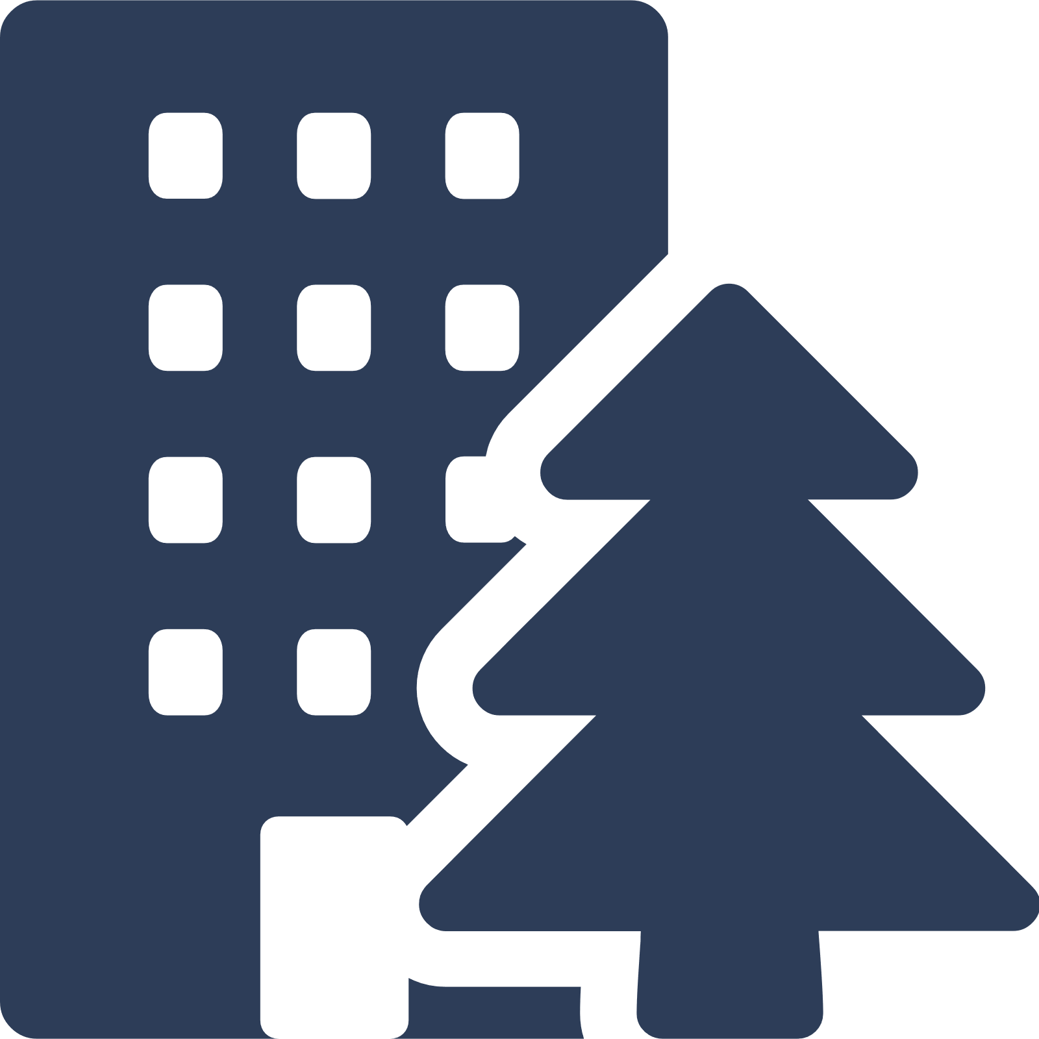
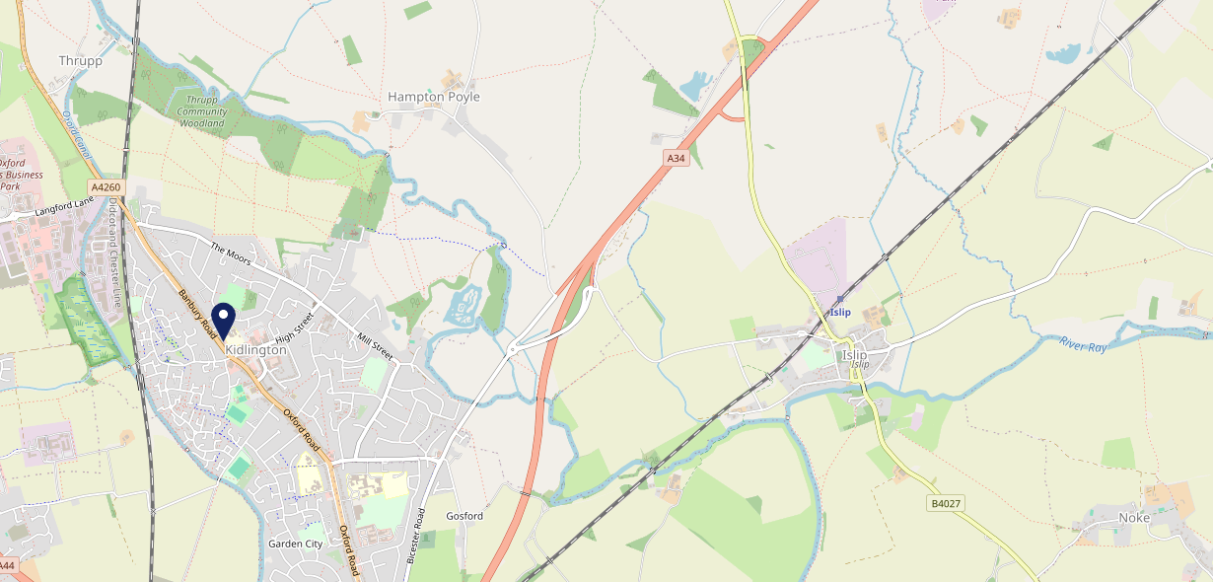
Site Intel
Black Bull OX52BT
3 Miles
97 Chains
06/09/2023 - 28/08/2024
Site Summary
Black Bull OX52BT
Work Area
Region
TV Region
Urbanicity
Oxford
South East
Central
Urban city and town
OX52BT
Punch - Mighty Local
Top Competitors
ATV
Gender
Red Lion
#1
£8.05
81.26%
Male
OX52BP
Ember Inns
Affluence
Segmentation
Black Horse (Kidlington)
#2
75.62%
40.87%
Middle Income
Enterprising Mainstream
OX52BT
GK - Pub & Social
Age Group
Visit Day
Six Bells (Kidlington)
#3
34.24%
27.86%
OX52EF
55 to 64
Fri
Admiral Taverns Ltd
Nearest Station
Oxford Parkway(2.50 miles)
432 Site Customers
44 Competitors
11245 Competitor Customers

Slide 2
Site Intel
Black Bull OX52BT
3 Miles
97 Chains
06/09/2023 - 28/08/2024
Spend by Weekpart
How is customer spend distributed throughout the week for Black Bull OX52BT versus its competitors?
% of spend for Black Bull OX52BT and 97 Chains in 3 Miles from 06/09/2023 - 28/08/2024 split by Day of Week
432 Site Customers
44 Competitors
11245 Competitor Customers

Slide 3
Site Intel
Black Bull OX52BT
3 Miles
97 Chains
06/09/2023 - 28/08/2024
Visit Frequency
How frequently per year do customers visit Black Bull OX52BT versus its competitors?
% of customer numbers for Black Bull OX52BT and 97 Chains in 3 Miles from 06/09/2023 - 28/08/2024 and the number of visits made Per Annum
432 Site Customers
44 Competitors
11245 Competitor Customers

Slide 4
Site Intel
Black Bull OX52BT
3 Miles
97 Chains
06/09/2023 - 28/08/2024
ATV Change
How has ATV changed between two date ranges?
432 Site Customers

Slide 5
Site Intel
Black Bull OX52BT
3 Miles
97 Chains
06/09/2023 - 28/08/2024
Market Share Change
How has market share changed between two date ranges?
% of market share spend for Black Bull OX52BT and 97 Chains in 3 Miles from 06/09/2023 - 28/08/2024
432 Site Customers

Slide 6
Site Intel
Black Bull OX52BT
3 Miles
97 Chains
06/09/2023 - 28/08/2024
Age
How does the age profile of customers who visit Black Bull OX52BT compare versus its competitors?
% of spend for Black Bull OX52BT and 97 Chains in 3 Miles from 06/09/2023 - 28/08/2024 split by Age Range
196 Site Customers
44 Competitors
5519 Competitor Customers

Slide 7
Site Intel
Black Bull OX52BT
3 Miles
97 Chains
06/09/2023 - 28/08/2024
Affluence
How does the affluence of customers who visit Black Bull OX52BT compare versus its competitors?
% of spend for Black Bull OX52BT and 97 Chains in 3 Miles from 06/09/2023 - 28/08/2024 split by Affluence
199 Site Customers
44 Competitors
5540 Competitor Customers

Slide 8
Site Intel
Black Bull OX52BT
3 Miles
97 Chains
06/09/2023 - 28/08/2024
Gender
How does the gender profile of customers who visit Black Bull OX52BT compare versus its competitors?
% of spend for Black Bull OX52BT and 97 Chains in 3 Miles from 06/09/2023 - 28/08/2024 split by Gender
199 Site Customers
44 Competitors
5540 Competitor Customers

Slide 9
Site Intel
Black Bull OX52BT
3 Miles
97 Chains
06/09/2023 - 28/08/2024
Punch Segmentation
How does the Custom segmentation profile of customers who visit Black Bull OX52BT compare versus its competitors?
% of spend for Black Bull OX52BT and 97 Chains in 3 Miles from 06/09/2023 - 28/08/2024 split by Segment
432 Site Customers
44 Competitors
11245 Competitor Customers

Slide 10
Site Intel
Black Bull OX52BT
3 Miles
97 Chains
06/09/2023 - 28/08/2024
Spend by Distance
How does the spend profile of Black Bull OX52BT compare versus its competitors based on travel distances?
% of spend for Black Bull OX52BT and 97 Chains in 3 Miles from 06/09/2023 - 28/08/2024 split by Distance travelled
187 Site Customers
44 Competitors
5339 Competitor Customers

Slide 11
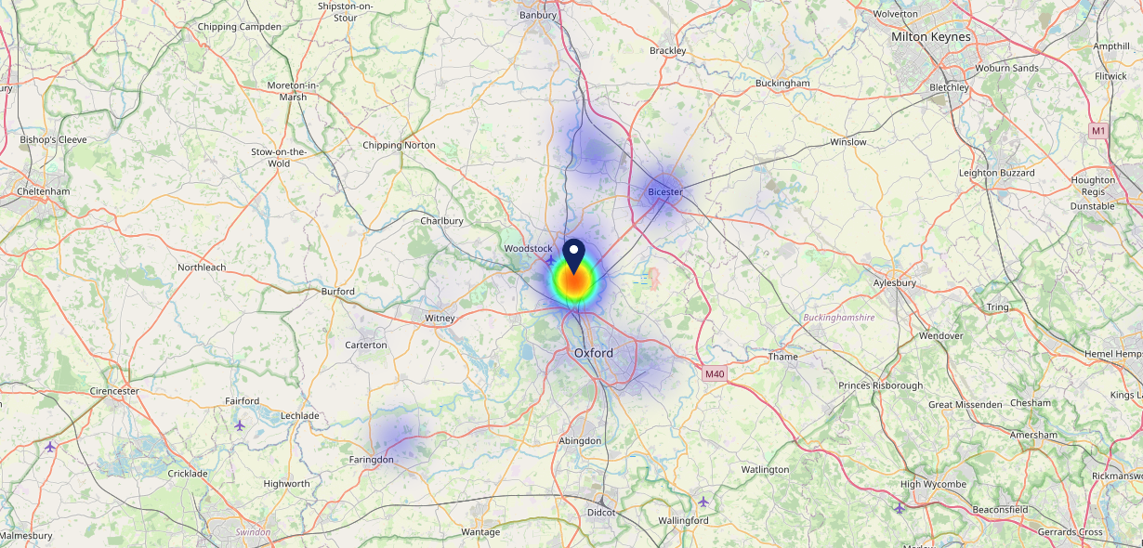
Site Intel
Black Bull OX52BT
06/09/2023 - 28/08/2024
Map of Guest Origin
Where do customers of Black Bull OX52BT come from?
Where do customers of Black Bull OX52BT for 06/09/2023 - 28/08/2024 live
187 Site Customers

Slide 12
Site Intel
Black Bull OX52BT
3 Miles
97 Chains
06/09/2023 - 28/08/2024
Share of Wallet
What are the Top 20 venues (by spend) that customers of Black Bull OX52BT also visit?
For customers of Black Bull OX52BT, who are the top 20 competitors from 97 Chains in 3 Miles for 06/09/2023 - 28/08/2024 split by Venue
432 Site Customers

Slide 13
Site Intel
Black Bull OX52BT
3 Miles
97 Chains
06/09/2023 - 28/08/2024
Share of Wallet Change
How has share of wallet of customers of Black Bull OX52BT changed between two date ranges?
432 Site Customers

Slide 14
Site Intel
Black Bull OX52BT
06/09/2023 - 28/08/2024
Market Summary
How does the local area for Black Bull OX52BT compare to the national average (1 = low, 10 = high)
Data Type | Name | Spend in 250m | 250m Spend vs National | Spend in 500m | 500m Spend vs National | Spend in 1 mile | 1 mile Spend vs National | Spend in 3 miles | 3 mile Spend vs National
Total | Annual Sales | £2.39M | 6 | £4.53M | 6 | £8.38M | 4 | £18.03M | 3
Weekpart | Mon - Thu | 42.3% | 7 | 41.9% | 6 | 40.3% | 5 | 40.3% | 4
Weekpart | Fri - Sat | 41.4% | 4 | 43.0% | 5 | 44.7% | 7 | 42.6% | 6
Weekpart | Sun | 16.3% | 7 | 15.2% | 6 | 14.9% | 5 | 17.1% | 9
Age | 18 to 24 | 2.9% | 3 | 3.7% | 3 | 4.1% | 3 | 3.8% | 2
Age | 25 to 34 | 11.6% | 1 | 10.9% | 1 | 11.0% | 1 | 11.6% | 1
Age | 35 to 44 | 30.4% | 9 | 27.7% | 9 | 24.7% | 7 | 22.5% | 4
Age | 45 to 54 | 18.6% | 4 | 19.7% | 5 | 18.8% | 4 | 20.7% | 6
Age | 55 to 64 | 18.7% | 8 | 20.0% | 8 | 23.3% | 10 | 21.9% | 10
Age | 65 to 74 | 12.0% | 9 | 12.2% | 9 | 11.7% | 9 | 11.6% | 9
Age | 75+ | 5.8% | 9 | 5.8% | 9 | 6.5% | 9 | 8.0% | 10
CAMEO | Business Elite | 4.6% | 4 | 3.7% | 3 | 3.6% | 3 | 5.9% | 4
CAMEO | Prosperous Professionals | 7.1% | 7 | 6.9% | 7 | 7.2% | 7 | 7.6% | 7
CAMEO | Flourishing Society | 16.1% | 7 | 15.1% | 7 | 15.9% | 7 | 18.7% | 8
CAMEO | Content Communities | 21.4% | 10 | 19.9% | 10 | 17.7% | 9 | 16.6% | 9
CAMEO | White Collar Neighbourhoods | 13.1% | 7 | 14.1% | 8 | 13.8% | 8 | 12.6% | 7
CAMEO | Enterprising Mainstream | 15.3% | 10 | 15.3% | 10 | 14.5% | 10 | 12.8% | 9
CAMEO | Paying The Mortgage | 10.9% | 3 | 10.4% | 3 | 12.8% | 4 | 13.1% | 4
CAMEO | Cash Conscious Communities | 4.8% | 2 | 5.2% | 2 | 5.3% | 2 | 5.9% | 2
CAMEO | On A Budget | 6.1% | 5 | 8.6% | 7 | 8.4% | 7 | 5.9% | 4
CAMEO | Family Value | 0.7% | 2 | 0.8% | 2 | 0.7% | 2 | 0.9% | 2
Affluence | AB | 27.8% | 6 | 25.7% | 5 | 26.7% | 5 | 32.3% | 6
Affluence | C1C2 | 60.7% | 9 | 59.7% | 9 | 58.9% | 10 | 55.0% | 9
Affluence | DE | 11.5% | 2 | 14.5% | 3 | 14.4% | 3 | 12.7% | 2

Slide 15
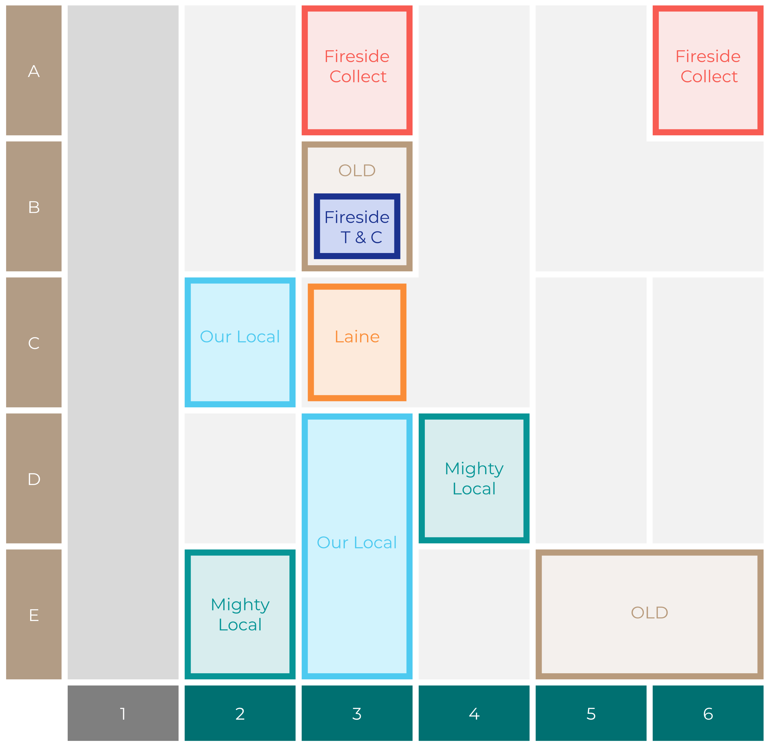
Site Intel
Black Bull OX52BT
Site Potential 1
Site Characteristics
£3000
£18000
OCC Concept Fit
Achievable Average Weekly Takings
Non-Core
£8500
A Food-Led High Affluence B Food-Led Mid Affluence C Wet-Led Mid/High Affluence D Wet-Led Low Affluence E Food-Led Low Affluence
AWT 2 Local Regulars 3 Local Passing Trade 4 Destination Wet-Led 5 Destination Food-Led 6 Destination Very Food-Led
A
B
C
D
E
1
2
3
4
5
6

Slide 16
Site Intel
Black Bull OX52BT
Site Potential 2
Concept Recommendation

Slide 17
Site Intel
Black Bull OX52BT
Local Market Profile
Mix of spend by customer segment in Punch site and local market
 | Customer Count | Family Familiar | Occasional & Local | Mid-Week Seniors | Part Of The Pub | Metro Sophisticates | Young & Connected | Bubbly Weekenders | Upmarket Diners
Black Bull | 87 | 15.50% | 0.95% | 28.65% | 29.64% | 11.00% | 5.97% | 3.49% | 4.76%
Local Catchment | 1401 | 5.18% | 2.97% | 31.62% | 20.17% | 9.43% | 7.60% | 4.13% | 18.86%
Punch T&L | 103230 | 8.34% | 5.96% | 29.07% | 10.93% | 11.57% | 11.74% | 7.08% | 15.27%
Black Bull vs Local Catchment |  | 10.32% | -2.02% | -2.97% | 9.47% | 1.57% | -1.63% | -0.64% | -14.10%
Black Bull vs Punch T&L |  | 7.16% | -5.01% | -0.42% | 18.71% | -0.57% | -5.77% | -3.59% | -10.51%
Local Catchment vs Punch T&L |  | -3.16% | -2.99% | 2.55% | 9.24% | -2.14% | -4.14% | -2.95% | 3.59%

Slide 18
Site Intel
Black Bull OX52BT
Local Competitor Profiles
Mix of spend by customer segment in Punch site and local competitors
 | Customer Count | Family Familiar | Occasional & Local | Mid-Week Seniors | Part Of The Pub | Metro Sophisticates | Young & Connected | Bubbly Weekenders | Upmarket Diners
Black Bull OX52BT | 87 | 15.50% | 0.95% | 28.65% | 29.64% | 11.00% | 5.97% | 3.49% | 4.76%
Red Lion OX52BP | 224 | 11.32% | 1.13% | 26.97% | 25.07% | 8.08% | 12.66% | 4.65% | 10.10%
Black Horse (Kidlington) OX52BT | 178 | 8.11% | 0.89% | 17.09% | 47.88% | 4.97% | 7.20% | 3.91% | 9.90%
Six Bells (Kidlington) OX52EF | 67 | 4.97% | 0.21% | 45.22% | 25.78% | 9.14% | 1.42% | 2.38% | 10.83%
Jolly Boatman (Thrupp) OX51JU | 257 | 7.78% | 1.74% | 39.93% | 1.08% | 11.90% | 7.72% | 5.16% | 24.65%
King's Arms OX52AJ | 69 | 4.27% | 0.00% | 68.78% | 1.76% | 4.36% | 12.24% | 2.83% | 5.72%
Gurkha Village OX51EA | 79 | 7.09% | 1.46% | 19.78% | 0.54% | 21.50% | 3.88% | 10.85% | 34.86%
Yarnton Royal British OX51LN | 9 | 8.94% | 0.00% | 0.06% | 0.33% | 0.15% | 83.03% | 0.00% | 7.47%
Red Lion (Yarnton) OX51QD | 58 | 17.45% | 0.00% | 2.72% | 1.98% | 32.60% | 15.29% | 2.31% | 27.60%
Highwayman Hotel OX51BF | 76 | 1.10% | 0.10% | 12.15% | 75.38% | 3.78% | 3.42% | 0.38% | 3.66%
Boat (Thrupp) OX51JY | 145 | 3.94% | 2.75% | 50.67% | 0.06% | 13.05% | 3.33% | 5.21% | 20.96%
White House (Bladon) OX201RQ | 119 | 1.54% | 1.82% | 27.69% | 3.17% | 9.33% | 7.66% | 10.18% | 38.58%
Plough (Wolvercote Green) OX28BD | 189 | 0.78% | 10.08% | 26.47% | 18.75% | 6.75% | 3.27% | 4.33% | 29.52%
Foresters Bar OX52DN | 10 | 18.84% | 8.66% | 32.44% | 0.00% | 0.00% | 14.66% | 3.67% | 21.70%
Gosford All Blacks OX51UP | 28 | 2.90% | 2.54% | 36.96% | 0.77% | 2.82% | 15.53% | 1.69% | 36.75%
Red Lion OX52RX | 40 | 3.71% | 1.56% | 14.03% | 3.45% | 21.60% | 6.21% | 8.00% | 41.40%
White Hart OX28PQ | 124 | 0.60% | 8.85% | 66.55% | 2.20% | 7.31% | 3.11% | 1.48% | 9.87%
The Wolvercote OX28PG | 105 | 2.34% | 2.85% | 33.96% | 0.16% | 8.83% | 1.37% | 2.94% | 47.51%
Swan Inn Islip Bar OX52SB | 8 | 0.00% | 6.43% | 10.05% | 0.00% | 36.60% | 0.00% | 0.00% | 46.90%
Kidlington Bow OX51AB | 4 | 0.00% | 0.00% | 34.72% | 37.50% | 0.00% | 0.00% | 27.77% | 0.00%
Midsummer Nightcap OX201PY | 39 | 11.18% | 0.00% | 13.17% | 2.23% | 8.78% | 6.86% | 7.42% | 50.31%
Ktnocls OX201PY | 41 | 0.67% | 0.00% | 16.61% | 3.89% | 20.60% | 13.68% | 9.75% | 34.75%
Summertown Sta OX27TL | 28 | 19.16% | 0.00% | 6.20% | 2.81% | 6.76% | 6.57% | 9.96% | 48.50%
Woodstock Town OX201PA | 6 | 24.41% | 0.00% | 5.30% | 3.21% | 0.00% | 0.00% | 67.06% | 0.00%
North Oxford L OX28EQ | 18 | 0.00% | 5.82% | 17.81% | 0.00% | 10.04% | 1.94% | 27.77% | 36.59%

