Slide 1
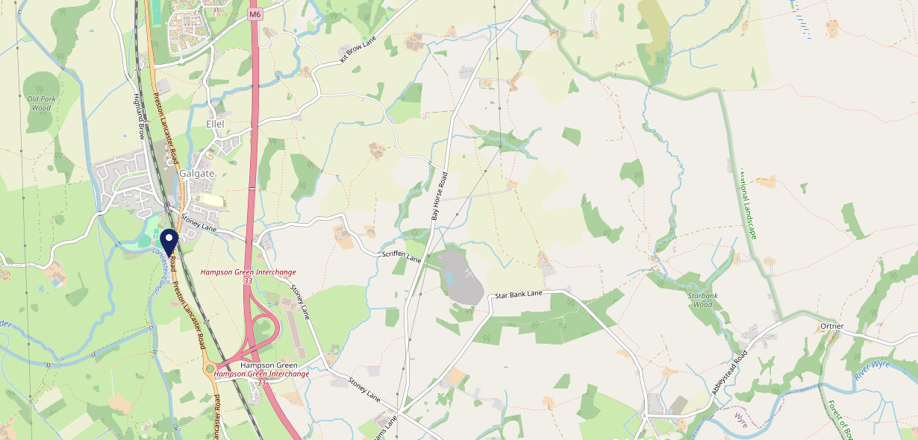
Site Intel
Plough LA20LQ
Plough LA20LQ
97 Chains
12/07/2023 - 03/07/2024
Site Summary
Plough LA20LQ
Work Area
Region
TV Region
Urbanicity
Lancaster and Morecambe
North West
North West
Rural town and fringe
LA20LQ
Punch - Our Local
Top Competitors
ATV
Gender
New Inn
#1
£18.64
60.37%
Male
LA20JW
Pub / Bar
Affluence
Segmentation
The Boot and Shoe
#2
52.93%
19.03%
Middle Income
Paying The Mortgage
LA14PU
Thwaites
Age Group
Visit Day
Fleece Inn
#3
21.14%
21.98%
LA29AQ
35 to 44
Sat
Pub Restaurant
Nearest Station
Lancaster(6.74 miles)
1365 Site Customers
14 Competitors
11972 Competitor Customers

Slide 2
Site Intel
Plough LA20LQ
Plough LA20LQ
97 Chains
12/07/2023 - 03/07/2024
Spend by Weekpart
How is customer spend distributed throughout the week for Plough LA20LQ versus its competitors?
% of spend for Plough LA20LQ and 97 Chains in 3 Miles from 12/07/2023 - 03/07/2024 split by Day of Week
1365 Site Customers
14 Competitors
11972 Competitor Customers

Slide 3
Site Intel
Plough LA20LQ
Plough LA20LQ
97 Chains
12/07/2023 - 03/07/2024
Visit Frequency
How frequently per year do customers visit Plough LA20LQ versus its competitors?
% of customer numbers for Plough LA20LQ and 97 Chains in 3 Miles from 12/07/2023 - 03/07/2024 and the number of visits made Per Annum
1365 Site Customers
14 Competitors
11972 Competitor Customers

Slide 4
Site Intel
Plough LA20LQ
Plough LA20LQ
97 Chains
12/07/2023 - 03/07/2024
ATV Change
How has ATV changed between two date ranges?
1365 Site Customers

Slide 5
Site Intel
Plough LA20LQ
Plough LA20LQ
97 Chains
12/07/2023 - 03/07/2024
Market Share Change
How has market share changed between two date ranges?
% of market share spend for Plough LA20LQ and 97 Chains in 3 Miles from 12/07/2023 - 03/07/2024
1365 Site Customers

Slide 6
Site Intel
Plough LA20LQ
Plough LA20LQ
97 Chains
12/07/2023 - 03/07/2024
Age
How does the age profile of customers who visit Plough LA20LQ compare versus its competitors?
% of spend for Plough LA20LQ and 97 Chains in 3 Miles from 12/07/2023 - 03/07/2024 split by Age Range
672 Site Customers
14 Competitors
5367 Competitor Customers

Slide 7
Site Intel
Plough LA20LQ
Plough LA20LQ
97 Chains
12/07/2023 - 03/07/2024
Affluence
How does the affluence of customers who visit Plough LA20LQ compare versus its competitors?
% of spend for Plough LA20LQ and 97 Chains in 3 Miles from 12/07/2023 - 03/07/2024 split by Affluence
672 Site Customers
14 Competitors
5406 Competitor Customers

Slide 8
Site Intel
Plough LA20LQ
Plough LA20LQ
97 Chains
12/07/2023 - 03/07/2024
Gender
How does the gender profile of customers who visit Plough LA20LQ compare versus its competitors?
% of spend for Plough LA20LQ and 97 Chains in 3 Miles from 12/07/2023 - 03/07/2024 split by Gender
672 Site Customers
14 Competitors
5406 Competitor Customers

Slide 9
Site Intel
Plough LA20LQ
Plough LA20LQ
97 Chains
12/07/2023 - 03/07/2024
Punch Segmentation
How does the Custom segmentation profile of customers who visit Plough LA20LQ compare versus its competitors?
% of spend for Plough LA20LQ and 97 Chains in 3 Miles from 12/07/2023 - 03/07/2024 split by Segment
1365 Site Customers
14 Competitors
11972 Competitor Customers

Slide 10
Site Intel
Plough LA20LQ
Plough LA20LQ
97 Chains
12/07/2023 - 03/07/2024
Spend by Distance
How does the spend profile of Plough LA20LQ compare versus its competitors based on travel distances?
% of spend for Plough LA20LQ and 97 Chains in 3 Miles from 12/07/2023 - 03/07/2024 split by Distance travelled
650 Site Customers
14 Competitors
5283 Competitor Customers

Slide 11
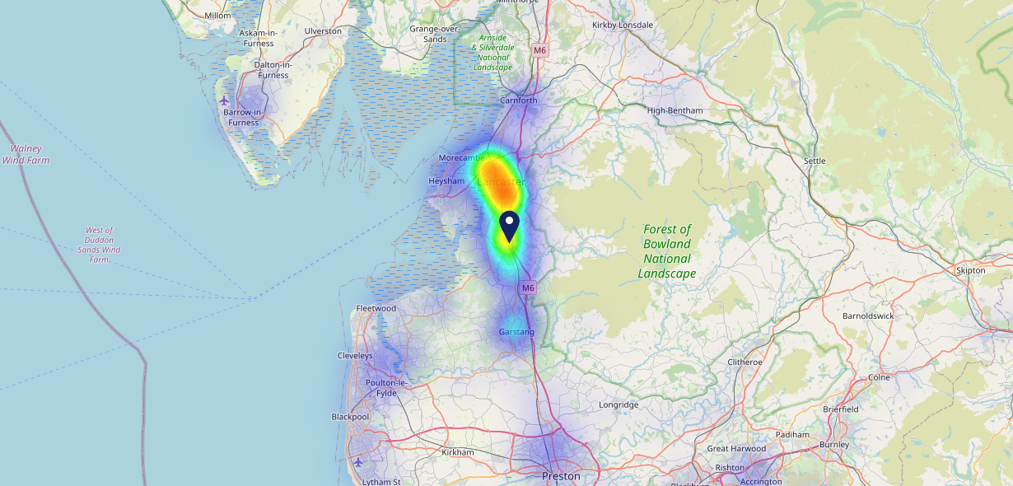
Site Intel
Plough LA20LQ
12/07/2023 - 03/07/2024
Map of Guest Origin
Where do customers of Plough LA20LQ come from?
Where do customers of Plough LA20LQ for 12/07/2023 - 03/07/2024 live
650 Site Customers

Slide 12
Site Intel
Plough LA20LQ
Plough LA20LQ
97 Chains
12/07/2023 - 03/07/2024
Share of Wallet
What are the Top 20 venues (by spend) that customers of Plough LA20LQ also visit?
For customers of Plough LA20LQ, who are the top 20 competitors from 97 Chains in 3 Miles for 12/07/2023 - 03/07/2024 split by Venue
1365 Site Customers

Slide 13
Site Intel
Plough LA20LQ
Plough LA20LQ
97 Chains
12/07/2023 - 03/07/2024
Share of Wallet Change
How has share of wallet of customers of Plough LA20LQ changed between two date ranges?
1365 Site Customers

Slide 14
Site Intel
Plough LA20LQ
12/07/2023 - 03/07/2024
Market Summary
How does the local area for Plough LA20LQ compare to the national average (1 = low, 10 = high)
Data Type | Name | Spend in 250m | 250m Spend vs National | Spend in 500m | 500m Spend vs National | Spend in 1 mile | 1 mile Spend vs National | Spend in 3 miles | 3 mile Spend vs National
Total | Annual Sales | £524K | 4 | £793K | 3 | £793K | 1 | £20.18M | 3
Weekpart | Mon - Thu | 42.6% | 7 | 37.0% | 3 | 37.0% | 2 | 45.0% | 9
Weekpart | Fri - Sat | 37.6% | 2 | 43.5% | 5 | 43.5% | 6 | 36.8% | 1
Weekpart | Sun | 19.7% | 9 | 19.5% | 9 | 19.5% | 10 | 18.3% | 10
Age | 18 to 24 | 3.8% | 4 | 3.9% | 3 | 3.9% | 3 | 5.4% | 4
Age | 25 to 34 | 12.6% | 2 | 10.6% | 1 | 10.6% | 1 | 14.0% | 1
Age | 35 to 44 | 21.3% | 4 | 24.4% | 6 | 24.4% | 6 | 22.9% | 5
Age | 45 to 54 | 20.8% | 6 | 27.8% | 10 | 27.8% | 10 | 20.7% | 6
Age | 55 to 64 | 20.2% | 8 | 16.9% | 7 | 16.9% | 7 | 20.9% | 10
Age | 65 to 74 | 13.8% | 9 | 11.1% | 9 | 11.1% | 9 | 11.0% | 9
Age | 75+ | 7.4% | 10 | 5.2% | 9 | 5.2% | 9 | 5.1% | 9
CAMEO | Business Elite | 4.8% | 4 | 6.7% | 6 | 6.7% | 5 | 7.0% | 5
CAMEO | Prosperous Professionals | 9.4% | 8 | 7.9% | 7 | 7.9% | 7 | 8.6% | 8
CAMEO | Flourishing Society | 10.8% | 5 | 8.8% | 4 | 8.8% | 3 | 13.7% | 6
CAMEO | Content Communities | 10.2% | 4 | 8.2% | 2 | 8.2% | 2 | 12.9% | 6
CAMEO | White Collar Neighbourhoods | 11.2% | 5 | 14.1% | 8 | 14.1% | 9 | 10.7% | 4
CAMEO | Enterprising Mainstream | 12.0% | 8 | 10.7% | 8 | 10.7% | 8 | 10.9% | 8
CAMEO | Paying The Mortgage | 18.4% | 8 | 15.4% | 6 | 15.4% | 6 | 14.9% | 6
CAMEO | Cash Conscious Communities | 14.1% | 9 | 20.7% | 10 | 20.7% | 10 | 10.8% | 7
CAMEO | On A Budget | 5.0% | 4 | 4.2% | 3 | 4.2% | 2 | 5.9% | 4
CAMEO | Family Value | 4.1% | 7 | 3.2% | 6 | 3.2% | 6 | 4.5% | 7
Affluence | AB | 25.0% | 5 | 23.4% | 4 | 23.4% | 4 | 29.4% | 6
Affluence | C1C2 | 51.9% | 7 | 48.5% | 5 | 48.5% | 5 | 49.4% | 6
Affluence | DE | 23.2% | 6 | 28.1% | 8 | 28.1% | 8 | 21.2% | 6

Slide 15
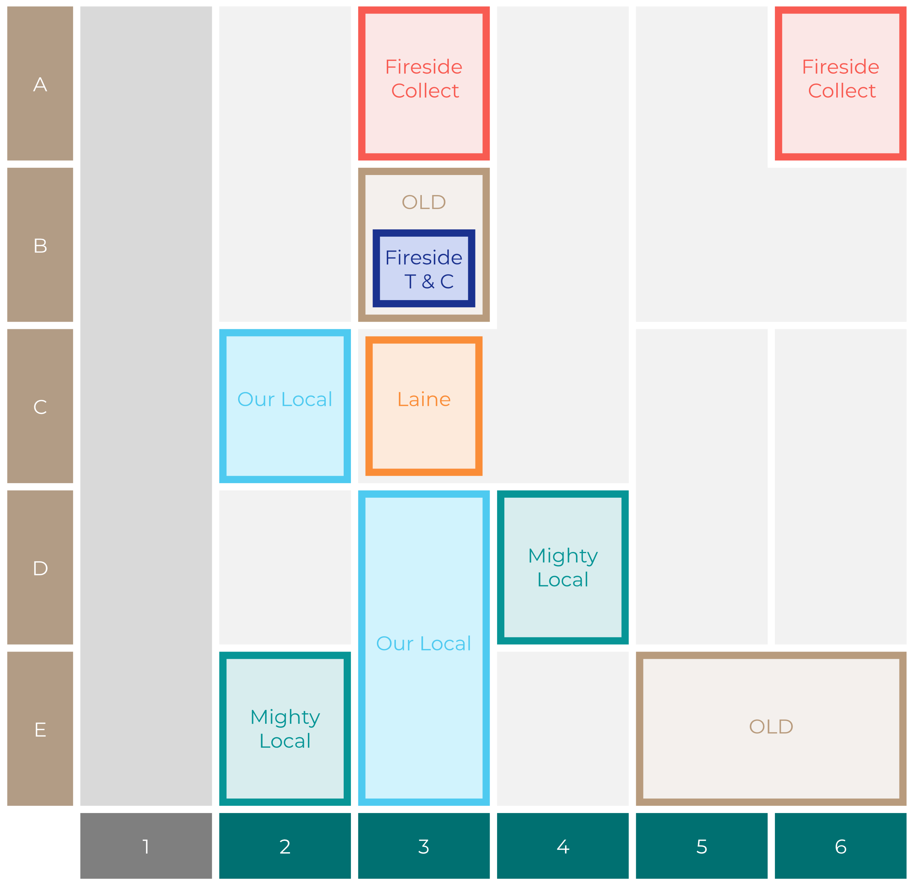
Site Intel
Plough LA20LQ
Site Potential 1
Site Characteristics
£3000
£18000
OCC Concept Fit
Achievable Average Weekly Takings
Non-Core
£0
A Food-Led High Affluence B Food-Led Mid Affluence C Wet-Led Mid/High Affluence D Wet-Led Low Affluence E Food-Led Low Affluence
AWT 2 Local Regulars 3 Local Passing Trade 4 Destination Wet-Led 5 Destination Food-Led 6 Destination Very Food-Led
A
B
C
D
E
1
2
3
4
5
6

Slide 16
Site Intel
Plough LA20LQ
Site Potential 2
Concept Recommendation

Slide 17
Site Intel
Plough LA20LQ
Local Market Profile
Mix of spend by customer segment in Punch site and local market
 | Customer Count | Family Familiar | Occasional & Local | Mid-Week Seniors | Part Of The Pub | Metro Sophisticates | Young & Connected | Bubbly Weekenders | Upmarket Diners
Plough | 255 | 23.82% | 2.26% | 27.65% | 4.26% | 5.86% | 14.27% | 9.12% | 12.72%
Local Catchment | 1521 | 6.67% | 6.84% | 35.05% | 3.20% | 7.31% | 10.59% | 7.68% | 22.63%
Punch T&L | 103903 | 8.12% | 5.84% | 29.16% | 10.82% | 11.71% | 11.70% | 7.13% | 15.48%
Plough vs Local Catchment |  | 17.15% | -4.58% | -7.40% | 1.06% | -1.45% | 3.68% | 1.44% | -9.91%
Plough vs Punch T&L |  | 15.70% | -3.58% | -1.51% | -6.56% | -5.85% | 2.57% | 1.99% | -2.76%
Local Catchment vs Punch T&L |  | -1.45% | 1.00% | 5.89% | -7.62% | -4.40% | -1.11% | 0.55% | 7.15%

Slide 18
Site Intel
Plough LA20LQ
Local Competitor Profiles
Mix of spend by customer segment in Punch site and local competitors
 | Customer Count | Family Familiar | Occasional & Local | Mid-Week Seniors | Part Of The Pub | Metro Sophisticates | Young & Connected | Bubbly Weekenders | Upmarket Diners
Plough LA20LQ | 255 | 23.82% | 2.26% | 27.65% | 4.26% | 5.86% | 14.27% | 9.12% | 12.72%
New Inn LA20JW | 65 | 9.39% | 1.19% | 7.38% | 10.28% | 2.79% | 46.30% | 18.12% | 4.51%
The Boot and Shoe LA14PU | 420 | 8.67% | 6.83% | 48.40% | 2.26% | 6.00% | 5.54% | 6.80% | 15.46%
Fleece Inn LA29AQ | 288 | 3.49% | 2.08% | 28.19% | 4.10% | 9.47% | 11.84% | 3.54% | 37.25%
Stork Hotel Thurnham LA20AN | 401 | 7.45% | 6.27% | 45.78% | 3.28% | 7.75% | 9.06% | 6.64% | 13.75%
Mill Inn LA20BD | 256 | 6.79% | 6.01% | 26.88% | 3.00% | 6.84% | 9.49% | 15.42% | 25.54%
Pizzetta Republic LA14YG | 182 | 8.06% | 19.45% | 9.12% | 1.97% | 12.10% | 16.27% | 10.13% | 22.87%
Dalton Arms LA20BZ | 109 | 8.07% | 16.70% | 38.16% | 4.55% | 4.45% | 20.41% | 1.99% | 5.63%
Bay Horse Inn LA20HR | 84 | 5.57% | 4.81% | 29.08% | 0.13% | 10.55% | 2.53% | 6.39% | 40.89%
Cafe Republic LA14PF | 94 | 1.15% | 31.03% | 22.93% | 0.29% | 4.11% | 1.37% | 3.73% | 35.35%
Shiresheadandf PR30AS | 6 | 0.00% | 0.00% | 70.50% | 0.00% | 6.65% | 0.00% | 0.00% | 22.83%

