Slide 1
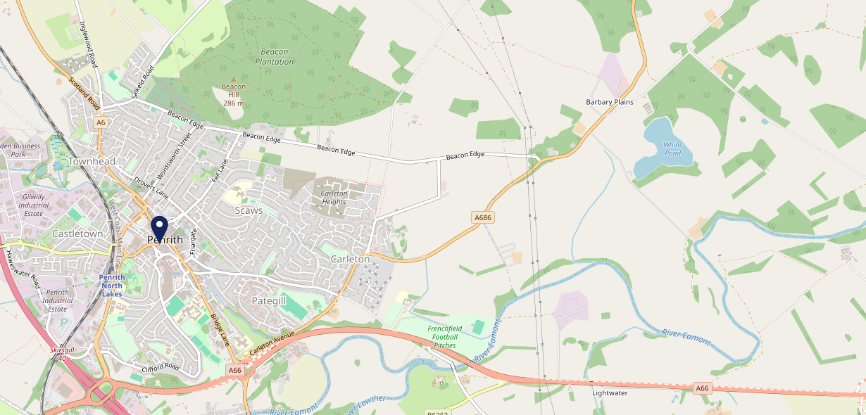
Site Intel
Board & Elbow CA117HS
Board & Elbow CA117HS
97 Chains
02/08/2023 - 24/07/2024
Site Summary
Board & Elbow CA117HS
Work Area
Region
TV Region
Urbanicity
Penrith
North West
North West
Urban city and town in a sparse setting
CA117HS
Punch T&L
Top Competitors
ATV
Gender
The Dog Beck
#1
£11.59
61.80%
Male
CA118JH
JD Wetherspoon
Affluence
Segmentation
Lounge Hotel & Bar
#2
57.74%
21.09%
Middle Income
Paying The Mortgage
CA117AJ
Pub / Bar
Age Group
Visit Day
Royal Penrith
#3
25.67%
25.16%
CA117PZ
55 to 64
Sat
Craft Union
Nearest Station
Penrith (North Lakes)(0.42 miles)
2119 Site Customers
26 Competitors
17849 Competitor Customers

Slide 2
Site Intel
Board & Elbow CA117HS
Board & Elbow CA117HS
97 Chains
02/08/2023 - 24/07/2024
Spend by Weekpart
How is customer spend distributed throughout the week for Board & Elbow CA117HS versus its competitors?
% of spend for Board & Elbow CA117HS and 97 Chains in 1 Miles from 02/08/2023 - 24/07/2024 split by Day of Week
2119 Site Customers
26 Competitors
17849 Competitor Customers

Slide 3
Site Intel
Board & Elbow CA117HS
Board & Elbow CA117HS
97 Chains
02/08/2023 - 24/07/2024
Visit Frequency
How frequently per year do customers visit Board & Elbow CA117HS versus its competitors?
% of customer numbers for Board & Elbow CA117HS and 97 Chains in 1 Miles from 02/08/2023 - 24/07/2024 and the number of visits made Per Annum
2119 Site Customers
26 Competitors
17849 Competitor Customers

Slide 4
Site Intel
Board & Elbow CA117HS
Board & Elbow CA117HS
97 Chains
02/08/2023 - 24/07/2024
ATV Change
How has ATV changed between two date ranges?
2119 Site Customers

Slide 5
Site Intel
Board & Elbow CA117HS
Board & Elbow CA117HS
97 Chains
02/08/2023 - 24/07/2024
Market Share Change
How has market share changed between two date ranges?
% of market share spend for Board & Elbow CA117HS and 97 Chains in 1 Miles from 02/08/2023 - 24/07/2024
2119 Site Customers

Slide 6
Site Intel
Board & Elbow CA117HS
Board & Elbow CA117HS
97 Chains
02/08/2023 - 24/07/2024
Age
How does the age profile of customers who visit Board & Elbow CA117HS compare versus its competitors?
% of spend for Board & Elbow CA117HS and 97 Chains in 1 Miles from 02/08/2023 - 24/07/2024 split by Age Range
1007 Site Customers
26 Competitors
8223 Competitor Customers

Slide 7
Site Intel
Board & Elbow CA117HS
Board & Elbow CA117HS
97 Chains
02/08/2023 - 24/07/2024
Affluence
How does the affluence of customers who visit Board & Elbow CA117HS compare versus its competitors?
% of spend for Board & Elbow CA117HS and 97 Chains in 1 Miles from 02/08/2023 - 24/07/2024 split by Affluence
1025 Site Customers
26 Competitors
8334 Competitor Customers

Slide 8
Site Intel
Board & Elbow CA117HS
Board & Elbow CA117HS
97 Chains
02/08/2023 - 24/07/2024
Gender
How does the gender profile of customers who visit Board & Elbow CA117HS compare versus its competitors?
% of spend for Board & Elbow CA117HS and 97 Chains in 1 Miles from 02/08/2023 - 24/07/2024 split by Gender
1025 Site Customers
26 Competitors
8334 Competitor Customers

Slide 9
Site Intel
Board & Elbow CA117HS
Board & Elbow CA117HS
97 Chains
02/08/2023 - 24/07/2024
Punch Segmentation
How does the Custom segmentation profile of customers who visit Board & Elbow CA117HS compare versus its competitors?
% of spend for Board & Elbow CA117HS and 97 Chains in 1 Miles from 02/08/2023 - 24/07/2024 split by Segment
2119 Site Customers
26 Competitors
17849 Competitor Customers

Slide 10
Site Intel
Board & Elbow CA117HS
Board & Elbow CA117HS
97 Chains
02/08/2023 - 24/07/2024
Spend by Distance
How does the spend profile of Board & Elbow CA117HS compare versus its competitors based on travel distances?
% of spend for Board & Elbow CA117HS and 97 Chains in 1 Miles from 02/08/2023 - 24/07/2024 split by Distance travelled
988 Site Customers
26 Competitors
8072 Competitor Customers

Slide 11
Site Intel
Board & Elbow CA117HS
02/08/2023 - 24/07/2024
Map of Guest Origin
Where do customers of Board & Elbow CA117HS come from?
Where do customers of Board & Elbow CA117HS for 02/08/2023 - 24/07/2024 live
988 Site Customers

Slide 12
Site Intel
Board & Elbow CA117HS
Board & Elbow CA117HS
97 Chains
02/08/2023 - 24/07/2024
Share of Wallet
What are the Top 20 venues (by spend) that customers of Board & Elbow CA117HS also visit?
For customers of Board & Elbow CA117HS, who are the top 20 competitors from 97 Chains in 1 Miles for 02/08/2023 - 24/07/2024 split by Venue
2119 Site Customers

Slide 13
Site Intel
Board & Elbow CA117HS
Board & Elbow CA117HS
97 Chains
02/08/2023 - 24/07/2024
Share of Wallet Change
How has share of wallet of customers of Board & Elbow CA117HS changed between two date ranges?
2119 Site Customers

Slide 14
Site Intel
Board & Elbow CA117HS
02/08/2023 - 24/07/2024
Market Summary
How does the local area for Board & Elbow CA117HS compare to the national average (1 = low, 10 = high)
Data Type | Name | Spend in 250m | 250m Spend vs National | Spend in 500m | 500m Spend vs National | Spend in 1 mile | 1 mile Spend vs National | Spend in 3 miles | 3 mile Spend vs National
Total | Annual Sales | £9.92M | 9 | £16.40M | 8 | £23.39M | 7 | £26.64M | 3
Weekpart | Mon - Thu | 42.7% | 7 | 44.2% | 8 | 44.9% | 8 | 44.3% | 8
Weekpart | Fri - Sat | 44.4% | 6 | 41.8% | 4 | 40.5% | 4 | 40.3% | 3
Weekpart | Sun | 13.0% | 4 | 14.0% | 4 | 14.6% | 4 | 15.4% | 5
Age | 18 to 24 | 4.1% | 4 | 4.8% | 4 | 5.6% | 5 | 5.2% | 3
Age | 25 to 34 | 14.8% | 2 | 16.2% | 3 | 17.6% | 3 | 17.0% | 2
Age | 35 to 44 | 18.6% | 2 | 21.3% | 4 | 22.2% | 4 | 21.7% | 3
Age | 45 to 54 | 20.1% | 5 | 21.3% | 7 | 20.4% | 6 | 20.0% | 5
Age | 55 to 64 | 23.6% | 9 | 21.1% | 9 | 20.0% | 9 | 20.6% | 9
Age | 65 to 74 | 13.0% | 9 | 10.8% | 9 | 9.8% | 8 | 10.8% | 9
Age | 75+ | 5.8% | 9 | 4.5% | 8 | 4.4% | 8 | 4.8% | 9
CAMEO | Business Elite | 3.2% | 3 | 3.0% | 3 | 4.4% | 4 | 4.8% | 4
CAMEO | Prosperous Professionals | 5.8% | 5 | 5.7% | 5 | 6.0% | 5 | 6.7% | 6
CAMEO | Flourishing Society | 17.5% | 8 | 17.2% | 8 | 17.1% | 8 | 17.4% | 8
CAMEO | Content Communities | 11.3% | 5 | 11.0% | 4 | 11.7% | 5 | 11.8% | 4
CAMEO | White Collar Neighbourhoods | 12.2% | 6 | 11.5% | 6 | 11.3% | 5 | 11.1% | 5
CAMEO | Enterprising Mainstream | 15.1% | 9 | 15.8% | 10 | 14.4% | 9 | 14.1% | 10
CAMEO | Paying The Mortgage | 14.8% | 6 | 14.8% | 6 | 14.7% | 5 | 14.0% | 5
CAMEO | Cash Conscious Communities | 10.0% | 6 | 10.0% | 6 | 9.4% | 6 | 9.3% | 6
CAMEO | On A Budget | 7.2% | 6 | 7.4% | 6 | 6.8% | 6 | 6.5% | 5
CAMEO | Family Value | 2.9% | 6 | 3.6% | 6 | 4.2% | 7 | 4.3% | 7
Affluence | AB | 26.5% | 5 | 25.9% | 5 | 27.5% | 5 | 28.9% | 5
Affluence | C1C2 | 53.3% | 7 | 53.1% | 7 | 52.1% | 7 | 51.0% | 7
Affluence | DE | 20.2% | 6 | 21.0% | 6 | 20.4% | 6 | 20.1% | 6

Slide 15
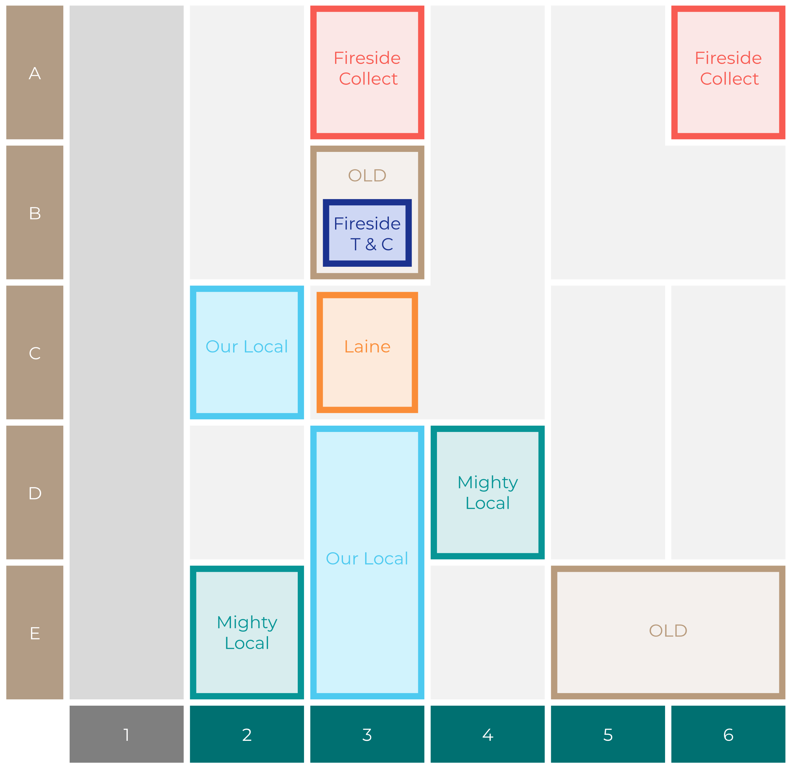
Site Intel
Board & Elbow CA117HS
Site Potential 1
Site Characteristics
£3000
£18000
OCC Concept Fit
Achievable Average Weekly Takings
Our Local Destination
£10500
A Food-Led High Affluence B Food-Led Mid Affluence C Wet-Led Mid/High Affluence D Wet-Led Low Affluence E Food-Led Low Affluence
AWT 2 Local Regulars 3 Local Passing Trade 4 Destination Wet-Led 5 Destination Food-Led 6 Destination Very Food-Led
A
B
C
D
E
1
2
3
4
5
6

Slide 16
Site Intel
Board & Elbow CA117HS
Site Potential 2
Concept Recommendation

Slide 17
Site Intel
Board & Elbow CA117HS
Local Market Profile
Mix of spend by customer segment in Punch site and local market
 | Customer Count | Family Familiar | Occasional & Local | Mid-Week Seniors | Part Of The Pub | Metro Sophisticates | Young & Connected | Bubbly Weekenders | Upmarket Diners
Board & Elbow | 382 | 9.39% | 5.61% | 41.80% | 7.80% | 5.89% | 11.88% | 10.21% | 7.38%
Local Catchment | 1812 | 7.23% | 3.00% | 24.47% | 4.24% | 9.98% | 18.53% | 11.61% | 20.91%
Punch T&L | 103376 | 8.18% | 5.88% | 29.04% | 10.91% | 11.68% | 11.73% | 7.09% | 15.46%
Board & Elbow vs Local Catchment |  | 2.16% | 2.61% | 17.33% | 3.56% | -4.09% | -6.65% | -1.40% | -13.53%
Board & Elbow vs Punch T&L |  | 1.21% | -0.27% | 12.76% | -3.11% | -5.79% | 0.15% | 3.12% | -8.08%
Local Catchment vs Punch T&L |  | -0.95% | -2.88% | -4.57% | -6.67% | -1.70% | 6.80% | 4.52% | 5.45%

Slide 18
Site Intel
Board & Elbow CA117HS
Local Competitor Profiles
Mix of spend by customer segment in Punch site and local competitors
 | Customer Count | Family Familiar | Occasional & Local | Mid-Week Seniors | Part Of The Pub | Metro Sophisticates | Young & Connected | Bubbly Weekenders | Upmarket Diners
Board & Elbow CA117HS | 382 | 9.39% | 5.61% | 41.80% | 7.80% | 5.89% | 11.88% | 10.21% | 7.38%
The Dog Beck CA118JH | 487 | 13.88% | 5.99% | 25.47% | 22.31% | 3.63% | 16.84% | 6.75% | 5.09%
Lounge Hotel & Bar CA117AJ | 262 | 10.48% | 3.51% | 28.05% | 1.36% | 5.13% | 19.37% | 11.62% | 20.45%
Royal Penrith CA117PZ | 140 | 3.16% | 1.82% | 23.40% | 2.85% | 5.51% | 40.94% | 16.24% | 6.04%
Arturo Lounge CA117FG | 263 | 5.34% | 1.70% | 35.95% | 2.33% | 6.72% | 17.70% | 11.08% | 19.15%
North Lakes Hotel & Spa CA118QT | 467 | 7.63% | 3.04% | 14.63% | 1.01% | 15.21% | 19.91% | 12.46% | 26.06%
Cross Keys Inn CA118TP | 147 | 6.67% | 2.11% | 33.61% | 1.39% | 5.86% | 13.29% | 10.42% | 26.62%
Robin Hood Inn CA117AY | 133 | 4.58% | 8.61% | 21.07% | 27.20% | 3.70% | 18.90% | 12.06% | 3.84%
White Wave Penrith CA117HL | 81 | 9.34% | 8.58% | 13.08% | 0.80% | 2.10% | 23.02% | 35.63% | 7.42%
Grey Goat CA117TH | 41 | 5.35% | 2.85% | 18.92% | 21.36% | 1.28% | 37.02% | 9.73% | 3.45%
Woolpack Inn CA117TA | 120 | 5.71% | 1.45% | 49.91% | 5.75% | 4.94% | 10.75% | 18.22% | 3.23%
Warehouse CA117TA | 49 | 3.05% | 2.47% | 12.69% | 0.00% | 6.15% | 24.02% | 20.52% | 31.08%
Fell Bar CA117AY | 170 | 1.67% | 1.06% | 52.47% | 2.10% | 8.64% | 12.25% | 3.57% | 18.18%
Pinny CA117TA | 80 | 6.18% | 6.30% | 13.68% | 5.61% | 8.81% | 16.76% | 40.30% | 2.32%
Station Hotel CA117JB | 117 | 11.69% | 1.35% | 43.47% | 4.59% | 5.89% | 18.47% | 6.44% | 8.06%
Grants Of Castlegate CA117HY | 78 | 8.10% | 0.09% | 23.80% | 1.65% | 15.97% | 19.01% | 8.41% | 22.94%
Xaivers Cafe And Wine Bar CA118HN | 78 | 0.86% | 1.56% | 28.61% | 1.70% | 2.18% | 9.57% | 15.01% | 40.45%
Dockray Hall CA117DE | 103 | 2.77% | 0.91% | 27.79% | 4.18% | 9.07% | 18.33% | 6.24% | 30.67%
Penrith Conservative Club CA117AB | 31 | 3.72% | 2.14% | 33.25% | 4.25% | 2.10% | 19.71% | 1.37% | 33.41%
Penrith Cricket Sports & Social Club CA118PE | 18 | 24.72% | 6.84% | 50.57% | 0.00% | 0.00% | 15.11% | 1.40% | 1.34%
Loft Wine And Cock CA117YE | 17 | 0.00% | 0.00% | 43.99% | 0.00% | 0.00% | 20.20% | 35.79% | 0.00%
Spirits Of Dawn CA117SU | 2 | 0.00% | 0.00% | 0.00% | 0.00% | 0.00% | 17.44% | 0.00% | 82.55%
Tuftons Arms Hotel CA119GQ | 51 | 1.60% | 1.02% | 36.11% | 4.53% | 17.01% | 0.19% | 2.63% | 36.88%

