Slide 1
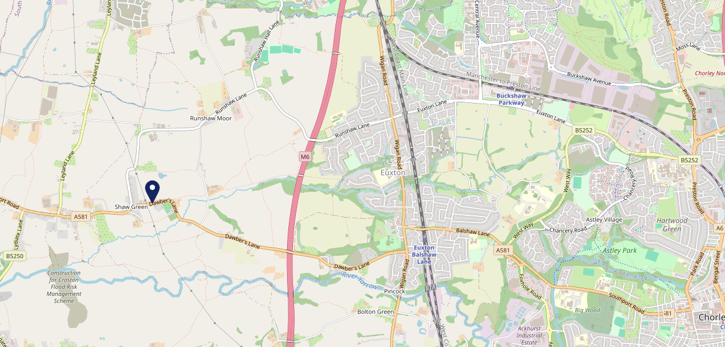
Site Intel
Travellers Rest PR76EG
Travellers Rest PR76EG
97 Chains
21/06/2023 - 12/06/2024
Site Summary
Travellers Rest PR76EG
Work Area
Region
TV Region
Urbanicity
Preston
North West
North West
Rural hamlet and isolated dwellings
PR76EG
Punch - Fireside
Top Competitors
ATV
Gender
Rose & Crown Inn
#1
£38.42
56.23%
Male
PR268LP
Marstons - T&L
Affluence
Segmentation
The Talbot
#2
66.36%
22.22%
Middle Income
Paying The Mortgage
PR76HX
Star Pubs & Bars
Age Group
Visit Day
Plough Inn
#3
21.25%
30.77%
PR76HB
35 to 44
Sun
Star Pubs & Bars
Nearest Station
Euxton Balshaw Lane(2.62 miles)
732 Site Customers
90 Competitors
58865 Competitor Customers

Slide 2
Site Intel
Travellers Rest PR76EG
Travellers Rest PR76EG
97 Chains
21/06/2023 - 12/06/2024
Spend by Weekpart
How is customer spend distributed throughout the week for Travellers Rest PR76EG versus its competitors?
% of spend for Travellers Rest PR76EG and 97 Chains in 3 Miles from 21/06/2023 - 12/06/2024 split by Day of Week
732 Site Customers
90 Competitors
58865 Competitor Customers

Slide 3
Site Intel
Travellers Rest PR76EG
Travellers Rest PR76EG
97 Chains
21/06/2023 - 12/06/2024
Visit Frequency
How frequently per year do customers visit Travellers Rest PR76EG versus its competitors?
% of customer numbers for Travellers Rest PR76EG and 97 Chains in 3 Miles from 21/06/2023 - 12/06/2024 and the number of visits made Per Annum
732 Site Customers
90 Competitors
58865 Competitor Customers

Slide 4
Site Intel
Travellers Rest PR76EG
Travellers Rest PR76EG
97 Chains
21/06/2023 - 12/06/2024
ATV Change
How has ATV changed between two date ranges?
732 Site Customers

Slide 5
Site Intel
Travellers Rest PR76EG
Travellers Rest PR76EG
97 Chains
21/06/2023 - 12/06/2024
Market Share Change
How has market share changed between two date ranges?
% of market share spend for Travellers Rest PR76EG and 97 Chains in 3 Miles from 21/06/2023 - 12/06/2024
732 Site Customers

Slide 6
Site Intel
Travellers Rest PR76EG
Travellers Rest PR76EG
97 Chains
21/06/2023 - 12/06/2024
Age
How does the age profile of customers who visit Travellers Rest PR76EG compare versus its competitors?
% of spend for Travellers Rest PR76EG and 97 Chains in 3 Miles from 21/06/2023 - 12/06/2024 split by Age Range
379 Site Customers
90 Competitors
25062 Competitor Customers

Slide 7
Site Intel
Travellers Rest PR76EG
Travellers Rest PR76EG
97 Chains
21/06/2023 - 12/06/2024
Affluence
How does the affluence of customers who visit Travellers Rest PR76EG compare versus its competitors?
% of spend for Travellers Rest PR76EG and 97 Chains in 3 Miles from 21/06/2023 - 12/06/2024 split by Affluence
382 Site Customers
90 Competitors
25299 Competitor Customers

Slide 8
Site Intel
Travellers Rest PR76EG
Travellers Rest PR76EG
97 Chains
21/06/2023 - 12/06/2024
Gender
How does the gender profile of customers who visit Travellers Rest PR76EG compare versus its competitors?
% of spend for Travellers Rest PR76EG and 97 Chains in 3 Miles from 21/06/2023 - 12/06/2024 split by Gender
382 Site Customers
90 Competitors
25299 Competitor Customers

Slide 9
Site Intel
Travellers Rest PR76EG
Travellers Rest PR76EG
97 Chains
21/06/2023 - 12/06/2024
Punch Segmentation
How does the Custom segmentation profile of customers who visit Travellers Rest PR76EG compare versus its competitors?
% of spend for Travellers Rest PR76EG and 97 Chains in 3 Miles from 21/06/2023 - 12/06/2024 split by Segment
732 Site Customers
90 Competitors
58865 Competitor Customers

Slide 10
Site Intel
Travellers Rest PR76EG
Travellers Rest PR76EG
97 Chains
21/06/2023 - 12/06/2024
Spend by Distance
How does the spend profile of Travellers Rest PR76EG compare versus its competitors based on travel distances?
% of spend for Travellers Rest PR76EG and 97 Chains in 3 Miles from 21/06/2023 - 12/06/2024 split by Distance travelled
370 Site Customers
90 Competitors
24520 Competitor Customers

Slide 11
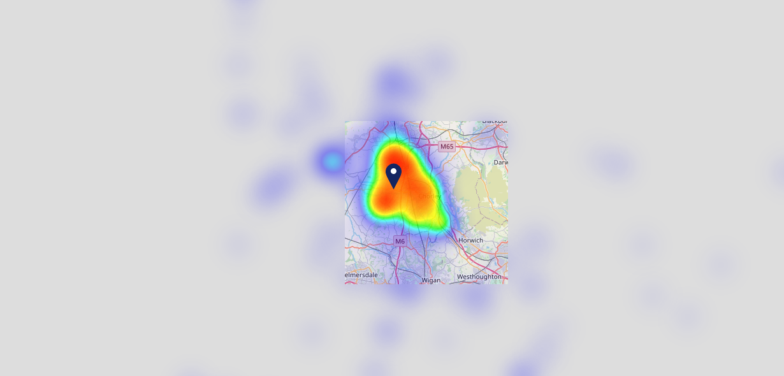
Site Intel
Travellers Rest PR76EG
21/06/2023 - 12/06/2024
Map of Guest Origin
Where do customers of Travellers Rest PR76EG come from?
Where do customers of Travellers Rest PR76EG for 21/06/2023 - 12/06/2024 live
370 Site Customers

Slide 12
Site Intel
Travellers Rest PR76EG
Travellers Rest PR76EG
97 Chains
21/06/2023 - 12/06/2024
Share of Wallet
What are the Top 20 venues (by spend) that customers of Travellers Rest PR76EG also visit?
For customers of Travellers Rest PR76EG, who are the top 20 competitors from 97 Chains in 3 Miles for 21/06/2023 - 12/06/2024 split by Venue
732 Site Customers

Slide 13
Site Intel
Travellers Rest PR76EG
Travellers Rest PR76EG
97 Chains
21/06/2023 - 12/06/2024
Share of Wallet Change
How has share of wallet of customers of Travellers Rest PR76EG changed between two date ranges?
732 Site Customers

Slide 14
Site Intel
Travellers Rest PR76EG
21/06/2023 - 12/06/2024
Market Summary
How does the local area for Travellers Rest PR76EG compare to the national average (1 = low, 10 = high)
Data Type | Name | Spend in 250m | 250m Spend vs National | Spend in 500m | 500m Spend vs National | Spend in 1 mile | 1 mile Spend vs National | Spend in 3 miles | 3 mile Spend vs National
Total | Annual Sales | £433K | 3 | £433K | 2 | £2.89M | 2 | £96.40M | 6
Weekpart | Mon - Thu | 35.6% | 3 | 35.6% | 2 | 35.4% | 1 | 39.7% | 3
Weekpart | Fri - Sat | 33.4% | 1 | 33.4% | 1 | 40.6% | 4 | 41.7% | 5
Weekpart | Sun | 30.9% | 10 | 30.9% | 10 | 24.0% | 10 | 18.6% | 10
Age | 18 to 24 | 0.3% | 1 | 0.3% | 1 | 2.7% | 2 | 5.8% | 4
Age | 25 to 34 | 20.8% | 5 | 20.8% | 5 | 11.5% | 1 | 16.7% | 2
Age | 35 to 44 | 21.1% | 4 | 21.1% | 4 | 18.0% | 2 | 24.3% | 6
Age | 45 to 54 | 21.0% | 6 | 21.0% | 6 | 21.9% | 8 | 20.5% | 6
Age | 55 to 64 | 17.5% | 7 | 17.5% | 7 | 24.6% | 10 | 18.0% | 8
Age | 65 to 74 | 11.5% | 9 | 11.5% | 9 | 13.3% | 10 | 9.9% | 9
Age | 75+ | 7.8% | 10 | 7.8% | 10 | 7.9% | 10 | 4.8% | 9
CAMEO | Business Elite | 3.0% | 3 | 3.0% | 3 | 8.1% | 6 | 4.0% | 3
CAMEO | Prosperous Professionals | 9.4% | 9 | 9.4% | 9 | 10.0% | 9 | 5.6% | 4
CAMEO | Flourishing Society | 4.1% | 1 | 4.1% | 1 | 6.9% | 2 | 6.8% | 2
CAMEO | Content Communities | 17.1% | 9 | 17.1% | 9 | 17.8% | 9 | 14.3% | 8
CAMEO | White Collar Neighbourhoods | 16.8% | 9 | 16.8% | 10 | 11.6% | 6 | 13.0% | 8
CAMEO | Enterprising Mainstream | 10.3% | 7 | 10.3% | 7 | 13.7% | 9 | 15.3% | 10
CAMEO | Paying The Mortgage | 22.1% | 9 | 22.1% | 9 | 19.8% | 9 | 21.2% | 10
CAMEO | Cash Conscious Communities | 8.3% | 5 | 8.3% | 5 | 5.7% | 2 | 8.6% | 5
CAMEO | On A Budget | 5.0% | 4 | 5.0% | 4 | 4.8% | 3 | 7.9% | 7
CAMEO | Family Value | 3.9% | 7 | 3.9% | 7 | 1.7% | 4 | 3.3% | 6
Affluence | AB | 16.5% | 3 | 16.5% | 3 | 25.0% | 5 | 16.4% | 2
Affluence | C1C2 | 66.4% | 10 | 66.4% | 10 | 62.9% | 10 | 63.8% | 10
Affluence | DE | 17.2% | 4 | 17.2% | 4 | 12.1% | 2 | 19.8% | 6

Slide 15
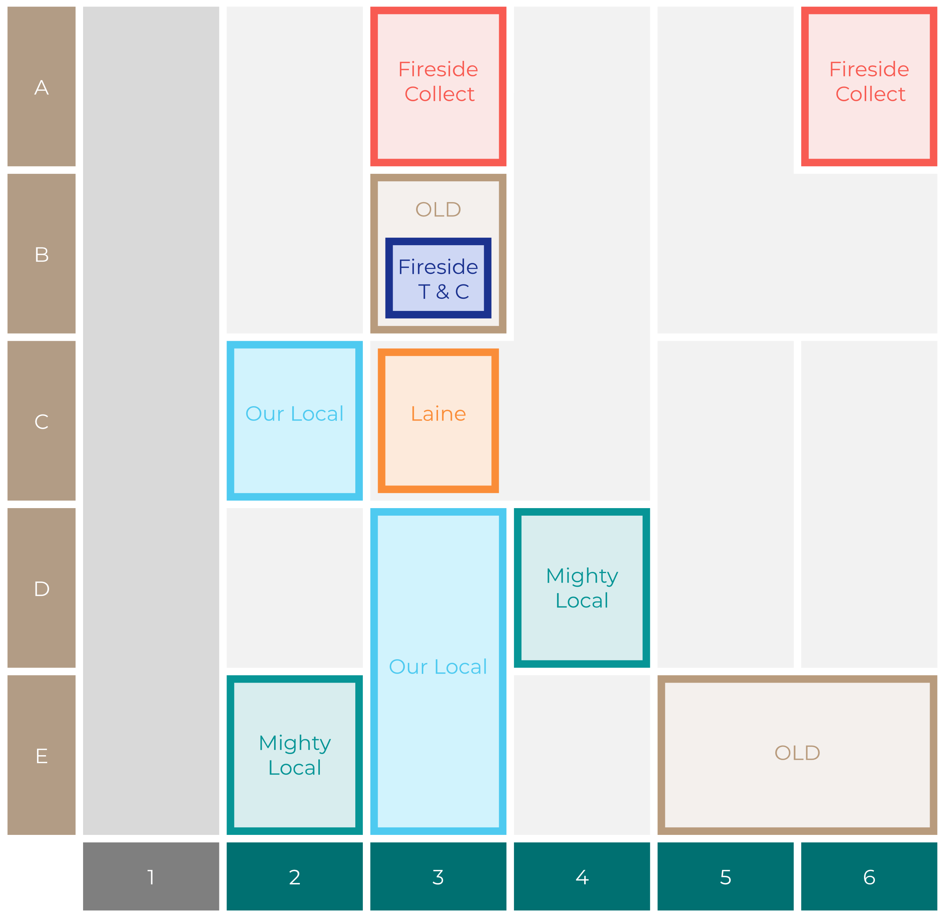
Site Intel
Travellers Rest PR76EG
Site Potential 1
Site Characteristics
£3000
£18000
OCC Concept Fit
Achievable Average Weekly Takings
Our Local Destination
£10000
A Food-Led High Affluence B Food-Led Mid Affluence C Wet-Led Mid/High Affluence D Wet-Led Low Affluence E Food-Led Low Affluence
AWT 2 Local Regulars 3 Local Passing Trade 4 Destination Wet-Led 5 Destination Food-Led 6 Destination Very Food-Led
A
B
C
D
E
1
2
3
4
5
6

Slide 16
Site Intel
Travellers Rest PR76EG
Site Potential 2
Concept Recommendation

Slide 17
Site Intel
Travellers Rest PR76EG
Local Market Profile
Mix of spend by customer segment in Punch site and local market
 | Customer Count | Family Familiar | Occasional & Local | Mid-Week Seniors | Part Of The Pub | Metro Sophisticates | Young & Connected | Bubbly Weekenders | Upmarket Diners
Travellers Rest | 136 | 23.12% | 7.22% | 14.66% | 3.43% | 12.48% | 7.17% | 9.02% | 22.86%
Local Catchment | 4508 | 13.10% | 8.32% | 21.22% | 15.70% | 9.53% | 12.14% | 8.98% | 10.98%
Punch T&L | 105065 | 8.10% | 5.82% | 29.29% | 10.78% | 11.72% | 11.71% | 7.11% | 15.43%
Travellers Rest vs Local Catchment |  | 10.02% | -1.10% | -6.56% | -12.27% | 2.95% | -4.97% | 0.04% | 11.88%
Travellers Rest vs Punch T&L |  | 15.02% | 1.40% | -14.63% | -7.35% | 0.76% | -4.54% | 1.91% | 7.43%
Local Catchment vs Punch T&L |  | 5.00% | 2.50% | -8.07% | 4.92% | -2.19% | 0.43% | 1.87% | -4.45%

Slide 18
Site Intel
Travellers Rest PR76EG
Local Competitor Profiles
Mix of spend by customer segment in Punch site and local competitors
 | Customer Count | Family Familiar | Occasional & Local | Mid-Week Seniors | Part Of The Pub | Metro Sophisticates | Young & Connected | Bubbly Weekenders | Upmarket Diners
Travellers Rest PR76EG | 136 | 23.12% | 7.22% | 14.66% | 3.43% | 12.48% | 7.17% | 9.02% | 22.86%
Rose & Crown Inn PR268LP | 423 | 8.73% | 4.49% | 42.09% | 1.60% | 6.25% | 3.94% | 6.42% | 26.43%
The Talbot PR76HX | 257 | 13.50% | 5.87% | 4.09% | 15.61% | 11.85% | 29.82% | 16.49% | 2.73%
Plough Inn PR76HB | 284 | 16.27% | 6.67% | 29.12% | 7.39% | 4.75% | 9.87% | 8.47% | 17.41%
Euxton Mills Hotel (Euxton) PR76JD | 150 | 10.60% | 9.66% | 30.63% | 10.48% | 14.67% | 6.45% | 5.37% | 12.11%
Mill at Charnock Farm PR255DA | 332 | 12.29% | 6.47% | 13.19% | 10.75% | 12.95% | 16.92% | 16.25% | 11.14%
Wheatsheaf Inn Croston PR269RA | 475 | 6.12% | 3.82% | 39.72% | 5.47% | 17.79% | 4.66% | 7.50% | 14.88%
Dog & Partridge PR75ES | 373 | 18.81% | 17.54% | 16.89% | 3.83% | 8.57% | 11.26% | 9.69% | 13.36%
Farmers Arms Heskin PR75NP | 248 | 17.32% | 9.02% | 42.59% | 4.07% | 3.02% | 8.02% | 5.77% | 10.15%
The Stag PR253EL | 262 | 8.10% | 21.18% | 20.52% | 11.60% | 4.76% | 15.33% | 9.30% | 9.18%
Eagle & Child PR253AA | 248 | 10.41% | 12.59% | 23.92% | 19.18% | 3.20% | 13.67% | 11.20% | 5.78%
Croston Sports Club PR269RR | 279 | 9.25% | 3.77% | 16.59% | 12.00% | 15.73% | 8.42% | 18.61% | 15.57%
Euxton Cricket Club PR76DD | 103 | 7.36% | 3.82% | 16.08% | 1.88% | 20.69% | 5.11% | 15.28% | 29.75%
Hinds Head Inn PR75HL | 409 | 16.24% | 6.03% | 19.10% | 3.70% | 6.36% | 11.97% | 10.74% | 25.82%
Wheatsheaf Hotel PR268PH | 33 | 48.67% | 2.49% | 16.80% | 17.81% | 6.73% | 3.39% | 2.21% | 1.85%
Bay Horse Chorley PR76JH | 210 | 10.60% | 4.25% | 13.63% | 44.44% | 1.86% | 13.60% | 8.07% | 3.52%
Original Farmers Arms Eccleston PR75QS | 186 | 15.97% | 18.66% | 28.69% | 13.18% | 5.93% | 8.69% | 2.90% | 5.93%
The Astley Village Inn PR71XP | 279 | 23.82% | 6.59% | 16.40% | 9.63% | 6.90% | 18.18% | 8.04% | 10.40%
Verthe Euxton Mills PR76JD | 90 | 10.39% | 16.42% | 20.44% | 11.02% | 12.49% | 13.15% | 5.12% | 10.93%
The Leyland Lion PR252SA | 763 | 20.07% | 11.59% | 10.50% | 26.13% | 5.82% | 12.49% | 8.42% | 4.94%
Broadfield Arms PR251XH | 138 | 22.27% | 3.39% | 3.84% | 28.17% | 21.60% | 13.94% | 5.39% | 1.37%
Bowling Green PR75LA | 450 | 33.01% | 9.28% | 17.00% | 5.27% | 3.58% | 12.64% | 7.87% | 11.31%
Rose & Crown Hotel PR254QA | 37 | 6.48% | 1.50% | 53.82% | 28.19% | 2.30% | 5.74% | 1.94% | 0.00%
Woodsman PR255RY | 216 | 17.75% | 6.95% | 20.52% | 18.64% | 5.48% | 16.74% | 2.94% | 10.95%
Gables PR252SD | 454 | 15.08% | 9.30% | 8.26% | 12.73% | 15.71% | 22.60% | 10.16% | 6.12%

