Slide 1
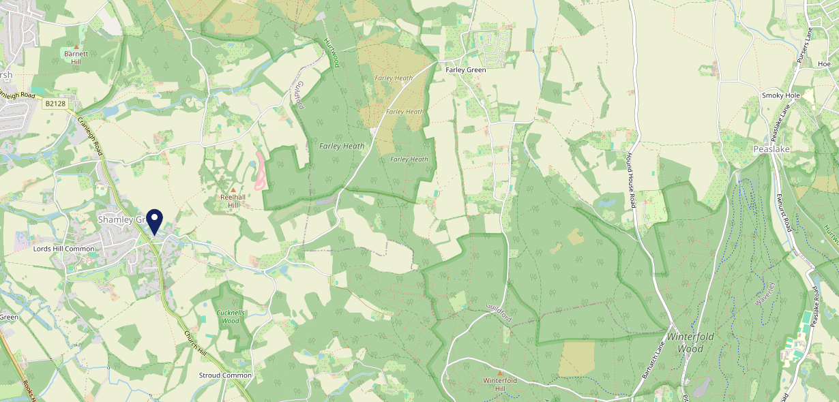
Site Intel
Red Lion GU50UB
Red Lion GU50UB
97 Chains
07/06/2023 - 29/05/2024
Site Summary
Red Lion GU50UB
Work Area
Region
TV Region
Urbanicity
Guildford and Aldershot
South East
London
Rural village
GU50UB
Punch - Fireside
Top Competitors
ATV
Gender
Grantley Arms
#1
£30.93
69.35%
Male
GU50PE
Youngs Managed
Affluence
Segmentation
Percy Arms (Chilworth)
#2
75.90%
31.16%
High Income
Flourishing Society
GU48NP
GK Pub Partners
Age Group
Visit Day
Bricklayers Arms Shamley
#3
25.28%
27.08%
GU50UA
55 to 64
Sun
Stonegate PP
Nearest Station
Chilworth(3.38 miles)
1125 Site Customers
17 Competitors
8776 Competitor Customers

Slide 2
Site Intel
Red Lion GU50UB
Red Lion GU50UB
97 Chains
07/06/2023 - 29/05/2024
Spend by Weekpart
How is customer spend distributed throughout the week for Red Lion GU50UB versus its competitors?
% of spend for Red Lion GU50UB and 97 Chains in 3 Miles from 07/06/2023 - 29/05/2024 split by Day of Week
1125 Site Customers
17 Competitors
8776 Competitor Customers

Slide 3
Site Intel
Red Lion GU50UB
Red Lion GU50UB
97 Chains
07/06/2023 - 29/05/2024
Visit Frequency
How frequently per year do customers visit Red Lion GU50UB versus its competitors?
% of customer numbers for Red Lion GU50UB and 97 Chains in 3 Miles from 07/06/2023 - 29/05/2024 and the number of visits made Per Annum
1125 Site Customers
17 Competitors
8776 Competitor Customers

Slide 4
Site Intel
Red Lion GU50UB
Red Lion GU50UB
97 Chains
07/06/2023 - 29/05/2024
ATV Change
How has ATV changed between two date ranges?
1125 Site Customers

Slide 5
Site Intel
Red Lion GU50UB
Red Lion GU50UB
97 Chains
07/06/2023 - 29/05/2024
Market Share Change
How has market share changed between two date ranges?
% of market share spend for Red Lion GU50UB and 97 Chains in 3 Miles from 07/06/2023 - 29/05/2024
1125 Site Customers

Slide 6
Site Intel
Red Lion GU50UB
Red Lion GU50UB
97 Chains
07/06/2023 - 29/05/2024
Age
How does the age profile of customers who visit Red Lion GU50UB compare versus its competitors?
% of spend for Red Lion GU50UB and 97 Chains in 3 Miles from 07/06/2023 - 29/05/2024 split by Age Range
568 Site Customers
17 Competitors
4435 Competitor Customers

Slide 7
Site Intel
Red Lion GU50UB
Red Lion GU50UB
97 Chains
07/06/2023 - 29/05/2024
Affluence
How does the affluence of customers who visit Red Lion GU50UB compare versus its competitors?
% of spend for Red Lion GU50UB and 97 Chains in 3 Miles from 07/06/2023 - 29/05/2024 split by Affluence
580 Site Customers
17 Competitors
4450 Competitor Customers

Slide 8
Site Intel
Red Lion GU50UB
Red Lion GU50UB
97 Chains
07/06/2023 - 29/05/2024
Gender
How does the gender profile of customers who visit Red Lion GU50UB compare versus its competitors?
% of spend for Red Lion GU50UB and 97 Chains in 3 Miles from 07/06/2023 - 29/05/2024 split by Gender
580 Site Customers
17 Competitors
4450 Competitor Customers

Slide 9
Site Intel
Red Lion GU50UB
Red Lion GU50UB
97 Chains
07/06/2023 - 29/05/2024
Punch Segmentation
How does the Custom segmentation profile of customers who visit Red Lion GU50UB compare versus its competitors?
% of spend for Red Lion GU50UB and 97 Chains in 3 Miles from 07/06/2023 - 29/05/2024 split by Segment
1125 Site Customers
17 Competitors
8776 Competitor Customers

Slide 10
Site Intel
Red Lion GU50UB
Red Lion GU50UB
97 Chains
07/06/2023 - 29/05/2024
Spend by Distance
How does the spend profile of Red Lion GU50UB compare versus its competitors based on travel distances?
% of spend for Red Lion GU50UB and 97 Chains in 3 Miles from 07/06/2023 - 29/05/2024 split by Distance travelled
566 Site Customers
17 Competitors
4332 Competitor Customers

Slide 11
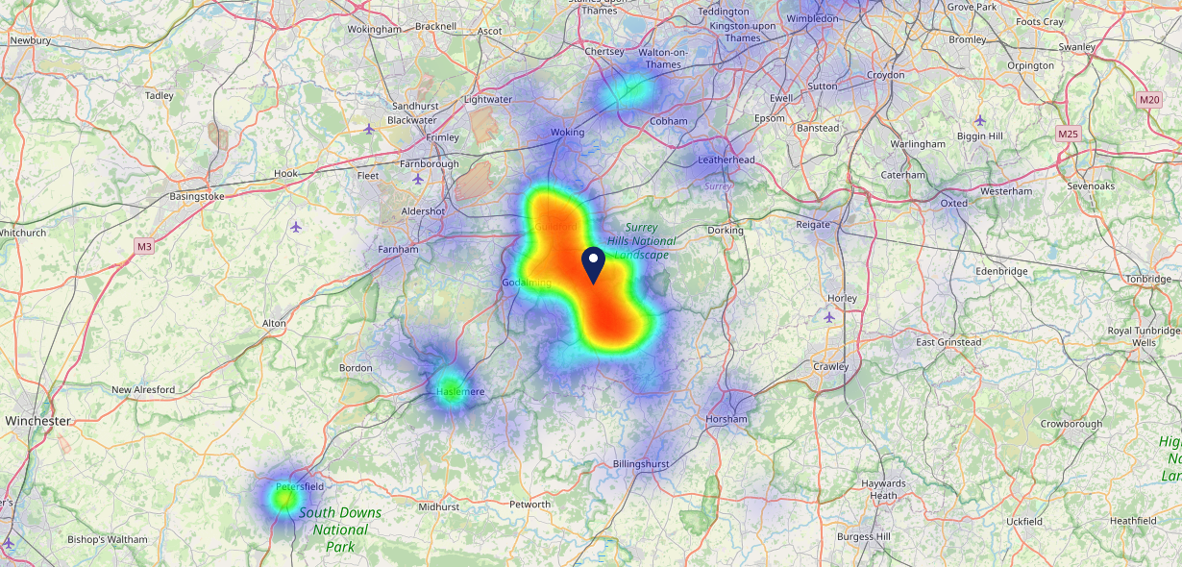
Site Intel
Red Lion GU50UB
07/06/2023 - 29/05/2024
Map of Guest Origin
Where do customers of Red Lion GU50UB come from?
Where do customers of Red Lion GU50UB for 07/06/2023 - 29/05/2024 live
566 Site Customers

Slide 12
Site Intel
Red Lion GU50UB
Red Lion GU50UB
97 Chains
07/06/2023 - 29/05/2024
Share of Wallet
What are the Top 20 venues (by spend) that customers of Red Lion GU50UB also visit?
For customers of Red Lion GU50UB, who are the top 20 competitors from 97 Chains in 3 Miles for 07/06/2023 - 29/05/2024 split by Venue
1125 Site Customers

Slide 13
Site Intel
Red Lion GU50UB
Red Lion GU50UB
97 Chains
07/06/2023 - 29/05/2024
Share of Wallet Change
How has share of wallet of customers of Red Lion GU50UB changed between two date ranges?
1125 Site Customers

Slide 14
Site Intel
Red Lion GU50UB
07/06/2023 - 29/05/2024
Market Summary
How does the local area for Red Lion GU50UB compare to the national average (1 = low, 10 = high)
Data Type | Name | Spend in 250m | 250m Spend vs National | Spend in 500m | 500m Spend vs National | Spend in 1 mile | 1 mile Spend vs National | Spend in 3 miles | 3 mile Spend vs National
Total | Annual Sales | £1.13M | 5 | £1.14M | 4 | £1.14M | 2 | £10.07M | 2
Weekpart | Mon - Thu | 34.3% | 2 | 34.2% | 2 | 34.2% | 1 | 37.3% | 1
Weekpart | Fri - Sat | 41.3% | 4 | 41.3% | 4 | 41.3% | 4 | 41.1% | 4
Weekpart | Sun | 24.5% | 10 | 24.4% | 10 | 24.4% | 10 | 21.6% | 10
Age | 18 to 24 | 5.9% | 6 | 5.9% | 5 | 5.9% | 5 | 1.9% | 1
Age | 25 to 34 | 4.7% | 1 | 4.7% | 1 | 4.7% | 1 | 7.9% | 1
Age | 35 to 44 | 16.1% | 1 | 16.1% | 1 | 16.1% | 1 | 19.9% | 2
Age | 45 to 54 | 16.7% | 3 | 16.7% | 2 | 16.7% | 2 | 22.2% | 9
Age | 55 to 64 | 22.0% | 9 | 22.1% | 9 | 22.1% | 10 | 24.8% | 10
Age | 65 to 74 | 13.1% | 9 | 13.1% | 9 | 13.1% | 10 | 13.5% | 10
Age | 75+ | 21.3% | 10 | 21.4% | 10 | 21.3% | 10 | 9.8% | 10
CAMEO | Business Elite | 25.9% | 10 | 26.0% | 10 | 25.9% | 10 | 29.2% | 10
CAMEO | Prosperous Professionals | 12.9% | 10 | 12.8% | 10 | 12.8% | 10 | 12.4% | 10
CAMEO | Flourishing Society | 31.9% | 10 | 31.9% | 10 | 31.9% | 10 | 24.1% | 10
CAMEO | Content Communities | 9.3% | 3 | 9.3% | 3 | 9.3% | 2 | 13.2% | 7
CAMEO | White Collar Neighbourhoods | 3.5% | 1 | 3.5% | 1 | 3.5% | 1 | 6.1% | 1
CAMEO | Enterprising Mainstream | 2.1% | 1 | 2.1% | 1 | 2.1% | 1 | 2.7% | 1
CAMEO | Paying The Mortgage | 12.1% | 4 | 12.1% | 4 | 12.1% | 4 | 8.6% | 1
CAMEO | Cash Conscious Communities | 1.4% | 1 | 1.4% | 1 | 1.4% | 1 | 2.2% | 1
CAMEO | On A Budget | 0.7% | 1 | 0.7% | 1 | 0.7% | 1 | 1.2% | 1
CAMEO | Family Value | 0.2% | 1 | 0.2% | 1 | 0.2% | 1 | 0.3% | 1
Affluence | AB | 70.7% | 10 | 70.7% | 10 | 70.6% | 10 | 65.8% | 10
Affluence | C1C2 | 27.1% | 1 | 27.1% | 1 | 27.1% | 1 | 30.6% | 1
Affluence | DE | 2.2% | 1 | 2.2% | 1 | 2.3% | 1 | 3.6% | 1

Slide 15
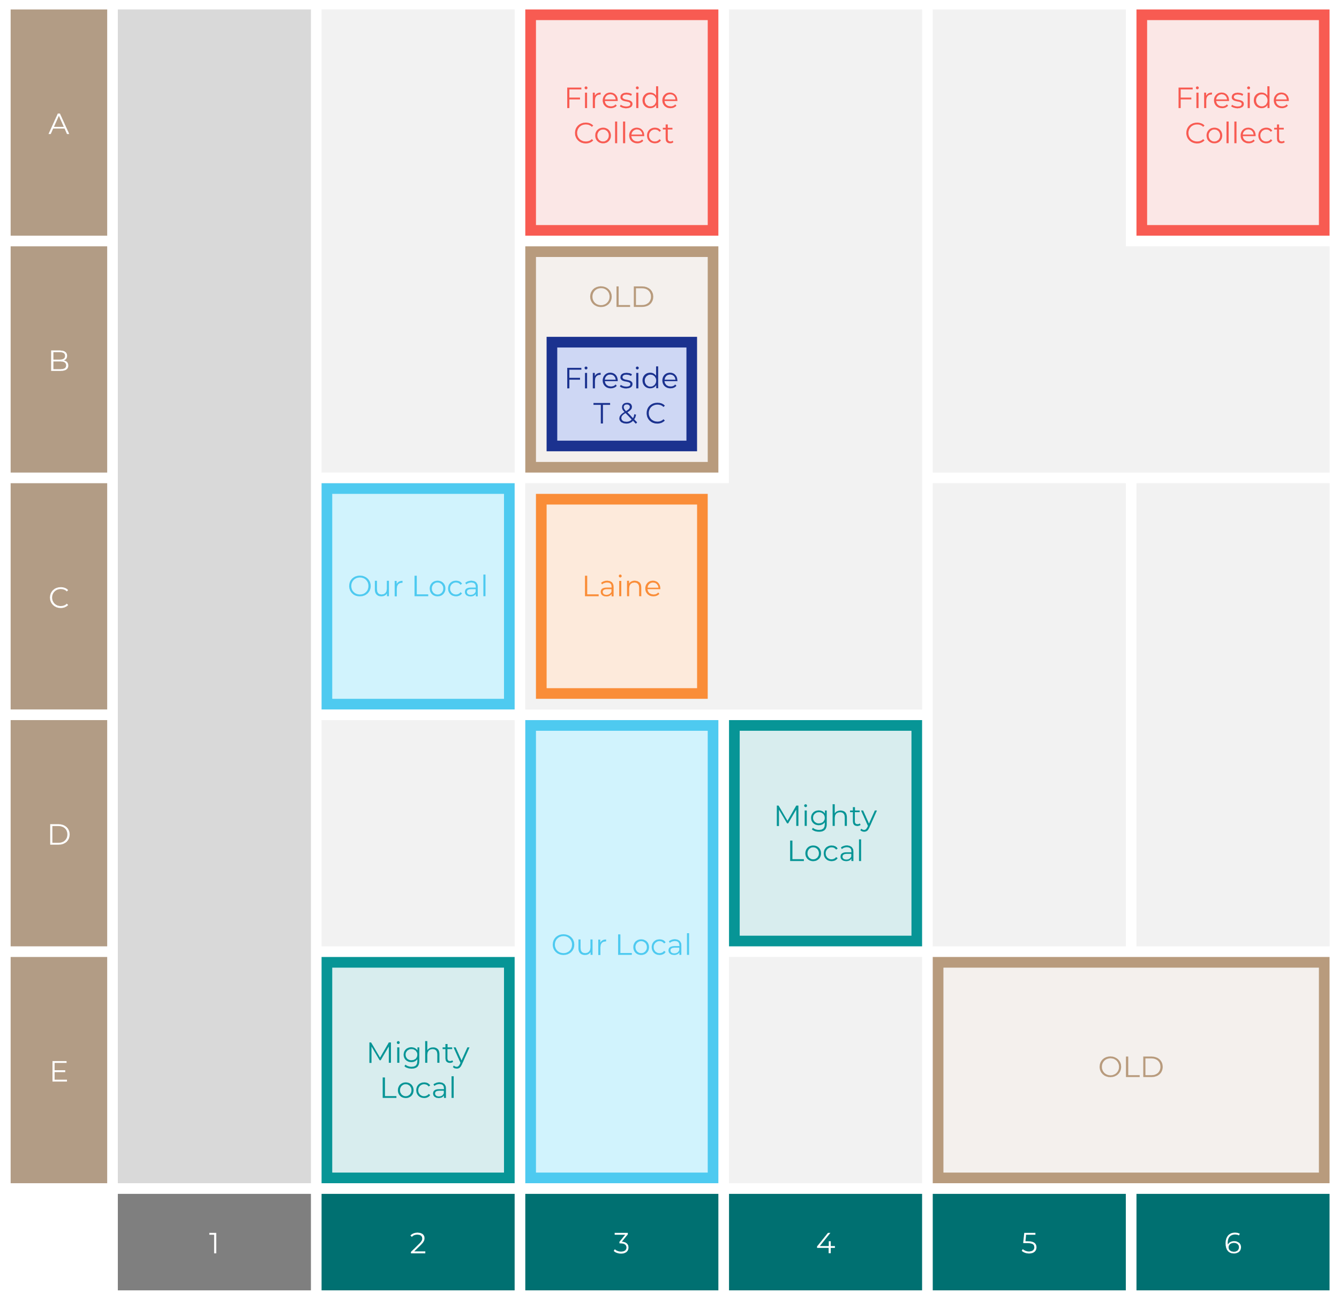
Site Intel
Red Lion GU50UB
Site Potential 1
Site Characteristics
£3000
£18000
OCC Concept Fit
Achievable Average Weekly Takings
Fireside Scenic
£3500
A Food-Led High Affluence B Food-Led Mid Affluence C Wet-Led Mid/High Affluence D Wet-Led Low Affluence E Food-Led Low Affluence
AWT 2 Local Regulars 3 Local Passing Trade 4 Destination Wet-Led 5 Destination Food-Led 6 Destination Very Food-Led
A
B
C
D
E
1
2
3
4
5
6

Slide 16
Site Intel
Red Lion GU50UB
Site Potential 2
Concept Recommendation

Slide 17
Site Intel
Red Lion GU50UB
Local Market Profile
Mix of spend by customer segment in Punch site and local market
 | Customer Count | Family Familiar | Occasional & Local | Mid-Week Seniors | Part Of The Pub | Metro Sophisticates | Young & Connected | Bubbly Weekenders | Upmarket Diners
Red Lion | 191 | 1.92% | 0.16% | 12.99% | 0.11% | 10.40% | 1.76% | 5.73% | 66.88%
Local Catchment | 1326 | 2.49% | 1.11% | 15.55% | 4.13% | 18.98% | 3.79% | 4.35% | 49.55%
Punch T&L | 104416 | 8.08% | 5.74% | 29.47% | 10.69% | 11.73% | 11.68% | 7.08% | 15.48%
Red Lion vs Local Catchment |  | -0.57% | -0.95% | -2.56% | -4.02% | -8.58% | -2.03% | 1.38% | 17.33%
Red Lion vs Punch T&L |  | -6.16% | -5.58% | -16.48% | -10.58% | -1.33% | -9.92% | -1.35% | 51.40%
Local Catchment vs Punch T&L |  | -5.59% | -4.63% | -13.92% | -6.56% | 7.25% | -7.89% | -2.73% | 34.07%

Slide 18
Site Intel
Red Lion GU50UB
Local Competitor Profiles
Mix of spend by customer segment in Punch site and local competitors
 | Customer Count | Family Familiar | Occasional & Local | Mid-Week Seniors | Part Of The Pub | Metro Sophisticates | Young & Connected | Bubbly Weekenders | Upmarket Diners
Red Lion GU50UB | 191 | 1.92% | 0.16% | 12.99% | 0.11% | 10.40% | 1.76% | 5.73% | 66.88%
Grantley Arms GU50PE | 326 | 0.40% | 2.27% | 14.03% | 0.19% | 12.27% | 1.59% | 1.74% | 67.47%
Percy Arms (Chilworth) GU48NP | 442 | 5.32% | 0.92% | 11.79% | 1.62% | 20.26% | 7.40% | 6.65% | 45.99%
Bricklayers Arms Shamley GU50UA | 82 | 1.82% | 0.10% | 30.63% | 0.34% | 10.76% | 1.81% | 22.13% | 32.36%
Drummond GU59AG | 358 | 2.00% | 0.47% | 17.54% | 0.85% | 19.40% | 1.73% | 1.25% | 56.72%
Jolly Farmer Inn GU50HB | 169 | 0.05% | 1.72% | 7.91% | 2.10% | 37.78% | 2.68% | 0.51% | 47.20%
Queen Victoria GU48BY | 125 | 3.59% | 0.49% | 34.83% | 1.87% | 11.82% | 6.34% | 4.23% | 36.78%
Wheatsheaf Bramley GU50HB | 38 | 5.12% | 0.00% | 18.07% | 56.26% | 8.62% | 7.63% | 1.16% | 3.11%
William IV (Albury) GU59DG | 105 | 3.03% | 0.93% | 16.15% | 0.00% | 10.91% | 0.59% | 4.35% | 64.02%
Bramley Social Club GU50AX | 3 | 0.00% | 0.00% | 1.34% | 82.02% | 0.00% | 16.63% | 0.00% | 0.00%
Steam Dreams Rail GU59AE | 36 | 2.41% | 0.00% | 31.11% | 3.05% | 13.25% | 1.11% | 22.31% | 26.72%
Botanical Bubbles GU50JR | 4 | 0.00% | 0.00% | 0.00% | 0.00% | 0.00% | 50.00% | 0.00% | 50.00%

