Slide 1
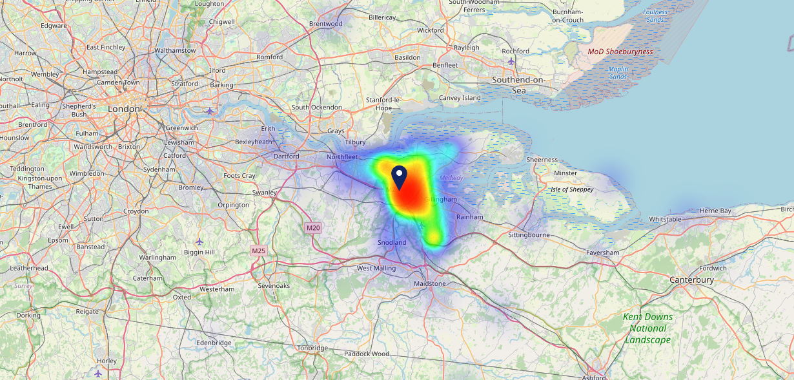
Site Intel
Three Crutches ME23UG
Three Crutches ME23UG
97 Chains
03/05/2023 - 24/04/2024
Site Summary
Three Crutches ME23UG
Work Area
Region
TV Region
Urbanicity
London
South East
South
Urban city and town
ME23UG
Punch - Our Local +
Top Competitors
ATV
Gender
Bounty Strood
#1
£19.57
62.97%
Male
ME22XH
Craft Union
Affluence
Segmentation
Stone Horse
#2
44.63%
26.60%
Middle Income
Flourishing Society
ME38EN
Admiral Taverns Ltd
Age Group
Visit Day
George Vaults Inn
#3
28.22%
24.15%
ME11LN
35 to 44
Sat
Pub Restaurant
Nearest Station
Cuxton(2.87 miles)
1220 Site Customers
97 Competitors
67021 Competitor Customers

Slide 2
Site Intel
Three Crutches ME23UG
Three Crutches ME23UG
97 Chains
03/05/2023 - 24/04/2024
Spend by Weekpart
How is customer spend distributed throughout the week for Three Crutches ME23UG versus its competitors?
% of spend for Three Crutches ME23UG and 97 Chains in 3 Miles from 03/05/2023 - 24/04/2024 split by Day of Week
1220 Site Customers
97 Competitors
67021 Competitor Customers

Slide 3
Site Intel
Three Crutches ME23UG
Three Crutches ME23UG
97 Chains
03/05/2023 - 24/04/2024
Visit Frequency
How frequently per year do customers visit Three Crutches ME23UG versus its competitors?
% of customer numbers for Three Crutches ME23UG and 97 Chains in 3 Miles from 03/05/2023 - 24/04/2024 and the number of visits made Per Annum
1220 Site Customers
97 Competitors
67021 Competitor Customers

Slide 4
Site Intel
Three Crutches ME23UG
Three Crutches ME23UG
97 Chains
03/05/2023 - 24/04/2024
ATV Change
How has ATV changed between two date ranges?
1220 Site Customers

Slide 5
Site Intel
Three Crutches ME23UG
Three Crutches ME23UG
97 Chains
03/05/2023 - 24/04/2024
Market Share Change
How has market share changed between two date ranges?
% of market share spend for Three Crutches ME23UG and 97 Chains in 3 Miles from 03/05/2023 - 24/04/2024
1220 Site Customers

Slide 6
Site Intel
Three Crutches ME23UG
Three Crutches ME23UG
97 Chains
03/05/2023 - 24/04/2024
Age
How does the age profile of customers who visit Three Crutches ME23UG compare versus its competitors?
% of spend for Three Crutches ME23UG and 97 Chains in 3 Miles from 03/05/2023 - 24/04/2024 split by Age Range
641 Site Customers
97 Competitors
32477 Competitor Customers

Slide 7
Site Intel
Three Crutches ME23UG
Three Crutches ME23UG
97 Chains
03/05/2023 - 24/04/2024
Affluence
How does the affluence of customers who visit Three Crutches ME23UG compare versus its competitors?
% of spend for Three Crutches ME23UG and 97 Chains in 3 Miles from 03/05/2023 - 24/04/2024 split by Affluence
659 Site Customers
97 Competitors
33236 Competitor Customers

Slide 8
Site Intel
Three Crutches ME23UG
Three Crutches ME23UG
97 Chains
03/05/2023 - 24/04/2024
Gender
How does the gender profile of customers who visit Three Crutches ME23UG compare versus its competitors?
% of spend for Three Crutches ME23UG and 97 Chains in 3 Miles from 03/05/2023 - 24/04/2024 split by Gender
659 Site Customers
97 Competitors
33236 Competitor Customers

Slide 9
Site Intel
Three Crutches ME23UG
Three Crutches ME23UG
97 Chains
03/05/2023 - 24/04/2024
Punch Segmentation
How does the Custom segmentation profile of customers who visit Three Crutches ME23UG compare versus its competitors?
% of spend for Three Crutches ME23UG and 97 Chains in 3 Miles from 03/05/2023 - 24/04/2024 split by Segment
1220 Site Customers
97 Competitors
67021 Competitor Customers

Slide 10
Site Intel
Three Crutches ME23UG
Three Crutches ME23UG
97 Chains
03/05/2023 - 24/04/2024
Spend by Distance
How does the spend profile of Three Crutches ME23UG compare versus its competitors based on travel distances?
% of spend for Three Crutches ME23UG and 97 Chains in 3 Miles from 03/05/2023 - 24/04/2024 split by Distance travelled
650 Site Customers
97 Competitors
32098 Competitor Customers

Slide 11
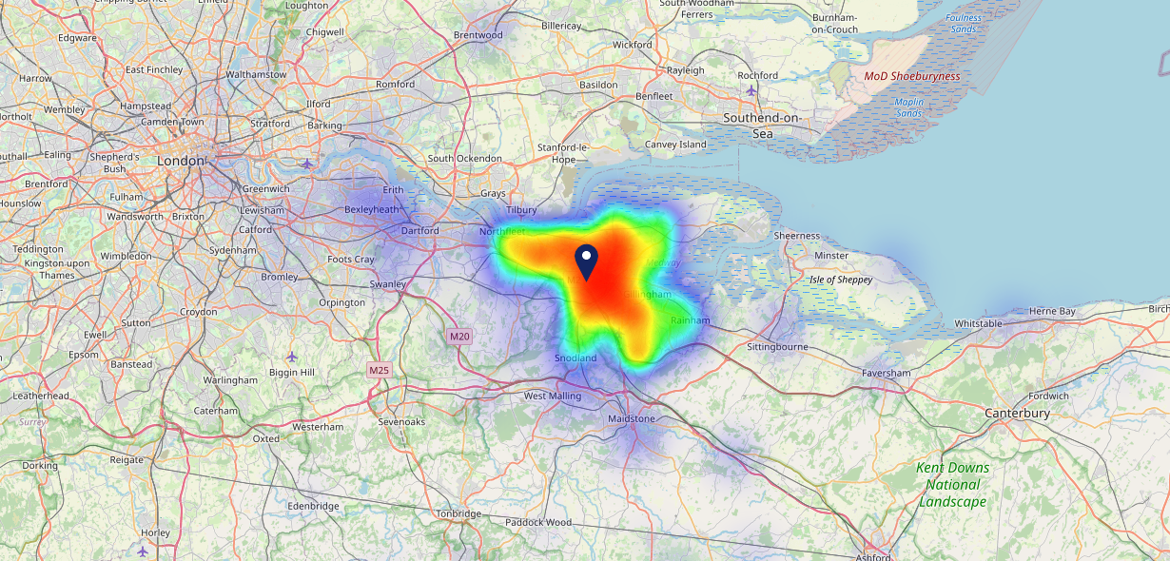
Site Intel
Three Crutches ME23UG
03/05/2023 - 24/04/2024
Map of Guest Origin
Where do customers of Three Crutches ME23UG come from?
Where do customers of Three Crutches ME23UG for 03/05/2023 - 24/04/2024 live
650 Site Customers

Slide 12
Site Intel
Three Crutches ME23UG
Three Crutches ME23UG
97 Chains
03/05/2023 - 24/04/2024
Share of Wallet
What are the Top 20 venues (by spend) that customers of Three Crutches ME23UG also visit?
For customers of Three Crutches ME23UG, who are the top 20 competitors from 97 Chains in 3 Miles for 03/05/2023 - 24/04/2024 split by Venue
1220 Site Customers

Slide 13
Site Intel
Three Crutches ME23UG
Three Crutches ME23UG
97 Chains
03/05/2023 - 24/04/2024
Share of Wallet Change
How has share of wallet of customers of Three Crutches ME23UG changed between two date ranges?
1220 Site Customers

Slide 14
Site Intel
Three Crutches ME23UG
03/05/2023 - 24/04/2024
Market Summary
How does the local area for Three Crutches ME23UG compare to the national average (1 = low, 10 = high)
Data Type | Name | Spend in 250m | 250m Spend vs National | Spend in 500m | 500m Spend vs National | Spend in 1 mile | 1 mile Spend vs National | Spend in 3 miles | 3 mile Spend vs National
Total | Annual Sales | £716K | 4 | £730K | 3 | £2.60M | 2 | £89.43M | 6
Weekpart | Mon - Thu | 37.2% | 4 | 37.4% | 3 | 43.6% | 7 | 36.7% | 1
Weekpart | Fri - Sat | 44.9% | 6 | 45.1% | 6 | 40.1% | 3 | 46.6% | 10
Weekpart | Sun | 17.8% | 8 | 17.5% | 8 | 16.3% | 7 | 16.8% | 8
Age | 18 to 24 | 4.7% | 5 | 4.9% | 4 | 6.6% | 5 | 8.4% | 7
Age | 25 to 34 | 13.1% | 2 | 13.0% | 2 | 10.5% | 1 | 19.5% | 3
Age | 35 to 44 | 28.6% | 9 | 28.4% | 9 | 19.0% | 2 | 25.0% | 7
Age | 45 to 54 | 16.8% | 3 | 16.9% | 2 | 15.4% | 1 | 19.9% | 5
Age | 55 to 64 | 19.9% | 8 | 19.7% | 8 | 20.5% | 9 | 15.9% | 6
Age | 65 to 74 | 10.2% | 8 | 10.5% | 8 | 18.3% | 10 | 7.8% | 7
Age | 75+ | 6.7% | 9 | 6.6% | 9 | 9.8% | 10 | 3.5% | 7
CAMEO | Business Elite | 2.9% | 3 | 2.9% | 3 | 4.6% | 4 | 4.6% | 3
CAMEO | Prosperous Professionals | 7.7% | 7 | 7.6% | 7 | 5.7% | 5 | 4.4% | 3
CAMEO | Flourishing Society | 27.3% | 10 | 27.0% | 10 | 23.9% | 10 | 17.8% | 8
CAMEO | Content Communities | 9.9% | 3 | 9.8% | 3 | 8.7% | 2 | 9.9% | 2
CAMEO | White Collar Neighbourhoods | 9.5% | 4 | 9.5% | 4 | 10.9% | 5 | 16.0% | 10
CAMEO | Enterprising Mainstream | 9.7% | 7 | 9.8% | 7 | 8.0% | 5 | 10.5% | 7
CAMEO | Paying The Mortgage | 14.8% | 6 | 14.9% | 6 | 15.6% | 6 | 18.3% | 8
CAMEO | Cash Conscious Communities | 7.8% | 5 | 7.9% | 5 | 10.5% | 7 | 7.7% | 4
CAMEO | On A Budget | 9.4% | 8 | 9.7% | 8 | 11.1% | 9 | 9.6% | 8
CAMEO | Family Value | 1.0% | 3 | 1.0% | 3 | 0.9% | 2 | 1.2% | 3
Affluence | AB | 37.9% | 8 | 37.5% | 8 | 34.1% | 7 | 26.8% | 5
Affluence | C1C2 | 43.9% | 4 | 44.0% | 4 | 43.3% | 4 | 54.7% | 9
Affluence | DE | 18.2% | 5 | 18.5% | 5 | 22.6% | 6 | 18.4% | 5

