Slide 1
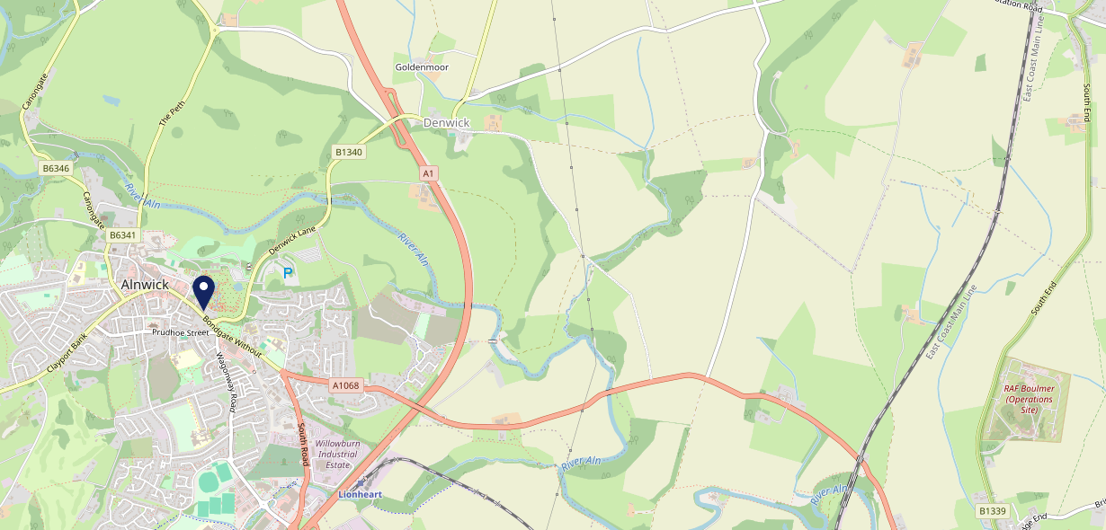
Site Intel
Plough NE661PN
Plough NE661PN
97 Chains
03/05/2023 - 24/04/2024
Site Summary
Plough NE661PN
Work Area
Region
TV Region
Urbanicity
Blyth and Ashington
North East
Tyne Tees
Rural town and fringe in a sparse setting
NE661PN
Punch - Our Local +
Top Competitors
ATV
Gender
Dirty Bottles
#1
£27.85
60.90%
Male
NE661JG
Pub Restaurant
Affluence
Segmentation
Oaks (Alnwick)
#2
53.80%
16.84%
Middle Income
White Collar Neighbourhoods
NE662PN
Admiral Taverns Ltd
Age Group
Visit Day
Queens Head Alnwick
#3
22.55%
21.54%
NE661SS
65 to 74
Sat
Craft Union
Nearest Station
Alnmouth(4.64 miles)
888 Site Customers
23 Competitors
11612 Competitor Customers

Slide 2
Site Intel
Plough NE661PN
Plough NE661PN
97 Chains
03/05/2023 - 24/04/2024
Spend by Weekpart
How is customer spend distributed throughout the week for Plough NE661PN versus its competitors?
% of spend for Plough NE661PN and 97 Chains in 3 Miles from 03/05/2023 - 24/04/2024 split by Day of Week
888 Site Customers
23 Competitors
11612 Competitor Customers

Slide 3
Site Intel
Plough NE661PN
Plough NE661PN
97 Chains
03/05/2023 - 24/04/2024
Visit Frequency
How frequently per year do customers visit Plough NE661PN versus its competitors?
% of customer numbers for Plough NE661PN and 97 Chains in 3 Miles from 03/05/2023 - 24/04/2024 and the number of visits made Per Annum
888 Site Customers
23 Competitors
11612 Competitor Customers

Slide 4
Site Intel
Plough NE661PN
Plough NE661PN
97 Chains
03/05/2023 - 24/04/2024
ATV Change
How has ATV changed between two date ranges?
888 Site Customers

Slide 5
Site Intel
Plough NE661PN
Plough NE661PN
97 Chains
03/05/2023 - 24/04/2024
Market Share Change
How has market share changed between two date ranges?
% of market share spend for Plough NE661PN and 97 Chains in 3 Miles from 03/05/2023 - 24/04/2024
888 Site Customers

Slide 6
Site Intel
Plough NE661PN
Plough NE661PN
97 Chains
03/05/2023 - 24/04/2024
Age
How does the age profile of customers who visit Plough NE661PN compare versus its competitors?
% of spend for Plough NE661PN and 97 Chains in 3 Miles from 03/05/2023 - 24/04/2024 split by Age Range
498 Site Customers
23 Competitors
6124 Competitor Customers

Slide 7
Site Intel
Plough NE661PN
Plough NE661PN
97 Chains
03/05/2023 - 24/04/2024
Affluence
How does the affluence of customers who visit Plough NE661PN compare versus its competitors?
% of spend for Plough NE661PN and 97 Chains in 3 Miles from 03/05/2023 - 24/04/2024 split by Affluence
501 Site Customers
23 Competitors
6151 Competitor Customers

Slide 8
Site Intel
Plough NE661PN
Plough NE661PN
97 Chains
03/05/2023 - 24/04/2024
Gender
How does the gender profile of customers who visit Plough NE661PN compare versus its competitors?
% of spend for Plough NE661PN and 97 Chains in 3 Miles from 03/05/2023 - 24/04/2024 split by Gender
501 Site Customers
23 Competitors
6151 Competitor Customers

Slide 9
Site Intel
Plough NE661PN
Plough NE661PN
97 Chains
03/05/2023 - 24/04/2024
Punch Segmentation
How does the Custom segmentation profile of customers who visit Plough NE661PN compare versus its competitors?
% of spend for Plough NE661PN and 97 Chains in 3 Miles from 03/05/2023 - 24/04/2024 split by Segment
888 Site Customers
23 Competitors
11612 Competitor Customers

Slide 10
Site Intel
Plough NE661PN
Plough NE661PN
97 Chains
03/05/2023 - 24/04/2024
Spend by Distance
How does the spend profile of Plough NE661PN compare versus its competitors based on travel distances?
% of spend for Plough NE661PN and 97 Chains in 3 Miles from 03/05/2023 - 24/04/2024 split by Distance travelled
487 Site Customers
23 Competitors
6013 Competitor Customers

Slide 11
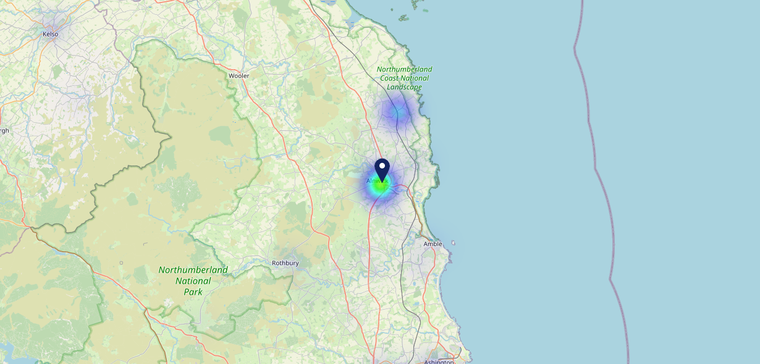
Site Intel
Plough NE661PN
03/05/2023 - 24/04/2024
Map of Guest Origin
Where do customers of Plough NE661PN come from?
Where do customers of Plough NE661PN for 03/05/2023 - 24/04/2024 live
487 Site Customers

Slide 12
Site Intel
Plough NE661PN
Plough NE661PN
97 Chains
03/05/2023 - 24/04/2024
Share of Wallet
What are the Top 20 venues (by spend) that customers of Plough NE661PN also visit?
For customers of Plough NE661PN, who are the top 20 competitors from 97 Chains in 3 Miles for 03/05/2023 - 24/04/2024 split by Venue
888 Site Customers

Slide 13
Site Intel
Plough NE661PN
Plough NE661PN
97 Chains
03/05/2023 - 24/04/2024
Share of Wallet Change
How has share of wallet of customers of Plough NE661PN changed between two date ranges?
888 Site Customers

Slide 14
Site Intel
Plough NE661PN
03/05/2023 - 24/04/2024
Market Summary
How does the local area for Plough NE661PN compare to the national average (1 = low, 10 = high)
Data Type | Name | Spend in 250m | 250m Spend vs National | Spend in 500m | 500m Spend vs National | Spend in 1 mile | 1 mile Spend vs National | Spend in 3 miles | 3 mile Spend vs National
Total | Annual Sales | £1.50M | 5 | £9.29M | 7 | £10.83M | 5 | £16.50M | 2
Weekpart | Mon - Thu | 43.0% | 7 | 46.9% | 9 | 47.0% | 9 | 46.6% | 9
Weekpart | Fri - Sat | 46.7% | 7 | 40.3% | 3 | 39.4% | 3 | 38.1% | 1
Weekpart | Sun | 10.3% | 2 | 12.8% | 3 | 13.7% | 3 | 15.3% | 4
Age | 18 to 24 | 0.5% | 1 | 1.9% | 2 | 1.8% | 1 | 2.5% | 1
Age | 25 to 34 | 8.2% | 1 | 9.9% | 1 | 9.7% | 1 | 11.0% | 1
Age | 35 to 44 | 16.8% | 2 | 19.6% | 3 | 19.5% | 2 | 21.6% | 3
Age | 45 to 54 | 22.9% | 8 | 20.9% | 6 | 20.3% | 6 | 20.6% | 6
Age | 55 to 64 | 23.2% | 9 | 24.7% | 10 | 25.8% | 10 | 24.6% | 10
Age | 65 to 74 | 20.8% | 10 | 16.9% | 10 | 16.4% | 10 | 14.1% | 10
Age | 75+ | 7.6% | 10 | 6.1% | 9 | 6.3% | 9 | 5.6% | 9
CAMEO | Business Elite | 6.9% | 6 | 7.3% | 6 | 7.4% | 6 | 6.6% | 5
CAMEO | Prosperous Professionals | 9.0% | 8 | 8.0% | 8 | 8.0% | 8 | 8.0% | 8
CAMEO | Flourishing Society | 14.3% | 7 | 14.5% | 7 | 14.5% | 7 | 13.8% | 6
CAMEO | Content Communities | 15.0% | 8 | 13.5% | 7 | 13.6% | 7 | 13.6% | 7
CAMEO | White Collar Neighbourhoods | 14.5% | 9 | 11.4% | 6 | 10.9% | 5 | 10.5% | 4
CAMEO | Enterprising Mainstream | 11.3% | 8 | 11.6% | 8 | 12.8% | 9 | 12.5% | 9
CAMEO | Paying The Mortgage | 12.8% | 5 | 14.0% | 5 | 13.7% | 5 | 14.2% | 5
CAMEO | Cash Conscious Communities | 9.8% | 6 | 10.1% | 6 | 9.6% | 6 | 10.0% | 6
CAMEO | On A Budget | 2.6% | 2 | 4.1% | 3 | 4.2% | 2 | 4.3% | 2
CAMEO | Family Value | 3.8% | 7 | 5.4% | 7 | 5.4% | 7 | 6.5% | 8
Affluence | AB | 30.2% | 6 | 29.8% | 6 | 29.9% | 6 | 28.4% | 5
Affluence | C1C2 | 53.6% | 8 | 50.6% | 6 | 50.9% | 6 | 50.8% | 7
Affluence | DE | 16.3% | 4 | 19.6% | 5 | 19.2% | 5 | 20.8% | 6

